Slide 1

Transport Layer
Chapter 3

Slide 2
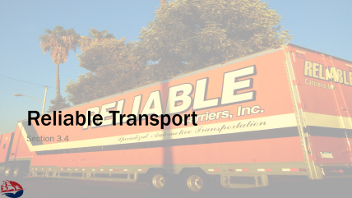

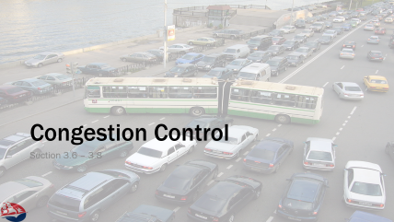


Slide 3
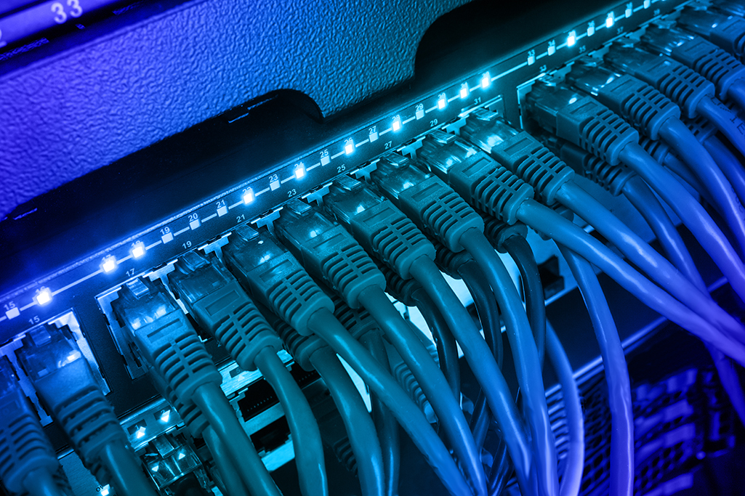
Introduction to Transport Layer
Part 1
Sections 3.1 – 3.3

Slide 4
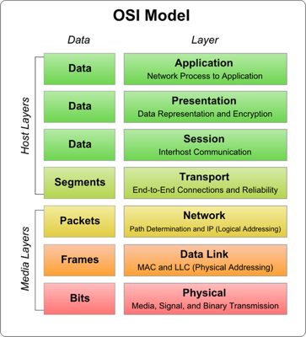
Transport Layer
Provides for logical communication between applications
  Logical implies this is transparent to applications
  Application puts data into / reads data from the transport layer
“Layer 4” of the OSI / Internet Model
  Remember, abstraction promotes independence between
  the layers.
Only implemented in the end-point hosts, not the
network devices which deal in layer 2 or 3 routing.
Two types in IP: TCP and UDP
  Application does select one transport or the other
This Photo by Unknown Author is licensed under CC BY-SA

Slide 5

TCP & UDP
Transmission Control Protocol (TCP)
  Reliable
  Connection Oriented Service
  The “protocol data unit” is “segment”
User Datagram Protocol (UDP)
  Unreliable (!?)
  Connectionless Service (?!?)
  The “protocol data unit” is “datagram” (or segment)
Why wouldn’t we use TCP for everything?
  TCP puts more burden on hosts to track connection states and
  ensure reliability – not always the right choice for all applications
  e.g. video streaming vs. audio streaming

Slide 6
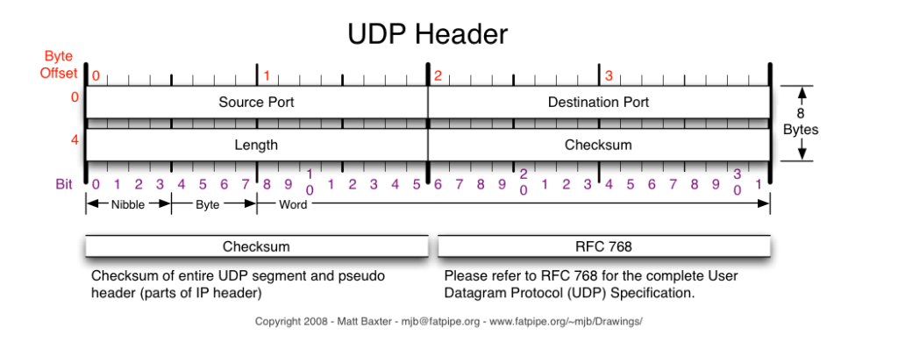
Overview of UDP
TCP layer provides the following:
  Reliable data transfer
  Flow Control / Congestion Control
  Sequence / Ordered delivery
  Acknowledgements
  Timers
UDP layer does not
  Applications can take over this role themselves

Slide 7
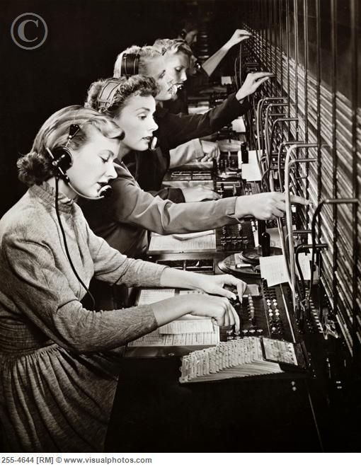
Multiplexing / Demultiplexing
TCP & UDP allow sharing a single IP address with multiple services
  Add a “service id” (port number) to the IP address
  Each socket is uniquely identified by five-tuple:
  (protocol, local addr, local port, remote addr, remote port)
  Port numbers
    Limited to 16-bit values (0 – 65535)
    Restricted use (0-1023) for “well known ports”
    RFC1700 documents well-known ports, we can pick our own
    Local port # is assigned from available ports when socket is created
    Remote port # is given by the application establishing the connection

Slide 8

Scanning for Well-Known Ports
Internet services typically use well-known ports
  E.g. Web uses port 80 or 443
Useful for standard services
  “ssh to sloop” uses port 22, email uses port 25.
Useful for service discovery
  E.g. we can scan a range of hosts to find the SMTP email servers
Useful for hackers
  E.g. they can scan a range of hosts to find the SMTP email servers
  Lets use “nmap” for Fun and Profit!

Slide 9

“Connectionless” UDP
UDP is a minimalist transport protocol
  Application creates sockets, sends PDU
  UDP wraps source/dest port numbers, and two small ID fields and sends to network
  UDP lacks any persistent state (in the transport layer)
    Application keeps track of its state
  Out-of-order delivery
  Missing delivery
  UDP flooding
Advantages
  Application in control
  Low-latency (but no congestion control!)
  Low-impact on server
  Application can define reliability and manage it

Slide 10
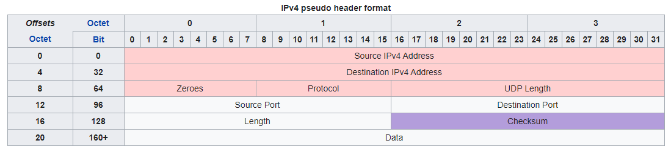
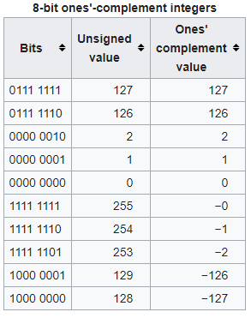
UDP Segment Structure
1’s complement: the negation of the bits
to perform arithmetic:
Checksum algorithm:
Add each of the 16-bits in the UDP pseudo-header (abv)
but with “carry-wraparound” such that 17th bit is added to
the sum.
Finally, store the value as the 1’s complement.

Slide 11
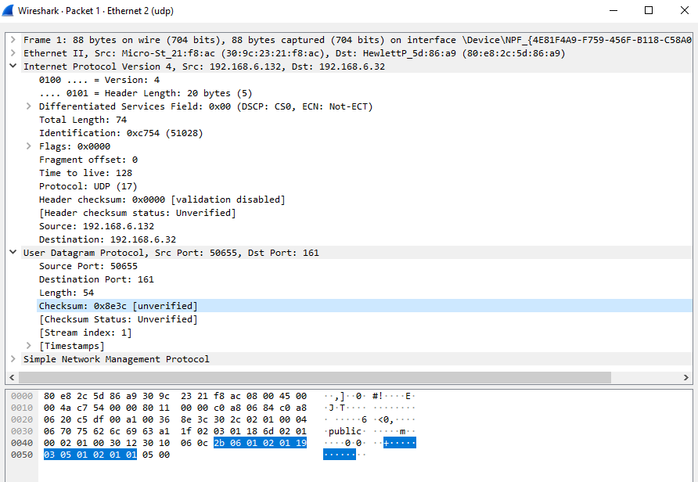
Example – CRC Calculation
16-bit Words | Sum
0xC0A8 | C0A8
0x0684 | C72C
0xC0A8 | 1 87D4 -> 87D5
0x0620 | 8DF5
0x0011 | 8E06
0x0058 | 8E5E
0xc5df | 1 543D -> 543E
0x00a1 | 54DF
0x0036 | 5515
54 bytes of data later…
Sum is 71C3,
1’s comp: 0x8e3c

Slide 12
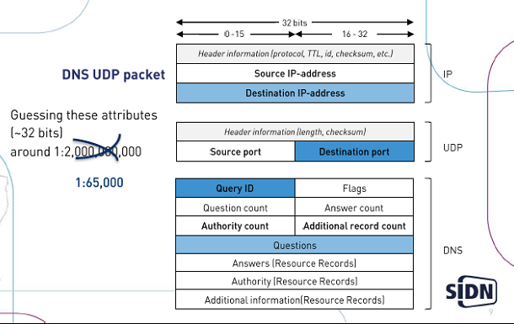
UDP Example – Domain Name System
The DNS uses UDP, because look-ups are:
  typically transient – a single query-response
  small – often fit inside one PDU
  unordered – fit in one PDU, no need to split / have no ordering issue
  Ideally low-latency
This Photo by Unknown Author is licensed under CC BY-SA

Slide 13
UDP Example – File Server
A file server can also use UDP for different reasons:
Imagine imaging a lab
  We can use UDP to “broadcast” the contents of the lab image to many computers at once – no need to track each computer
  If each message indicates what part of the file system it contains, then the clients can keep track of what messages that they still need, and then request retransmissions as needed

Slide 14
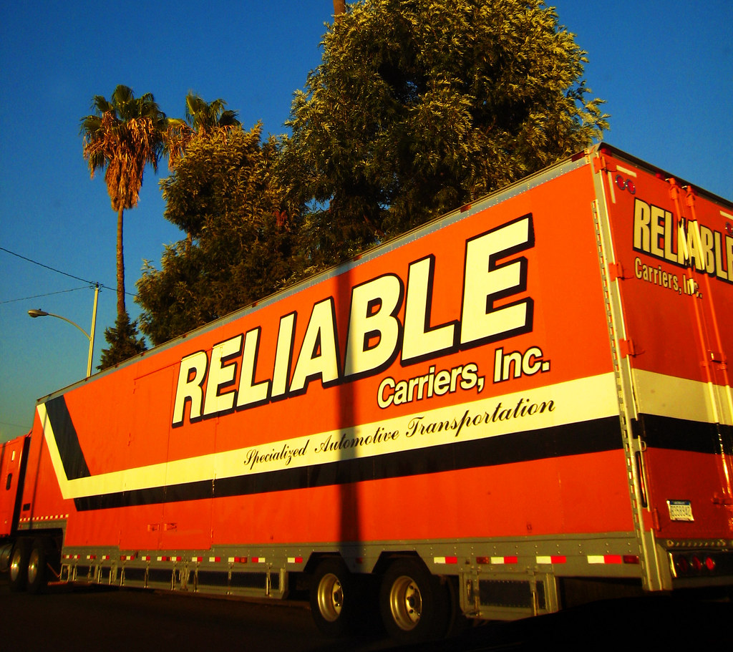
Reliable Transport
Section 3.4
This Photo by Unknown Author is licensed under CC BY-ND

Slide 15
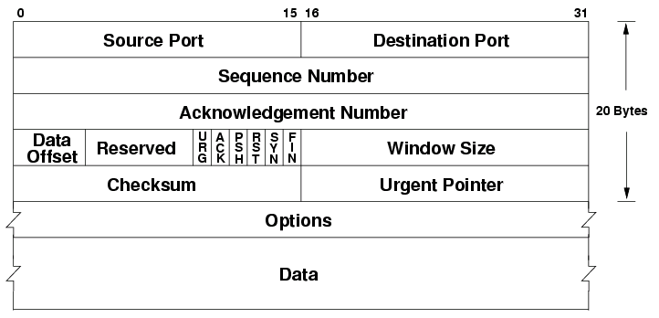
Transmission Control Protocol (TCP)
Provides:
  Reliable
  Ordered
  Error-Checked
  Connect Oriented
  Congestion Control
but,
  Requires Stateful TCP Kernel,
  Operation independent of network activity,
  Adds latency,
  Adds additional messages (overhead),
  Vulnerable to attacks
This Photo by Unknown Author is licensed under CC BY-SA

Slide 16
Reliable Data Transfer
Abstraction:
  Two computers communicating directly over an error-free direct link.
Reliability means:
  Upper-layers send data, and either data was recv’d correctly, or report an error
  Delivers data to upper-layers correctly, or will report an error
  Upper-layers are completely independent of this operation
  Makes no assumptions about lower-layers’ capabilities
Allows:
  Applications to be developed without regard to the actual implementation of this transport protocol
  Transport protocol can sit on top of any lower-layer that provides a minimal set of functionality

Slide 17
Developing a State Machine
Abstract functions:
  rdt_send() – reliable data transfer send - application invokes to send data to another application (through a transport layer)
  rdt_recv() – reliable data transfer receive – application invokes to read data from another application (through a transport layer)
  make_pkt() – encapsulate application data into a transfer layer packet
  udt_send() – unreliable data transfer send – transport layer delivers encapsulated packet to lower (link) layer.
  extract() – extract application data from a transfer layer packet
  deliver_data() – deliver data from transport layer to application

Slide 18
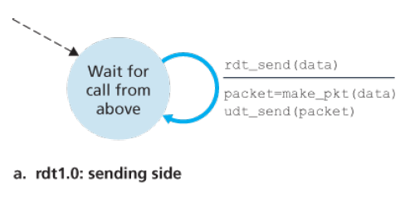
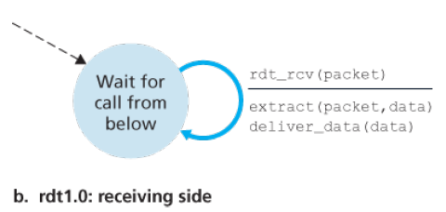
State Machine v1.0
State machine is invoked when application asks
to send data to another application.
State machine is invoked, by
the link layer, whenever the
link layer has received a packet.
Where does it deliver data? Memory Buffers.
This is basically UDP! No added reliability at all. What if data
is corrupted during transmission?

Slide 19
Version 1.0 Timing Diagram

Slide 20
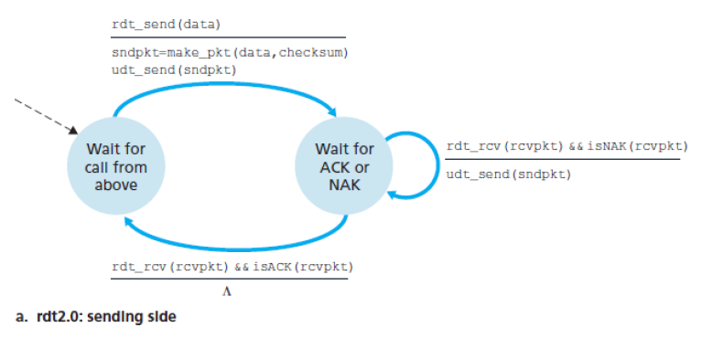
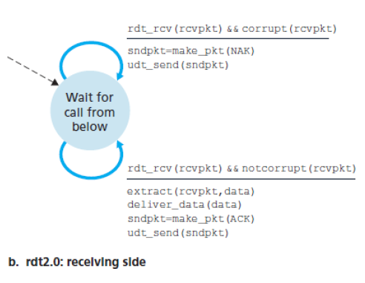
State Machine 2.0
Version 2 detects errors and ensures successful delivery.
“stop-and-wait”
Receiver checks the checksum, and sends an ACK if checksum matches, or a NACK
otherwise.
A checksum is added to the reliable packet,
before its sent over the unreliable media.
An ACK or NAK is returned from the remote
state machine (not the app) upon receipt.
But, what if the ACK/NACK is corrupted?

Slide 22
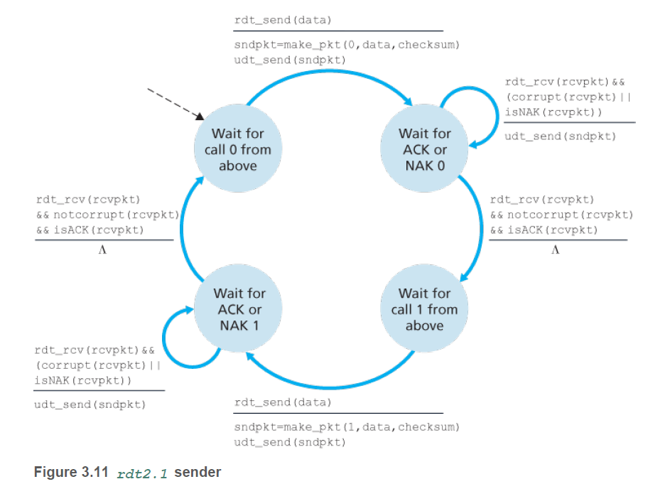
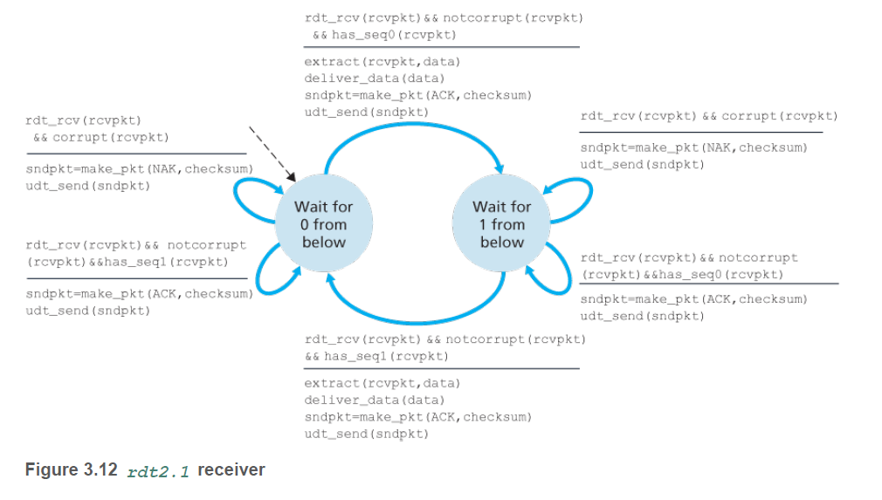
State Machine 2.1
Add a sequence # to the packet (0 or 1) – but not the ACK/NACK. Out of order packet gets NACKd
Can we eliminate the need for a NACK packet?

Slide 23
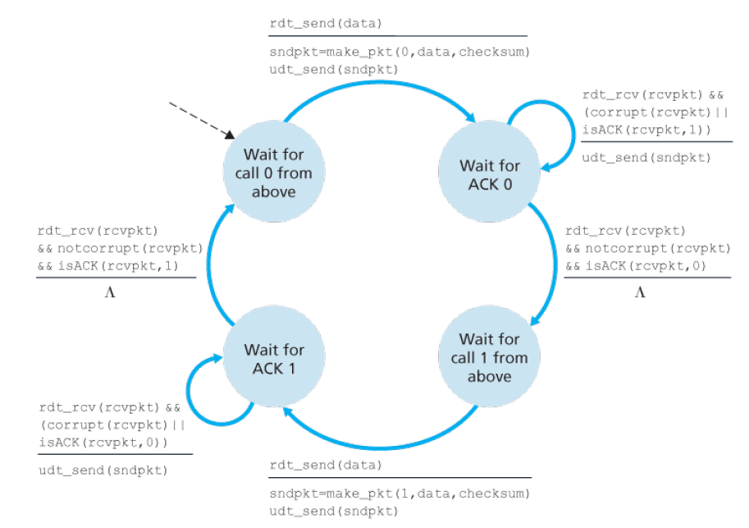
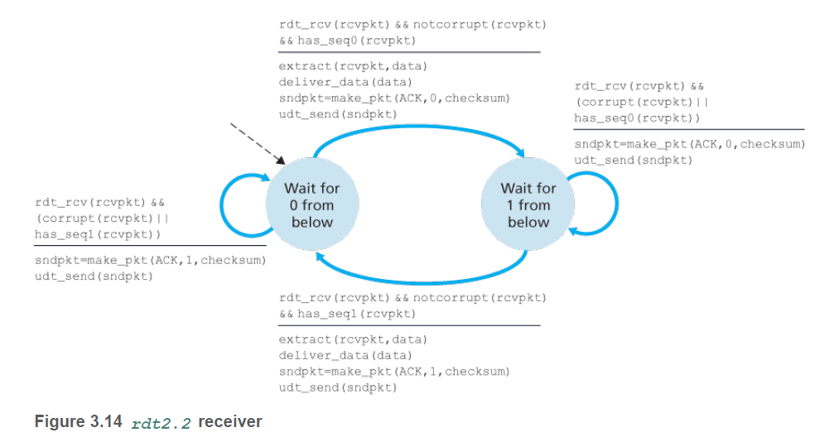
State Machine 2.2
NACK is replaced with an ACK for last correctly recv’d packet.

Slide 24
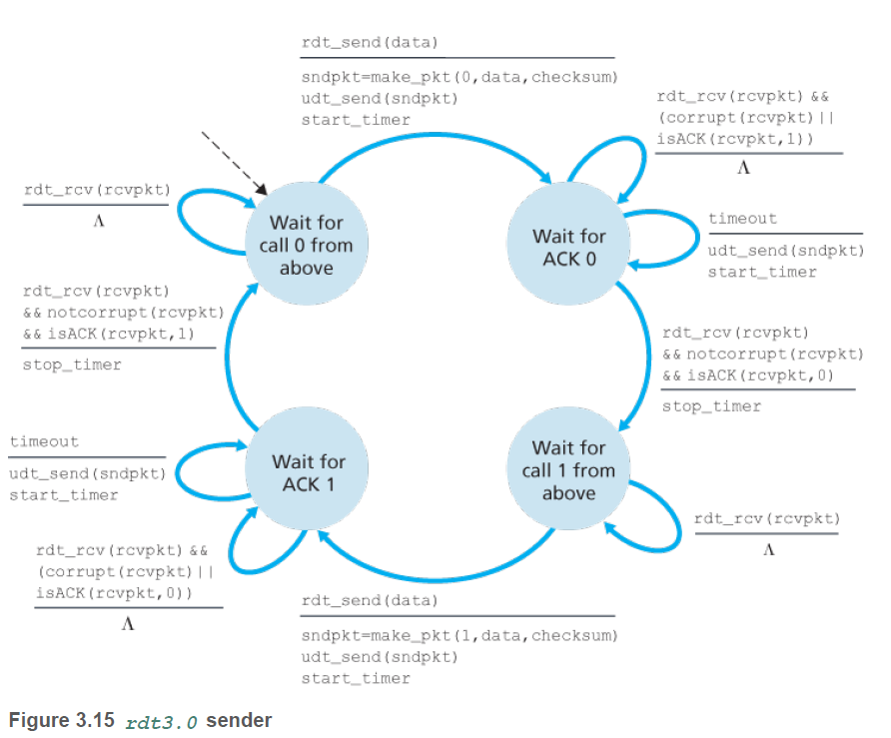
State Machine 3.0
Timeouts are explicitly added to retransmit packets
Receiver is a homework problem.

Slide 25
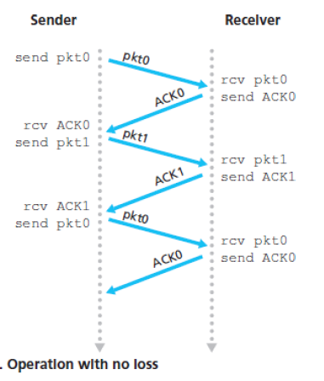
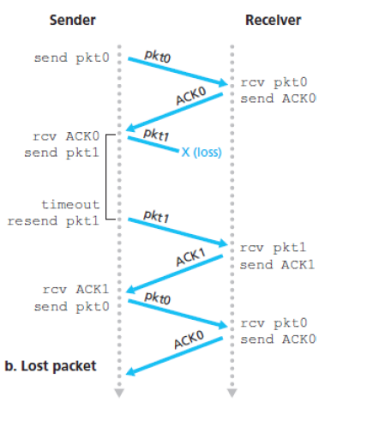
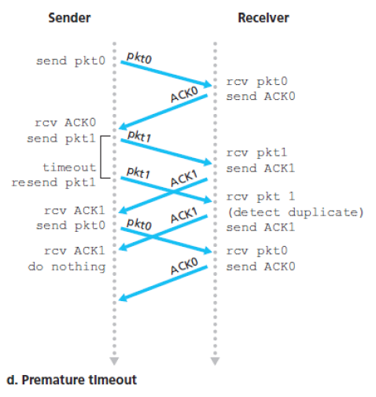
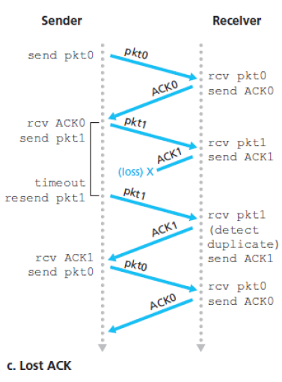
Limitations of Stop and Wait
Stop and wait protocols – only one packet is in flight at a time.
Can lead to:
Long delays,
Low utilization

Slide 26
An Example
Draw time diagram:
Suppose we have:
  Round Trip Time: 30ms
  Link speed: R=1Gbps
  Data Packet size: 1000 bytes
  Ack Packet size: 64 bytes
Find transmission time:
Find time packet “arrives” at destination (time of last bit):
Find time ACK leaves (assume no CPU delay):
Find time ACK leaves (time of last bit):
Solve utilization:
Notes:
Make sure to show the “shading” for when the transmit line is being used.

Slide 27
Pipelining
Allow multiple packets to be “in-flight” at a time:
  Range of sequence #’s
  Multiple buffers
  Reorder buffer
  Need rules to determine how to request resend of bad or missing data
    Go-Back-N
    Selective Repeat

Slide 28
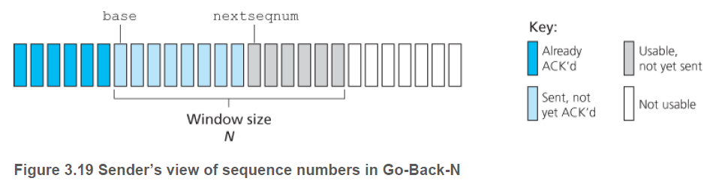
Go-Back-N (GBN)
Allow at most N unacknowledged packets “in-flight”
Sequence #’s are fixed-length integers (length k)
  Where 2^k > N
  All operations are modulus 2^k

Slide 29
GBN Events
GBN sender responds to 3 types of events:
  Invocation from above – rdt_send() – If window is full, call is blocked.
  Receipt of an ACK – GBN uses cumulative acknowledgement
  All packets with sequence number up to and includes n in the ACK message are noted as correctly received – allow moving the window forward.
  Timeout – If a timeout occurs, the sender resends all packets in the window that have been previously sent but not yet ACK’d
GBN receiver events:
  Receipt of packet – if sequence n is received correctly and in-order, the data is ACK’d for packet n. If the order doesn’t match or the data fails checksum, the data is discarded and resends an ACK for the most recently received in-order & correct packet.

Slide 30
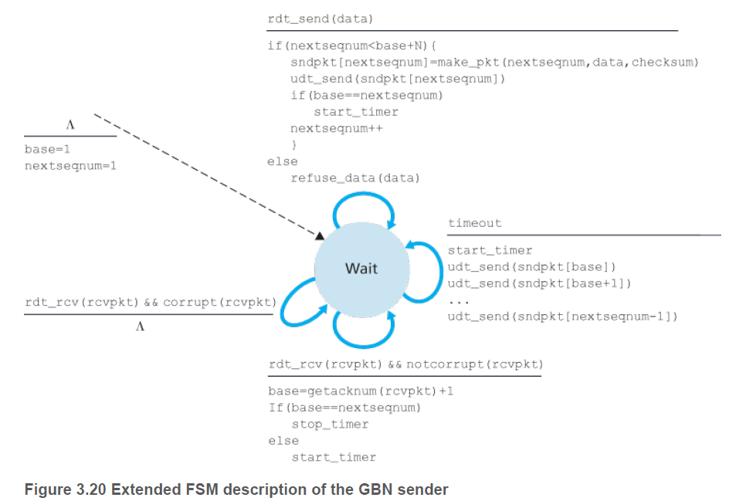
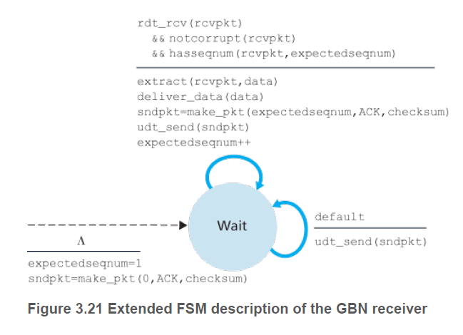
Extended GBN FSM for Sender

Slide 32
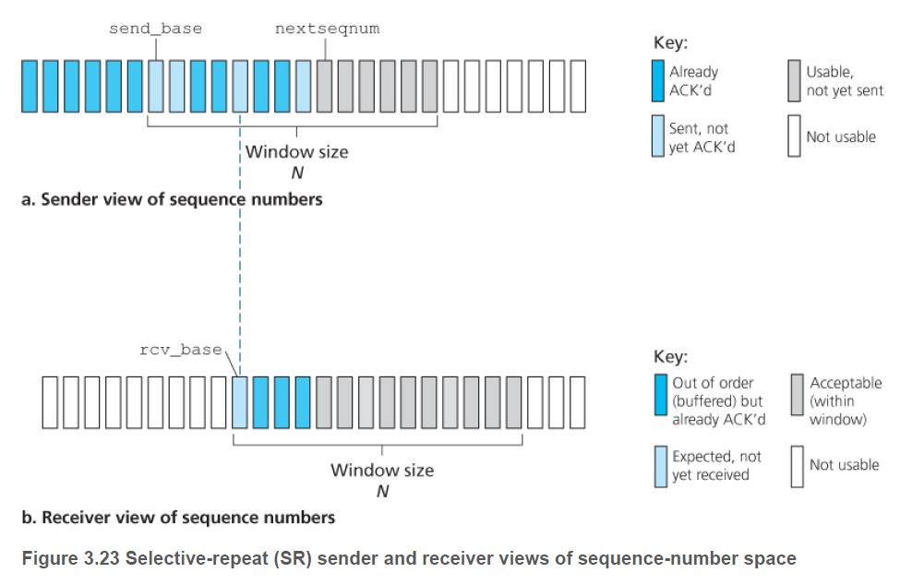
Selective Repeat
GBN can become inefficient as window sizes increases
Selective Repeat – sender resends only incorrectly received pkts
Timeout on each packet used to trigger resend
Window size N is used
  Some of the packets in window may already be ACK’d
  Receiver ACK’s pkt, irrespective of order

Slide 33
Selective Repeat Events
Sender events
  Data from above: Sender checks next available sequence, if within window, data is encapsulated and queued for transmit.
  Timeout : Unlike GBN w/ single timeout, each packet gets its own timeout
  ACK Received: marks that packet as received (if in window), if ACK = window base, move window forward to next un-ack’d packet
Receiver events:
  Packet in interval [base, base+N] : ACK packet, buffer packet. If seq is = base, dispatch this and any consecutive packets to application layer (reorder), slide window forward
  Packet in interval [base-N, base-1] : generate ACK, ignore packet
  Otherwise: ignore packet completely

Slide 35

Transmission Control
Protocol
Sections 3.5

Slide 36
Transmission Control Protocol (TCP)
Provides:
  Reliable
  Ordered
  Error-Checked
  Connection Oriented
  Congestion Control
  Full-Duplex
  Point-to-Point
  Multiplexed
but,
  Requires Stateful TCP Kernel,
  Operation independent of network activity,
  Adds latency,
  Adds additional messages (overhead),
  Vulnerable to attacks
This Photo by Unknown Author is licensed under CC BY-SA

Slide 37
Packet Switching, Virtual Circuits
TCP needs to establish a persistent connection between two machines
  Machines are identified as “server” and “client” by how the sockets are created
  Application will read or write from full-duplex connection
TCP will read/write data from application layer to network layer
  But how much?
  Link Layer specifies a maximum transmission unit (MTU) (e.g. 1500B for Eth2)
  Network Layer figures the Maximum Segment Size (MSS) can hold:
    IP header (60 bytes)
    TCP header (>= 20 bytes)
    Data payload (MTU – 100) (e.g. 1420 for Eth2)

Slide 38
Right Sizes for MSS
Individual devices on path can use different MTU (e.g. ATM cell is 53 bytes)
  May be fragmented during delivery
  Reassembled by Network Layer
Every TCP message gets the headers
  Sending 1 byte sends 101 TCP bytes, but 1500 ethernet bytes
  Sending 1400 data bytes sends 1480 TCP bytes, but 1500 ethernet bytes
  Sending 1501 bytes sends 1581 TCP bytes, but 3000 ethernet bytes!
Increasing the segment size (MSS) or transmission unit (MTU)
  E.g. Ethernet Jumbo Frames (9000 bytes)
  Could lead to better performance (more data / same overhead)
  All frames take same time, so increase penalty on small frames
  Retransmissions resend more data
  Increases latency for small packets
Find the Sweet Spot
  Tuning can lead to optimized performance
  Defaults get you pretty close.

Slide 39
TCP Segment Header
The TCP Segment Header Bit Fields
  Source & Destination Ports
  Sequence #
  Acknowledge #
  Window Size / Receive Window
  Header length (in 32-bit words)
    5 if no options
  Options used to negotiate a different MSS between sender & receiver, or other extensions
This Photo by Unknown Author is licensed under CC BY-SA

Slide 40
TCP Segment Flags
There are 6 bit-flags
  ACK – this header is an ACK
  RST, SYN, and FIN – 3way handshake
  PSH – Data should be “pushed” w/out
  buffering – i.e. sent as soon as its
  read/written; but delivered with
  normal priority with other applications.
  URG – Data was marked urgent by
  sending application layer and should be delivered ahead of “normal” data
    The location of the last urgent byte is
    listed in the urgent pointer field
This Photo by Unknown Author is licensed under CC BY-SA

Slide 41
Sequence and Acknowledgement Numbers
Sequence Numbers
  TCP treats data as an ordered byte stream – if we send n bytes, we have bytes [0..n-1]
  Sequence # starts at a randomly selected initial sequence number (ISN)
  Each header adds “+1” – so after the handshake, byte 0 gets ISN+1
  Then, each sequence # is the byte number of the first byte in this segment
Acknowledgement Numbers
  The acknowledge number is the sequence # of the next byte the receiver expects to receive; or we are ACK’ing x receipt of all data bytes <= byte number x.
  ACK value is only valid when the ACK bit field is set.
  TCP will acknowledge bytes up to the first missing byte in the stream – aka Cumulative Acknowledgement – reduces # of acknowledgements that need to be sent.
  Can be embedded in an otherwise “normal” segment – aka piggybacking

Slide 42
TCP ACK Generation
RFC 5681 Describes following events & actions:
Event | TCP Receiver Action
Arrival of in-order segment with expected sequence number, all data up to expected sequence already acknowledged | Delayed ACK, wait up to 500msec for arrival of another in-order segment, if next in-order segment does not arrive in this interval, send an ACK
Arrival of in-order segment with expected sequence number. One other in-order segment waiting for ACK xmit | Immediately send single cumulative ACK for both in-order segments
Arrival of out-of-order segment with higher than expected seq#, a gap is detected | Immediately send duplicate ACK, indicate sequence number of next expected byte (which is lower end of gap)
Arrival of segment that partially or completely fills in gap of rx data | Immediately send ACK, provided segment starts at the lower end of gap
Arrival of stream of segments back to back, but one segment is lost | Generate 3 duplicate ACKs for lost data, indicating the segment that was lost (aka fast retransmit)

Slide 43
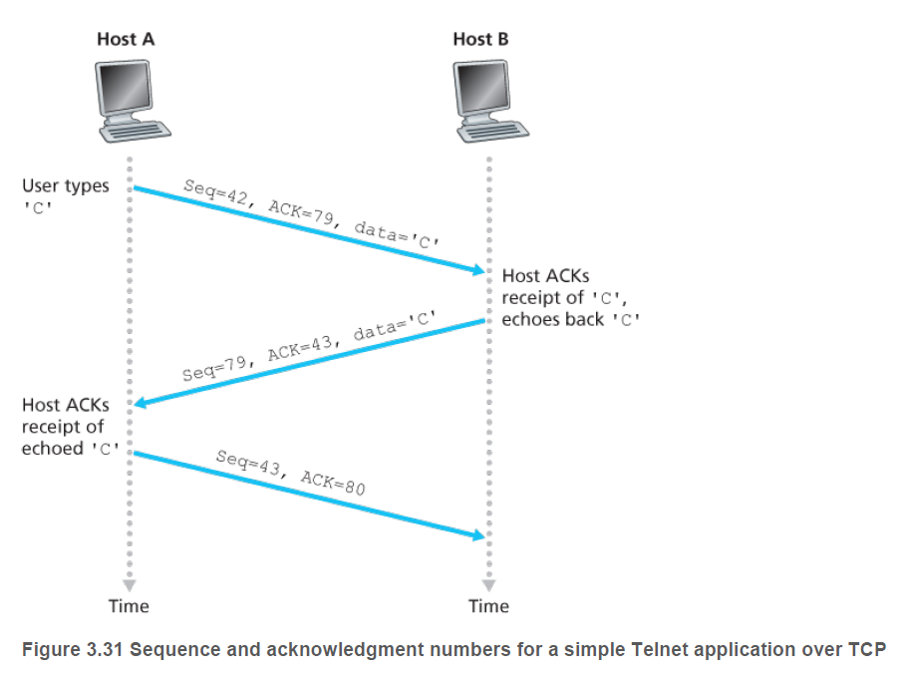
Telnet Example

Slide 44
Estimating Round-Trip Times (RTT)
Lost-packets need to be resent – timeout based on RTT
TCP uses a “simple” strategy
  The RTT is sampled once per burst of packets
  TCP kernel tracks the sent-time and ACK reply for a segment
  Take this as average RTT for next burst
  Do not re-sample for retransmit
  Revise estimate for each burst
How to revise?
  Running average
  Windowed / Weighted Average
  Geometric Mean
  Exponential Moving Average (EWA)
Fluctuations lead to variance about the
central mean of 30ms, congestion or
broken links can break this normal graph.

Slide 45

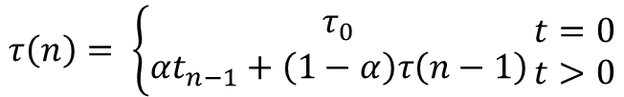

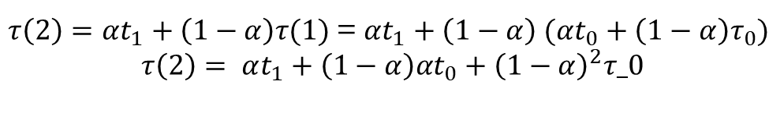
Exponential Average
Exponential Moving Average (EMA):
  Recursive Definition:
$$τ\left(n\right)= \left\{\begin{aligned}τ_{0} \\ αt_{n−1}+\left(1−α\right)τ\left(n−1\right)\end{aligned}\right.\begin{matrix}t=0 \\ t>0\end{matrix}$$
$$τ\left(0\right)=τ_{0}$$
$$τ\left(1\right)=αt_{0}+\left(1−α\right)τ_{0}$$
$τ\left(2\right)=αt_{1}+\left(1−α\right)τ(1)$ = $αt_{1}+\left(1−α\right) (αt_{0}+\left(1−α\right)τ_{0})$
$$τ\left(2\right)= αt_{1}+\left(1−α\right)αt_{0}+{\left(1−α\right)}^{2}τ_0$$

Slide 46
Different Predictions
Accuracy of different predictions using RMSQE:

Slide 47
Results

Slide 48
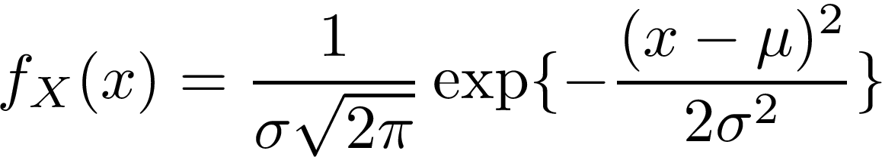

Further “smoothing”
We can compute the Timeout Interval as:
  Actual ($t$) and Estimated ($τ$) RTTs
  $T_{out}\left(x\right)=τ\left(x\right)+4 t\left(x−1\right)$
A little statistics:
  $μ=30.3\text{ms}\text{, }σ=2.5\text{ms}$
  Cumulative distribution function (CDF), for
  normal random variable with:
But, when a link goes down,
the normality is blown away,
and the model gets revised.

Slide 49
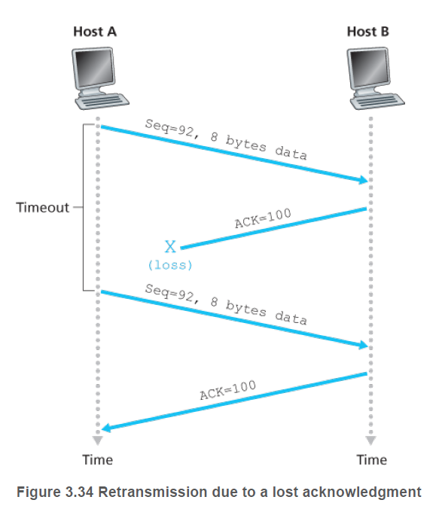
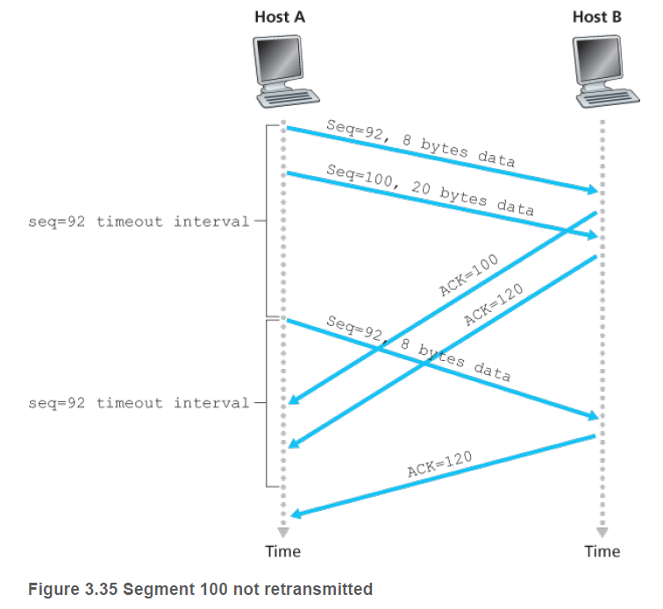
Retransmissions

Slide 50
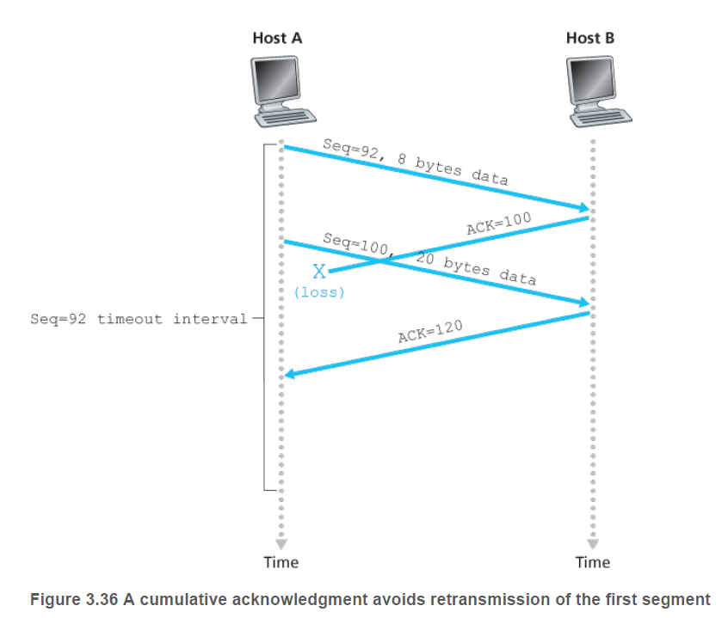
Cumulative Acknowledgement

Slide 51
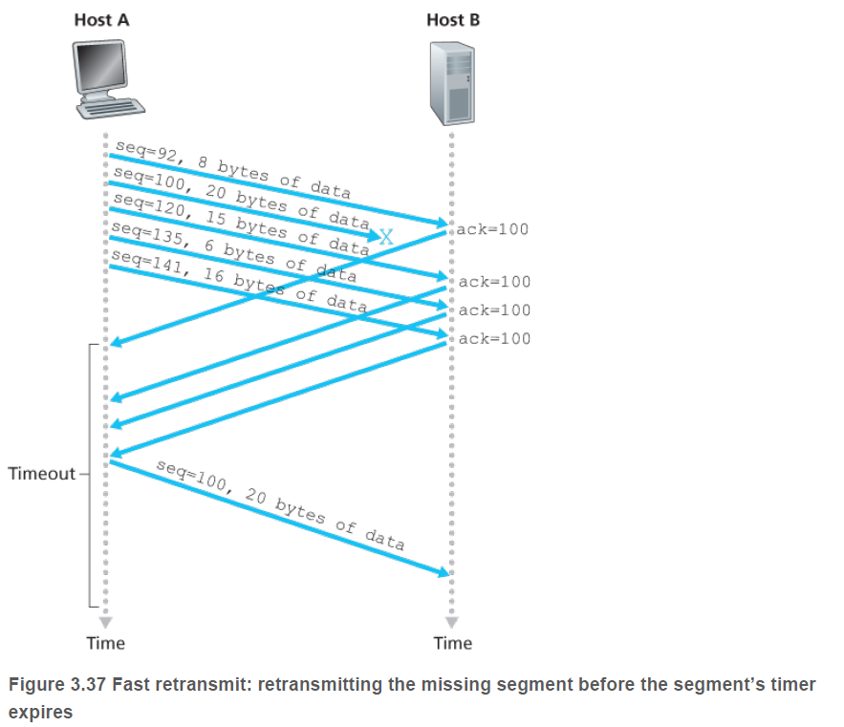
Fast Retransmits
When receiver gets faulty data (fails checksum) – timeout is relatively long
Duplicate ACK
  If receiver gets faulty data it will acknowledge last good data
  Sender sees as request to retransmit failed data

Slide 52

Flow Control
Received data is buffered into memory
  Limited # of slots
  Need to ensure not to overflow
  TCP provides a flow control mechanism to match the speed of the receiving application
  TCP also provides a congestion control mechanism due to limitations on network bandwidth
TCP Flow Control
  Based on the idea of a receive window
  Window size is available number of
  unacknowledged bytes that can be received
  Recall that TCP is full-duplex, both sides
  have their own window size.
  Window size is part of every message
  exchanged (even ACKs)
This Photo by Unknown Author is licensed under CC BY-SA

Slide 53
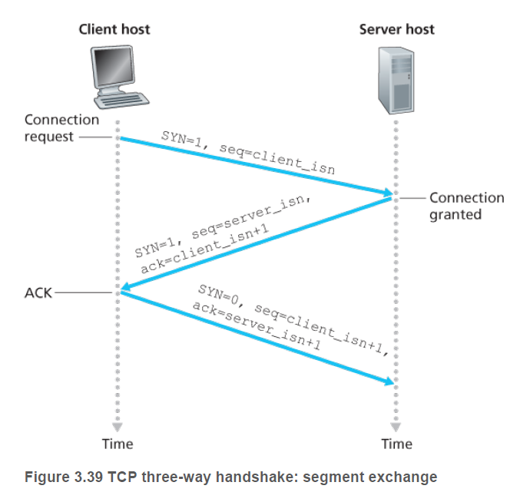
TCP Connections - Initiation
TCP uses a 3-way message exchange to start a connection
Client sends a synchronize (SYN) message
  No payload, but includes initial segment #
If server accept()s the connection, it
  Replies with a SYN, the server’s ISN, and
  an ACK to the client’s request
If server refuses the connection (or if 1st packet
is lost in transmission)
  No reply, so client times out, asks again
  Repeats until connection is ACK’d or
  client gives up ; OR
  Server replies with a “RST” connection
If server accepted connection, client must
ACK the server’s SYN, and then both sides
establish a virtual circuit / socket.

Slide 54
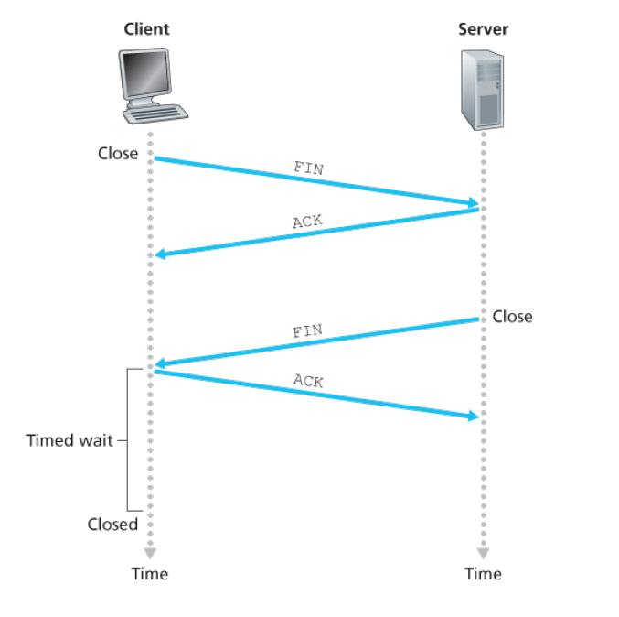
TCP Connections - Closing
Either side can initiate a close
  A packet with the “FIN” bit is sent
  The FIN request is acknowledged, and then a FIN packet is sent the other direction
  That packet is acknowledged
  Both sides can “free” any resources used (e.g. the receive buffer)

Slide 55
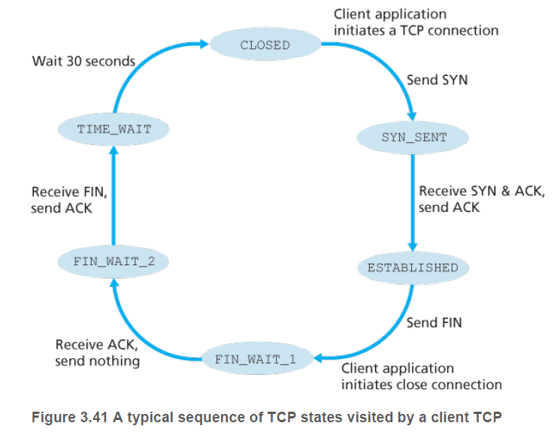
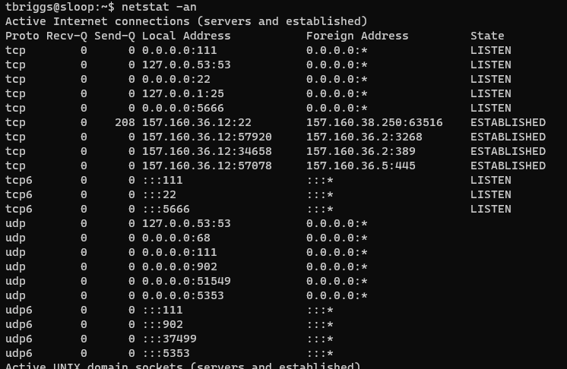
States a TCP Connection Moves Through
Output of “netstat –an”

Slide 56
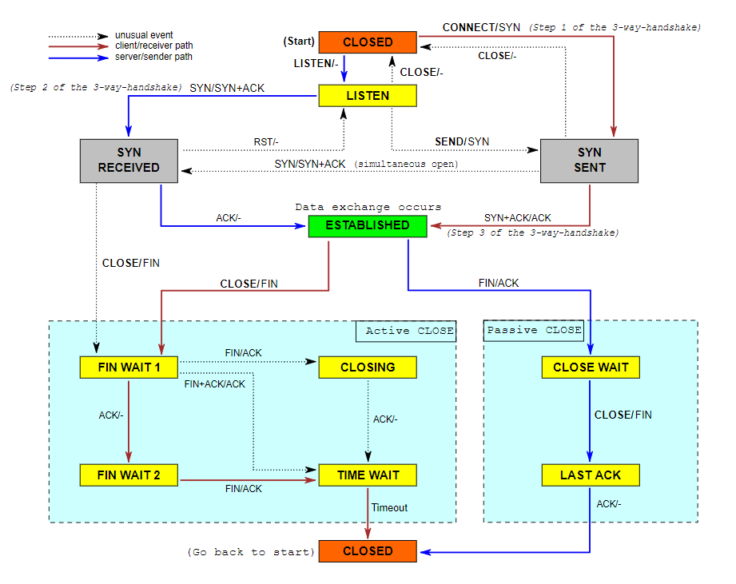
Real TCP – Extended FSM

Slide 57
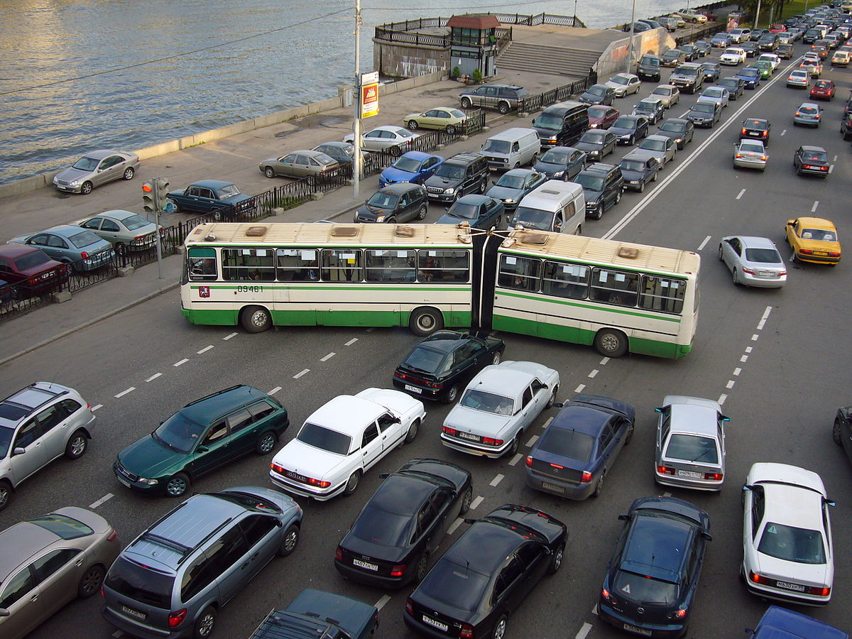
Congestion Control
Section 3.6 – 3.8
This Photo by Unknown Author is licensed under CC BY-SA

Slide 58
Network Congestion
Occurs when there is more data than a link can handle
Leads to a reduced quality of service
  Queueing Delay
  Packet Loss
  Blocking of New Connections
Networks that use retransmissions to compensate lead to “storms”
  Retransmits can increase congestion
  Two “stable states”
    Sufficient capacity to handle normal data load
    Sufficient capacity to handle retransmit storm, leading to very low throughput (aka congestive collapse)
Congestion can happen at any layer

Slide 59
Causes and Costs of Congestion
Three scenarios:
  Two senders with a shared router, infinite buffer
  Two senders with a shared router, finite buffers
  Four senders, routers with finite buffers, multi-hop paths
Sender – the machine that initiates sending data to a receiver
Router – a machine with multiple interfaces, it receives network traffic on one link, determines the destination, and sends it out over the link that reaches that destination
Multi-Hop Link – A path from a sender to a receiver that goes through multiple routers.
Buffer – memory on a host / router that holds packets to be sent or that have been received.

Slide 60
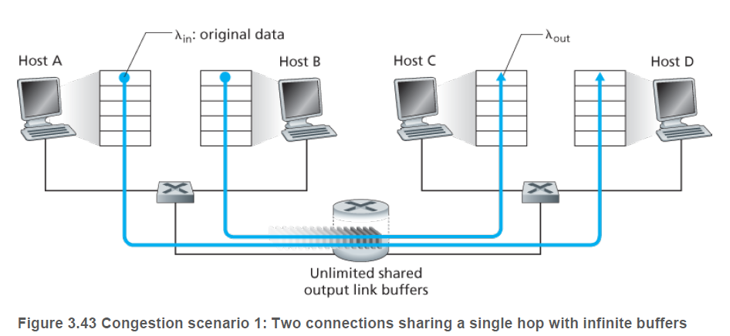

Scenario 1 – Two senders, Router with Infinite Buffers
Two senders, $H_{A}$ and $H_{B}$ each send data at rates: $λ_{in}$ bytes/sec.
Two receivers, $H_{C}$ and $H_{D}$ each receive data at rates: $λ_{out}$ bytes/sec.
$H_{A}$ and $H_{B}$ both share a link that can handle $R$ bytes/sec
$H_{C}$ and $H_{D}$ both share a link that can handle $R$ bytes/sec
For simplicity, we ignore encapsulation and error recovery

Slide 61
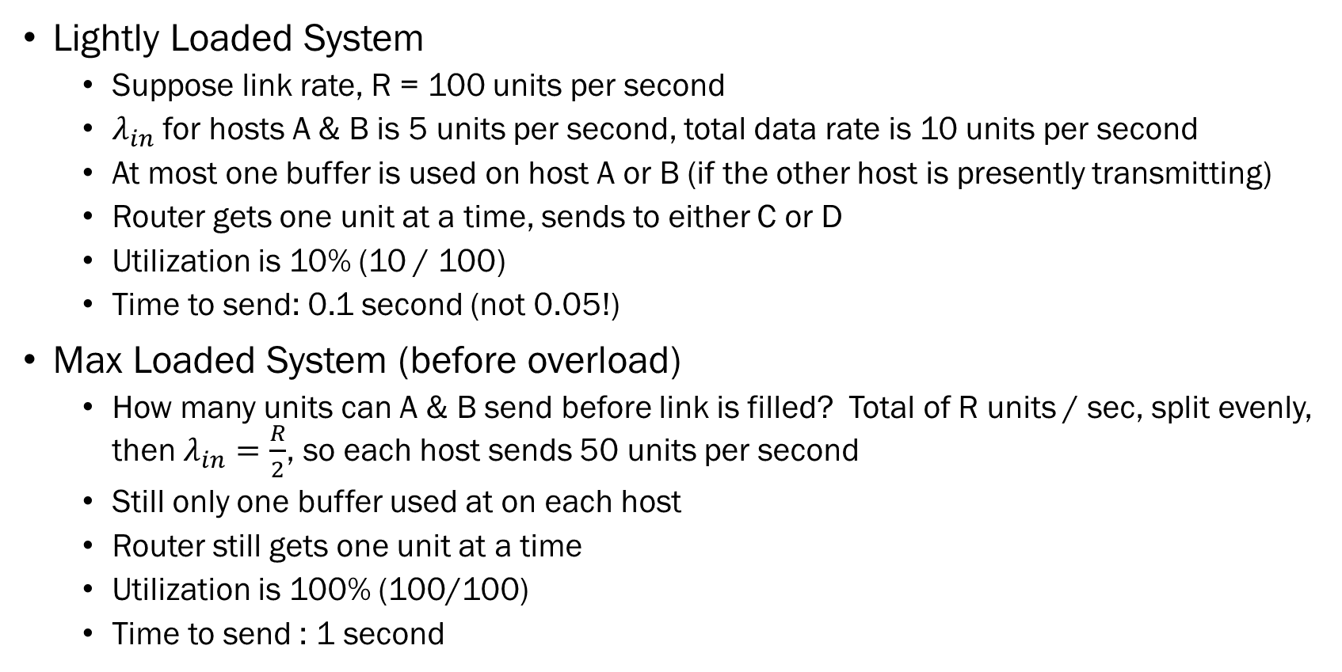
Concrete Example:
Lightly Loaded System
  Suppose link rate, R = 100 units per second
  $λ_{in}$ for hosts A & B is 5 units per second, total data rate is 10 units per second
  At most one buffer is used on host A or B (if the other host is presently transmitting)
  Router gets one unit at a time, sends to either C or D
  Utilization is 10% (10 / 100)
  Time to send: 0.1 second (not 0.05!)
Max Loaded System (before overload)
  How many units can A & B send before link is filled? Total of R units / sec, split evenly, then $λ_{in}=\frac{R}{2}$, so each host sends 50 units per second
  Still only one buffer used at on each host
  Router still gets one unit at a time
  Utilization is 100% (100/100)
  Time to send : 1 second

Slide 62
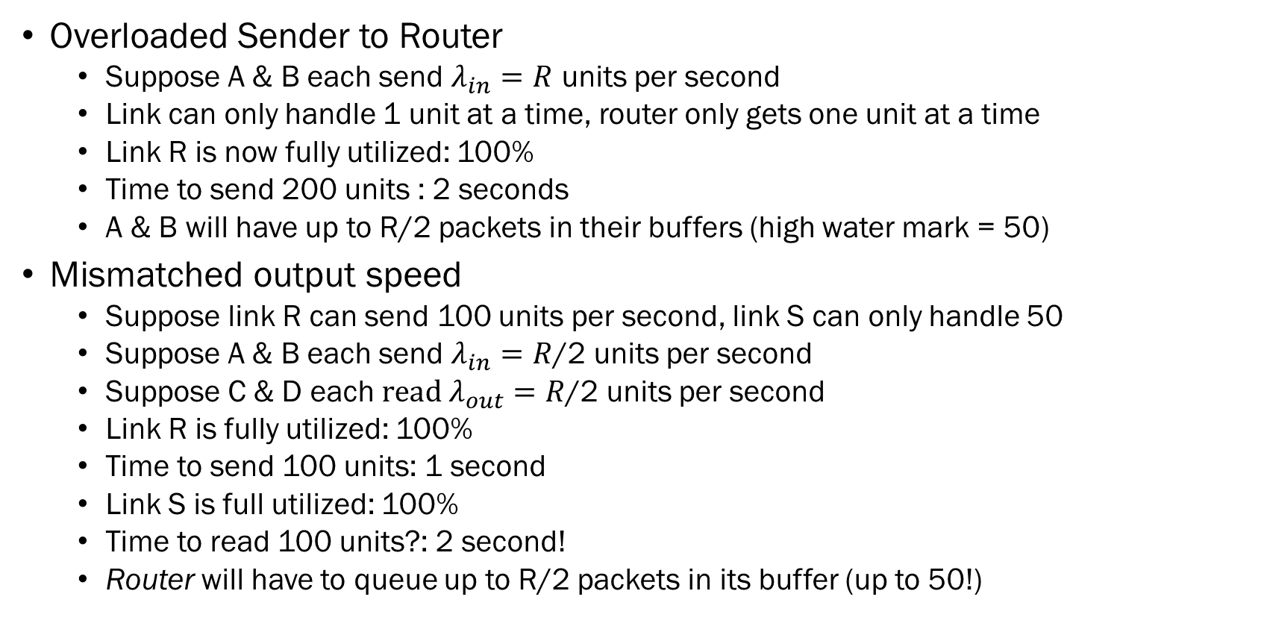
Concrete Example
Overloaded Sender to Router
  Suppose A & B each send $λ_{in}=R$ units per second
  Link can only handle 1 unit at a time, router only gets one unit at a time
  Link R is now fully utilized: 100%
  Time to send 200 units : 2 seconds
  A & B will have up to R/2 packets in their buffers (high water mark = 50)
Mismatched output speed
  Suppose link R can send 100 units per second, link S can only handle 50
  Suppose A & B each send $λ_{in}=R$/2 units per second
  Suppose C & D each $read λ_{out}=R$/2 units per second
  Link R is fully utilized: 100%
  Time to send 100 units: 1 second
  Link S is full utilized: 100%
  Time to read 100 units?: 2 second!
  Router will have to queue up to R/2 packets in its buffer (up to 50!)

Slide 63
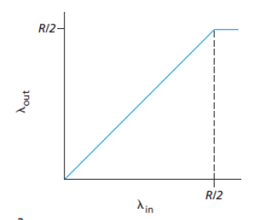
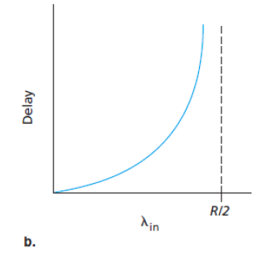
Scenario 1 - Graphically
One graph suggests approach R/2 is
“good”, the other suggest its NOT!
Delay (time) as a function of sending
rate. As we approach full utilization
delays start to grow exponentially.
Throughput as function of sending
rate. After hosts saturate link, throughput
becomes saturated.

Slide 64


Scenario 2 – Two Senders and a Router w/ Finite Buffers
Similar to #1, but now packets will be dropped if buffer is already full
  We also add retransmissions – if a packet is dropped, sender will eventually resend it
  Offered Load – $λ^{′}$ bytes / sec, the rate at which transport layer sends segments (original and retransmit data)

Slide 65


Scenario 2, Case 1 – No Retransmits
If every packet arrives at destination
  No extra load, so $λ_{out}=λ_{out}^{′}$, and $λ_{out}≤R/2$
We know that either:
  $λ≪R/2$, so that retransmits just don’t happen naturally, or
  Sending hosts knows that there are free buffers on the router
    Needs to know status of router, but there are other hosts add and removing packets to the router’s buffers, so our host need to know the status of all other hosts too….
Effectively the same performance & limits
as scenario 1.

Slide 66


Scenario 2, Case 2 – Sender retransmits perfectly
Sender only retransmits when packet is definitely lost
  Assuming a reliable network, the lost packet is only due to buffer capacity
  Assuming offered data rate is ${λ′}_{out}=R/2$, “the rate at which data are delivered to the receiver application is R/3. Thus, out of 0.5R units of data, 0.333R bytes/sec are
  original, and 0.166R bytes/sec are retransmitted data. “
  Why? Text just glosses over…
  Let $x$ represent % retransmits, then: $1\left(1−x\right)+2x=0.5R, x=\frac{0.5R}{3}=0.1666R$
  But, this is a really superficial, and not clearly explained analysis.
  Lets try to do better.

Slide 67



Occurrence of Multiple Events
Poisson Probability can be used to find the probability of k events occurring in some
unit of time:
$$P\left(k\right)=\exp^{−l} \frac{l^{k}}{k!}$$
This is the probability of exactly k, what if we wanted to know probability for 0..k events?
$P\left(k\right)=\exp^{−l} \sum_{i=0}^{k}{\frac{l^{i}}{i!}}$ or poisscdf(x,l)
Suppose we send an average of 1000 messages per second, and the receiver can handle
that number, and more needs to be queued. We can queue up to 10 packets, what is the
probability that we will observe 1010 messages in a second? Poissoncdf(1010,1000)=0.6318
36% of the time we send more than that, they’ll be dropped and re-xmitted! So, for every
message we send, we generate 1.36x network traffic!
1.36x = 1/2R, x= 0.367R messages, and retransmits = .133R!
This Photo by Unknown Author is licensed under CC BY-ND
The buffer size & message size all have a BIG impact on these results!

Slide 68

Scenario 2, Case 3 – Sender Retransmits Prematurely
Premature retransmits are not detected by routers & switches
  Unnecessary data is forwarded to destination link, which will see the packet twice
  Leads to additional congestion on the receiver’s links

Slide 69
Scenario 2 - Summary
Several conclusions can be made:
  We will never have perfect knowledge of buffer state across multiple links
  Average sending rate will be maxed at R/2
  Network congestion leads to retransmissions in order to handle dropped packets
    Additional time is needed for timeouts and rexmits
    Rexmits add to the congestion workload
  Unneeded transmissions by sender in face of large & unpredictable delays may cause a router to use its link bandwidth to forward unnecessary copies of a packet – adding to additional congestion!

Slide 70


Scenario 3 – 4 Senders, Finite Buffers, Multihop Paths
Adding additional routers / paths with different hop properties
Offered load vs. throughput trade-off
As traffic B-D goes to infinity, C-A becomes
saturated and approaches 0 due to
timeouts and retransmits.

Slide 71
Approaches to Congestion Control
Two approaches:
  End-to-End: Network layer provides no explicit support to transport layer. Presence of congestion must be inferred by observed behavior (e.g. packet loss / timeouts).
  Network Assisted Congestion Control: Routers provide explicit feedback to the sender / receiver regarding congestion state, e.g. setting a bit in the network layer to indicate link is approaching saturation, or in the case of ATM networks, routers stamp the sender of the maximum host bit rate the router can support on its outgoing link.
TCP uses the End-2-End approach
  makes no assumption on the network layer

Slide 72
TCP Congestion Control
Three rules:
  Sender limits rate at which it sends traffic as a function of perceived congestion
  Sender increases rate if it determines little congestion
  Sender decreases rate if it determines there is congestion
Four issues:
  How does sender limit the rate?
  How does sender determine congestion?
  What algorithm should the sender use to update its send rate?
  What happens if the sender gets it wrong (accidentally or intentionally?)

Slide 73
TCP Congestion Window
TCP kernel maintains a congestion window
  Imposes a constraint on the rate which TCP can send data into the network
  Amount of unacknowledged data at a sender may not exceed the minimum of:
    Constraint window (cwnd) and
    Receive window (rwnd)
  Note, this can be mixed with flow-control, for now , we assume rwnd > cwnd
  So, this takes care of issue #1 – before initiating a send event, we ensure that the amount of unacknowledged data is less than cwnd.

Slide 74
Mechanism to Adjust Congestion Window
TCP is “self-clocking” –
  The time delta from sending a segment to receiving its ACK are used to update the congestion window
Rules:
  A lost segment indicates congestion, send rate should be decreased (cwnd decrease)
  An acknowledge segment indicates network is working, send rate can be increased
  Bandwidth can be probed by increasing transmission rate to probe for the rate at which congestion begins.
Takes care of issue #2

Slide 75
Jacobson’s Algorithm for Congestion Control
Three parts:
  Slow Start
  Congestion Avoidance
  Fast Recovery
Slow Start –
  At start, cwnd starts at 1MSS (maximum segment size), resulting in a sending rate of roughly MSS/RTT. If MSS=500 and RTT = 200ms, then resulting rate is 20kbps
  Increase cwnd by 1MSS every time a segment is acknowledged, but then this allows sending twice the data, which, if ackd, will double cwnd! 1, 2, 4, 8, …
  If there is a fault, then slow start restarts, but a threshold, ssthreash is set to cwnd/2, or ½ the value that slow start reached before it aborted. Cwnd will continue to grow (exponentially) until it reaches sshthresh, and then it will end slow start.

Slide 76
Congestion Avoidance
During congestion avoidance phase:
  Increase cwnd by MSS/cwnd for each acknowledgement, e.g. if 10 segments sent out, all are ACK’d, then if MSS=1460 and cwnd = 14600, then the 10 segments will add 1MSS to cwnd (not doubling)
  If a missing ACK, subtract MSS/cwnd for each lost packet, e.g. if 10 segments sent out, 5 are ACK’d, then if MSS=1460, cwnd = 14600, then subtract 1/5 MSS from cwnd

Slide 77
Fast Retransmit
Recall from last part, 3 duplicate ACK’s enters fast retransmit
  TCP halves the value of cwnd, add 3MSS for duplicate ACK’s, and records value of sshthread to be 1/2 CWND
  Cwnd is increased by 1MSS for each duplicate ACK received
  Transitions to slow-start, until slow-start is finished.

Slide 78


Slide 79
Explicit Congestion Notification (ECN)
At network (IP) layer, two bits are added in the Type of Service field for IP packet
  One setting of the ECN bits is used by a router to indicate that its experiencing congestion. Another setting of the bits indicates sender/receiver is capable of reading those bits. The IP packet info is then made accessible to TCP kernel.

