Slide 1

Computer Networks
Network Engineering
Chapter 1
This Photo by Unknown Author is licensed under CC BY-NC-ND

Slide 2
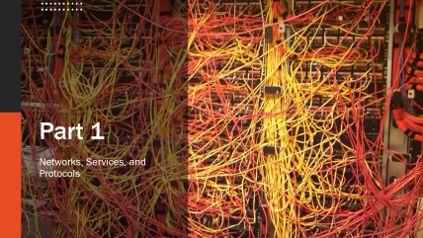
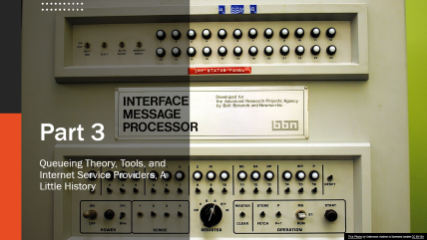
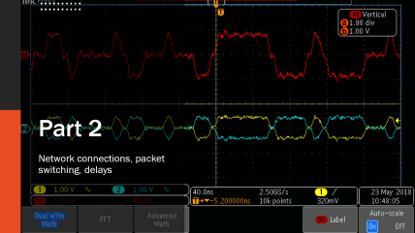

Slide 3
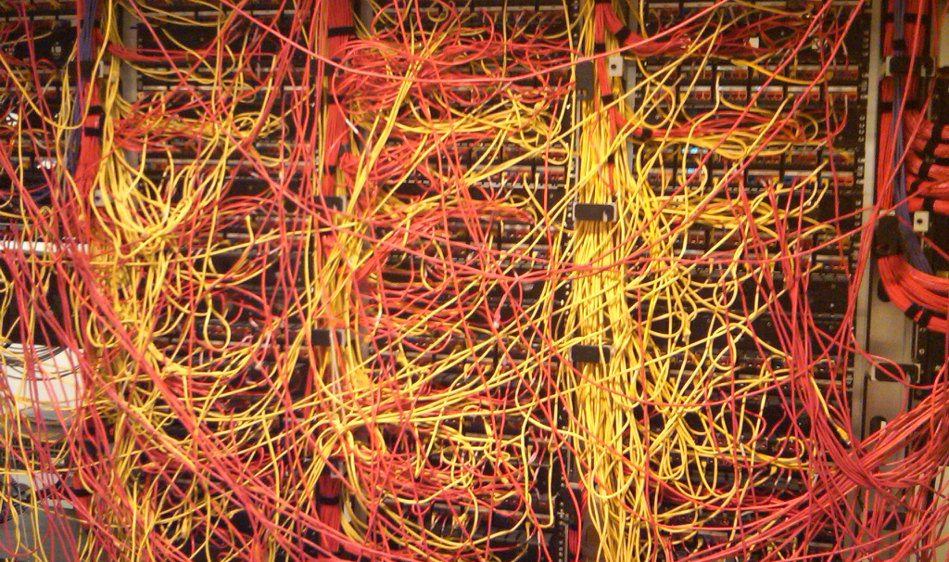
Part 1
Networks, Services, and Protocols

Slide 4
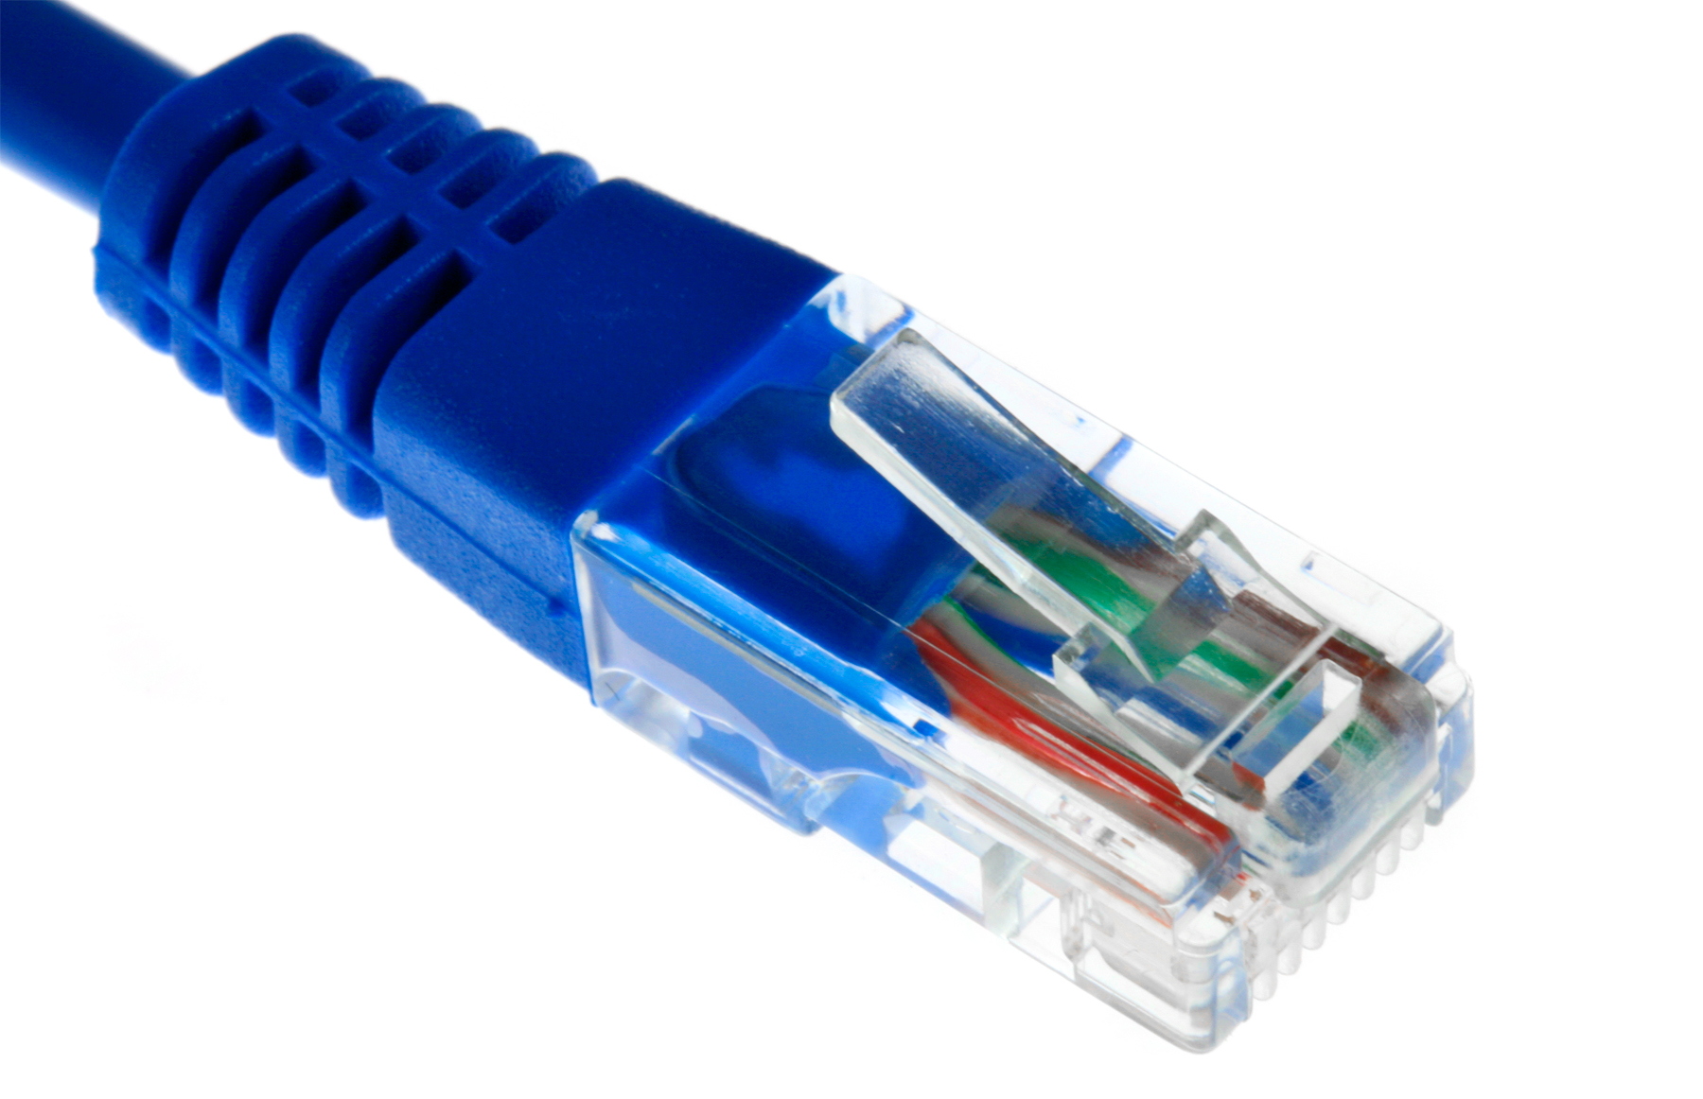
Networks
A computer network is…
  “a group of computers that use a set of common communication protocols over digital interconnections for the purpose of sharing resources located on or provided by the network nodes.” [1]
  As far as definitions go….
    Can a “group of computers” mean nearly all computers?
    Exactly how common is “common?”
    Is it really always digital?
    What resources are we really sharing?
    What is a node?
This Photo by Unknown Author is licensed under CC BY-NC
1 - https://en.wikipedia.org/wiki/Computer_network
Notes:
So, you are enrolled in a course entitled “Network Engineering,” but what, exactly, is a network? This definition comes from Wikipedia, and it does seem to cover most of the salient points. Networks do involve a group of computers, and sometimes they have specialized devices to help the network communication, but at its core, you really only need two computers.
Networks do require a protocol. We will see that a protocol is really a combination of rules and language that the computers use to exchange information. We have unspoken “protocols” that govern how we are expected to behave. For example, holding the door open for someone who walks into the building right behind you is considered good manners. Its part of our protocol. Computers also need rules, but they need to be more formal. For example, if I were your parent and programming you as my computer, err, child, I would tell you to always say “thank you” when someone gives you something. But, because you’re human, you know not to say thanks when someone gives you a “kiss with a fist.” The context of someone’s act determines whether you be grateful or not. Computers lack that context, and so we have to replace context sensitive reactions with extensive “if then” statements for every scenario. If protocols don’t match, we won’t be able to communicate, and we don’t have a network.
Networks do require interconnections, and we typically treat them as digital, 1’s and 0’s. Whether the actual “inter connection” is actually wireless, or over copper wire, or even fiber optics, ultimately, we still treat it as a sequence of bits.
Finally, we do this in order to share resources between the network nodes. There are a near infinite number of types of resources that can be shared over the network. For instance, we can stream movies from the cloud, share files between your desktop and laptop, or even distribute function calls and threads across the nodes of a supercomputer.
Sometimes it’s a good idea to take a definition (at the knowledge layer of the pyramid) and think about what that definition means taken to its extremes (that’s comprehension). For example, are two computers really the minimum? No, actually one computer is the minimum – a computer can often share data with itself. On the other hand, what do we get when the number of computers approaches infinity? We get the global Internet! How common are these communications protocols? Are there just a handful, or are there many different protocols? How does the internet’s protocol allow me to stream a movie or send email? Aren’t they pretty different things? That must be a complex protocol! Are the interconnections really always digital? Whats the alternative?
If the definition can handle all of these scenarios and still hold, then it’s a good definition. If it falls apart like a flimsy toy from a cereal box, we know that the definition needs some work!

Slide 5
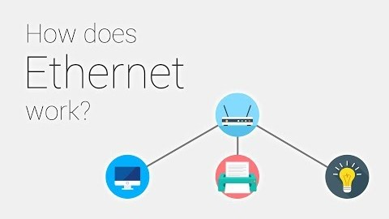
Local Area Networks
Connecting physically nearby computers, usually over Ethernet
[1] Janos Pasztor, “How does Ethernet Work,” YouTube, https://www.youtube.com/watch?v=5u52wbqBgEY, accessed 6/26/2020
Notes:
The next type of network is a local area network or LAN. Local refers to the network proximity rather than the physical proximity of the machines and the ability for the machines to communicate directly with one another – there are few network devices in-between. For example, a company may have a LAN for all of the computers in an office building or campus. Ethernet is one type of local network technology, others include different types of wireless, token ring, DECnet, AppleTalk, etc. While it was common to see different LAN protocols, eventually ethernet proved to be the victor. This short video shows how ethernet works.

Slide 6

Internet
The Internet
  A Group of computers:
    Network that interconnections nearly every computer on the planet
    With the Internet of Things (IoT), nearly 25 billion devices on the internet!
    Extends into inter-planetary space
  Uses a common set of protocols
    the Internet Protocol (IP)
    Also uses many others: TCP, UDP, HTTP, SMTP, FTP, ARP, RIP, BGP, NTP, …
  But it isn’t the only network
    Internet2
    SIPRNet and NIPRNet – Military’s “internet”
    Proprietary Local and organizational networks
    SCADA and Industrial Networks
This Photo by Unknown Author is licensed under CC BY-SA
Notes:
After local area networks, the next step up today is typically “The Internet” (with a capital I). Originally conceived as a network of networks (hence its name), the internet is a network that spans almost every computer on the planet. In fact, with the advent of the “internet of things,” there are believed to be nearly 25 billion devices on the internet. Today, the internet even spans into the solar system with NASA routing internet traffic from satellites and orbiters. It is really important to note that, although the internet is a network of networks, its impossible to point at a “thing” and say – that “thing” is the internet. For example, my computer, connected to the campus LAN, by virtue of the campus internet connection, can work on the internet. So, is the internet “on” my computer? And its not on your computer either. In fact, its not on anyone’s computer. Certainly some services are more centralized than others – for example, if Google made the decision to take away Gmail, a large proportion of the internet’s mail would suddenly stop flowing. But, not all of it. I could still run my own, you could still run our own mail server, and we could still send email to each other.
Part of the reason for this is that the Internet demands that we all adhere to a handful of basic protocols – the important one being the internet protocol (IP). That governs how my computer sends data to Google and gets back again. There are many other protocols, but we don’t need to use them – we could actually invent our own, so long as it uses IP underneath. And that’s truly the genius behind the internet – as long as we stick to a few simple rules, our network of computers can be on the net.
But the Internet is not the only network. To combat the commercialization and heavy traffic congestion of the “regular” internet, Universities have developed the “Internet 2,” and are restricting it to just inter-academic traffic. The US military maintains two global networks – SIPRnet and NIPRnet, one secure, the other less secure. These networks carry the sensitive data communications that are part of the modern military. Industrial applications use proprietary communications, such as SCADA and other industrial networks, that are carefully designed for the unique environment for which neither Ethernet nor the Internet protocols would work well.

Slide 7
Internet Metaphors Are Not Always Good
Metaphors can be useful for building understanding
Wyatt (2004) also examined the metaphors used to describe the Internet “in order to understand the perceptions and expectations of some of the actors involved in its shaping.” [11] She uncovered six main metaphorical themes in Wired:
revolution,
evolution,
salvation,
progress,
universalism, and
the ‘American Dream’.” [12]
These metaphors often promoted a form of
social justice
global access,
change, and
equality.
From non-technical media, Johnson found:
Physical space,
Physical speed,
Destruction, and
Salvation
Postal service, information superhighway,
Trucks, pony express, …
“Internet is destroying politics,” “internet
attacks,” “internet is transforming business,” and “internet streamlines government,” …
Rebecca Johnson, https://firstmonday.org/article/view/2370/2158
Notes:
It is surprisingly difficult to capture exactly what the internet is. In the first chapter, your textbook goes through several different metaphors.. “The internet is like a …” but in each of these, the metaphor is ultimately flawed, or maybe was true decades ago. The truth is that the internet is something onto itself, there is nothing else like it in all of our world. But, it can still be interesting to compare what metaphors are being used and the biases that they reflect.
Rebecca Johnson surveyed literature describing the internet, and collected both the metaphors used to describe it and the sentiments behind those metaphors. It is really a fascinating glimpse into the differences between technical and non-technical oriented people. Those who read the technical magazine, “Wired,” tend to have a positive view of the internet, and we see themes such as the internet bring a revolution to transform society (and make it better), or the internet will bring salvation from whatever social ill we are experiencing, or the internet will break down barriers between nations and people. Not surprisingly, the technical reader doesn’t get “The internet is like a box of chocolates…” metaphors. Similar analysis from non-technical publications reveals tremendous differences. The descriptions tended to focus on less abstract ideas, such as physical space (the “global” internet), or physical speed (the “information super-highway”). But the internet was also seen to bring destruction to the status quo (for good or for ill), and also seen as the salvation for dysfunction in society.
Of course, the internet can do none of those things. The internet is not, itself, and intelligent actor. The internet does not have a separate sense of self. Certainly, the Internet can be a platform to enable change – we’ve all seen that in our lives already. But it takes humans to develop those resources (e.g. Netflix) and humans to use those resources (e.g. Netflix). Taking the humanity out of the change process is a big oversight – and one that could be argued as intentional – “Sorry you’re loosing your job, the Internet made me do it!”

Slide 8

Internet Standards
Internet is largely decentralized
  Internet Engineering Task Force (IETF) manages most standards
    RFC 793 – Transmission Control Protocol (1981), updated by 1122, 3168,6093, and 6528
    RFC 2616 – Hypertext Transfer Protocol (1999), obsoleted by 7230, 7231, 7232, 7233,…
    RFC 1149 – IP over Avian Carriers with Quality of Service (1990)
  IEEE manages standards for electrical signaling standards
    See http://www.ieee802.org/11/ for some free references
  Internet Corporation Assigned Numbers Authority
Some parts are totally organic
  JavaScript – no single defined standard
This Photo by Unknown Author is licensed under CC BY-SA
Notes:
One of the great strengths of the internet is that it is largely decentralized. There is not one giant company that “runs the internet.” Instead, there are several non-profit groups that maintain open processes for the developments and refinement of the standards that drive the internet – its protocols. One of the chief groups the Internet Engineering Task Force or IETF. This is a non-profit that is supported by the big players in the industry that develops new standards. They do this by forming a working group to address some common problem, and then publishing a Request for Comment (RFC). Anyone can provide input to the RFC. The working group works through the suggestions, and eventually hammers out an agreement that then becomes a standard. For example, the Transmission Control Protocol (TCP) or the HTTP that drive the web are examples of vital protocols. RFC1149 is actually all about sticking memory sticks on carrier pigeons. Like I said, it’s a democratic and open process. One of the upcoming assignments will be to read an RFC, just to get a feeling for how precise these protocol definitions really need to be.
The IEEE maintains the electrical connectivity standards for things such as ethernet and wifi. They tend to be less “free” than the IETF, but that may also have to do with the complex nature of describing the electrical signally characteristics of a network. Although the IEEE is a non-profit, it still has to financially support its operations, and its standards are not “free” (as in beer), but rather accessible only behind “pay walls,” such as the IEEE xplore database.
The one final “centralized” authority is the Internet Corporation Assigned Numbers Authority, which serves as the international registrar for internet addresses. For example, if you wanted to put up your own server on the internet, you would need to request, from ICANN, a network address range. Once you have that, you would work with your service providers to have them advertise where those addresses “live” and how to get to / from your network equipment.
Other parts of the “internet” are largely organic. One good example of this is JavaScript – Microsoft, Google, and Mozilla, each implement their own versions of the JavaScript language, and since they aren’t trying to comply with some standards, they can do that. Of course, if the JavaScript is written for one browser, it may not work the same for another, so there is some pressure on these companies to play nicely with each other; but there isn’t a standards body over them telling them what they must do.

Slide 9

Network Services
Networks provide services
  Endpoints Software running on computers that provide data:
    Examples: search, streaming, games, email
    Services define servers and clients, not hardware
  Infrastructure – the stuff in between – just moves data between them
Services can look very different
  Typically use a protocol (see next slide)
  Protocol can be standard and highly formal or more ad hoc
  Move data between end-points
Notes:
The network exists for resource sharing, often described as a type of network service. Thus, we can split up all of the many computers in a network into two type: endpoints that are involved in a particular service, and the infrastructure machines that moves data between endpoints. The role of an endpoint as being either a “server” or a “client” is defined by its role in an existing protocol. For example, in the Web, your web browser (the client) opens a connection to a machine running the web server to request information. However, in the X/Windows graphics protocol, your local machine is the display server, and the programs running on remote computers are the clients that connect to your server. In fact, a machine can be both a client and a server at the same time.
So, what are network services? Your are probably already familiar with many different services, including the web, email, and instant messaging. A service defined what information is exchanged. But simply saying that a mail service exchanges email messages is not sufficient for diverse systems to operate with each other. Typically, a service also has a protocol that describes how the service will perform its job. You may already be familiar with the Hyper-Text Transport Protocol (HTTP) which is used by web services. Other resources (and protocols) include the Network Time Protocol (NTP) that most computers use to synchronize their on-board clocks to a central standard time. Your computer probably used the Dynamic Host Configuration Protocol (DHCP) to obtain information about how to communicate on your network.
So, if the network is built around the notion of providing services, the actual method of provide that service is the protocol. But, protocols don’t describe the code to build a client or server. This is the key to whole shebang! If someone comes up with a new service with a corresponding “open” protocol. If it’s a well known protocol, I can either use someone else’s software (application or library) or I can write my own. On the other hand, if a vendor makes a proprietary protocol, then I’m stuck using their provided software, warts in all. Of course, with hard work, we could reverse engineer a closed protocol to make our own version, which is what Andrew Trigdell did with the Samba system to enable UNIX systems to be both a Windows file server or client.

Slide 10
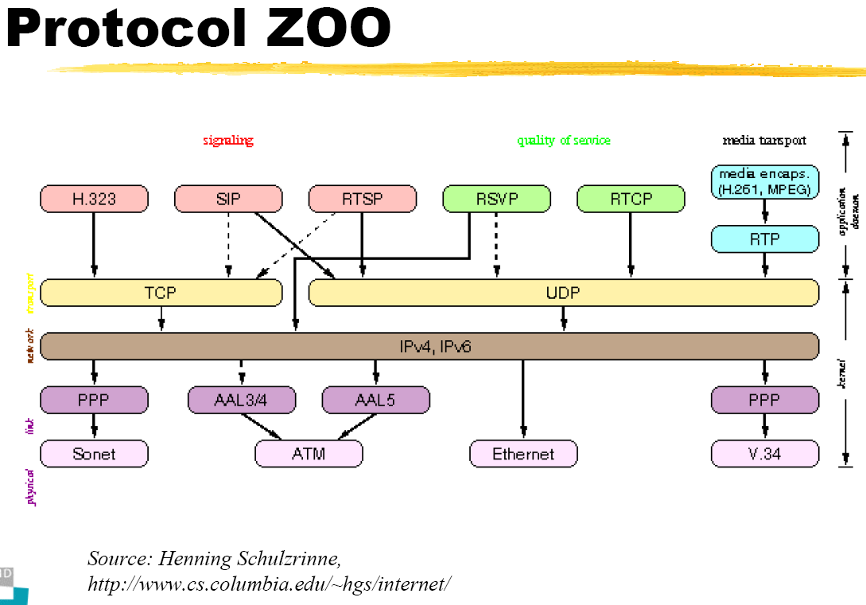
Protocols
Services depend on protocols
  Highly detailed and technical statements describe what must be done
  Code must implement, test, and verify adherence to those protocols
  RFC2119 defines the 5 imperatives:
    MUST – aka Required or Shall - absolute requirement
    Must NOT – aka Shall Not – absolute prohibition
    Should – aka recommended – may exist valid reasons to ignore an item but the full implications must be understood and weighed before choosing a different course.
    Should Not – aka not recommend – there may exist valid reasons when behavior is acceptable or even useful but the full implications should be
    understood…
    May – aka optional – an item is truly optional, one vendor
    may implement while another does not, product should be
    designed to recognize this.
Notes:
Clearly, protocols are vitally important to the function of a network. The protocol definition needs to contain clear, unambiguous language that describes exactly what the protocol needs to do. The IETF has actually created a standard for RFCs that contain the “five imperatives.” These imperatives describe the rules for implementing a protocol in code, including what must be done, what should be done or not if there is a compelling reason, what should absolutely never be allowed, and what you may do if you so choose. This does not mean that implementing the code for a protocol is trivial, but at least it gives a roadmap on how to get started and where to head out.

Slide 11
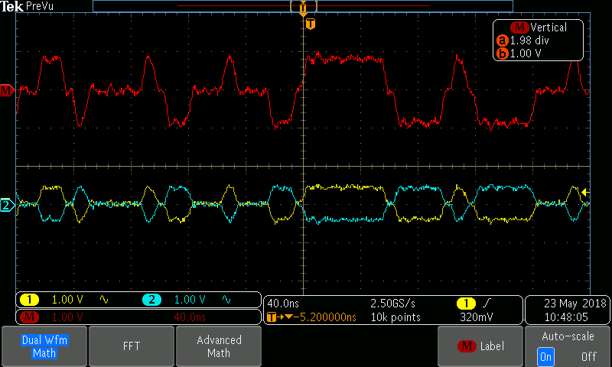
Part 2
Network connections, packet switching, delays

Slide 12

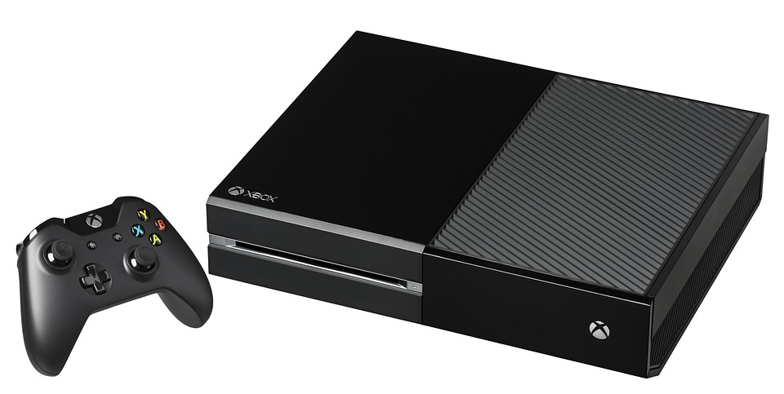
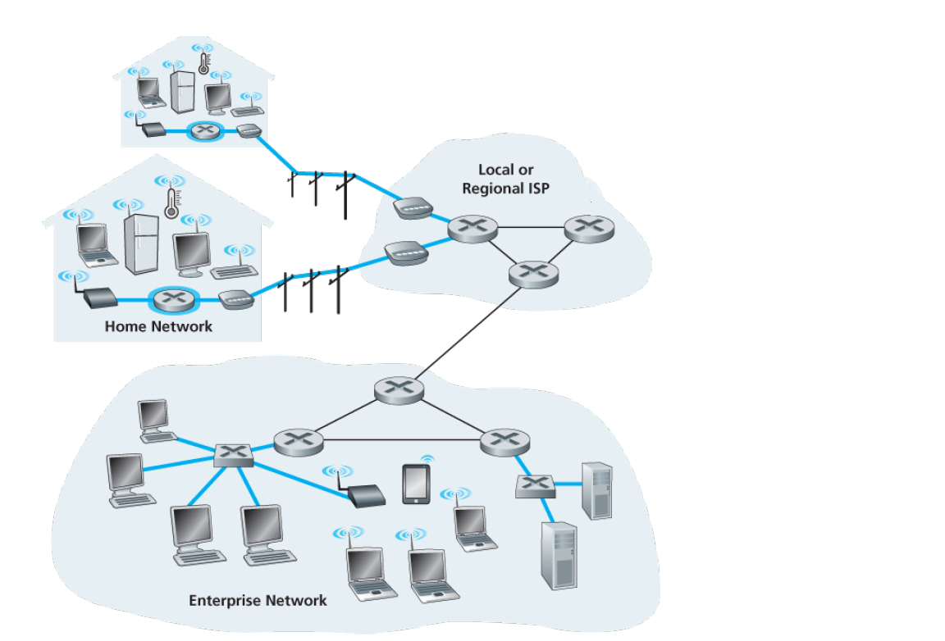
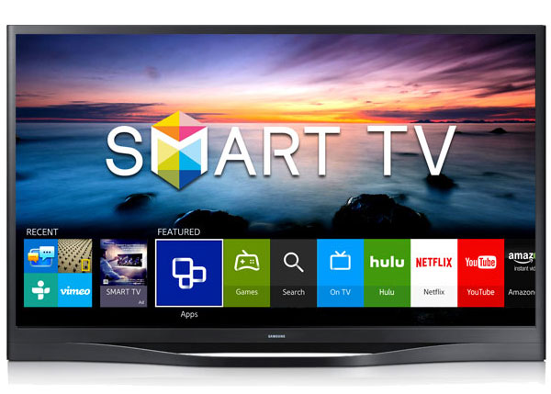

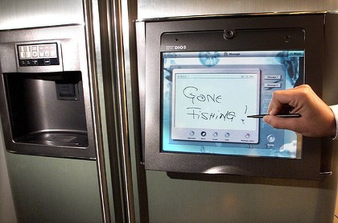
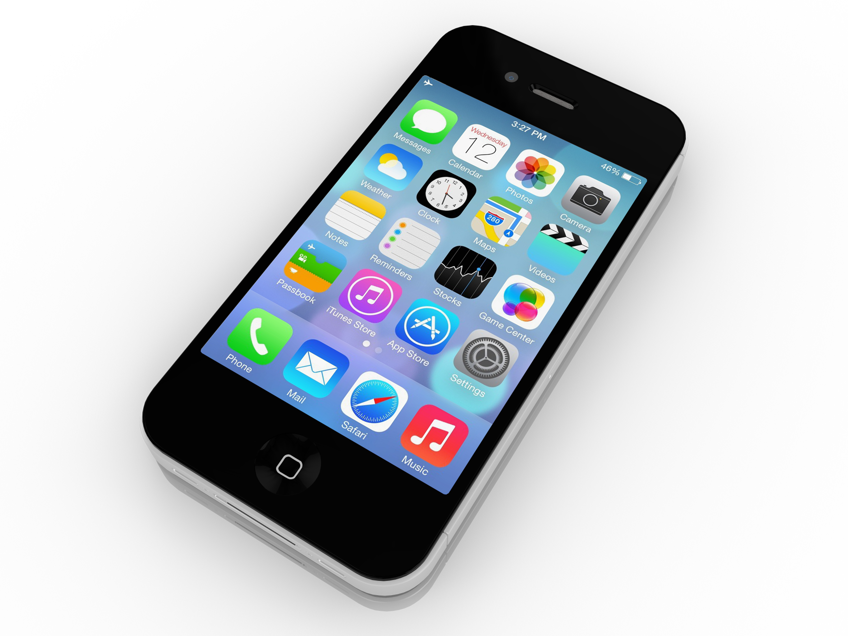
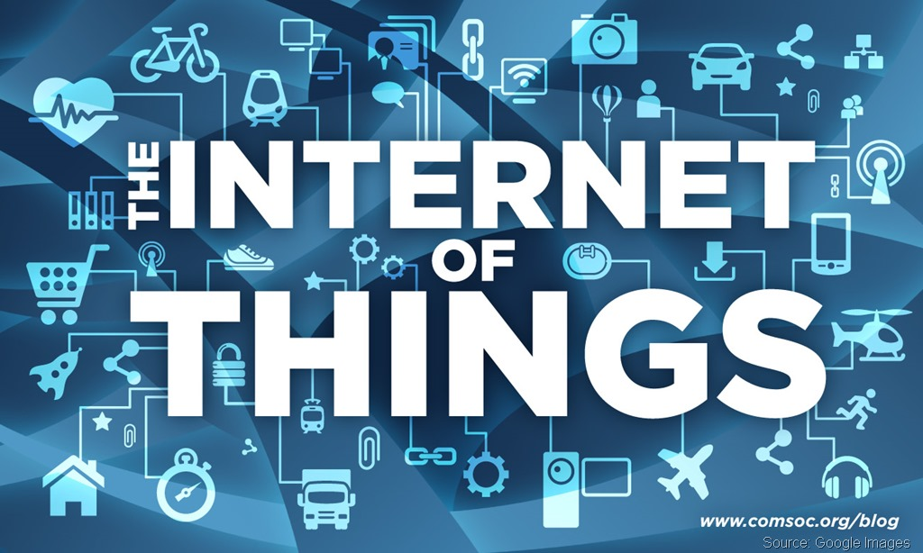
Network Access
Endpoints are typically connected physically differently based on use
  Home systems:
    DSL, Cable, FTTH, Dial-Up, Satellite, … 5G?
    “Broadband” connections
    Less than 100 connections
This Photo by Unknown Author is licensed under CC BY
This Photo by Unknown Author is licensed under CC BY-NC-ND
This Photo by Unknown Author is licensed under CC BY
Notes:
A network consists of a group of computers that are connected to share some resource. In this section we look at different ways to actually connect those computers.
The network technologies are typically driven by the needed capacity, the cost, and reliability.
You are probably most familiar with the technology used to support a home network. The network is split at the “front door” – the service provider is responsible for the cable coming into the home, and the home owner is responsible for the internal network. It is not uncommon, today, to see close to a hundred different devices on a home network – think about the number of different computers, printers, cell phones, game consoles, smart TVs, and even internet connected appliances in the home today. Home networks are starting to feel a little crowded!
Although still not common, many “upscale” homes have high-speed ethernet wiring installed into the walls of the home, while most others depend on high speed WiFi. The telecom providers, typically the old fashioned telephone company or cable company have massive “trunk lines” that serve all of the customers in a particular region. The real struggle with home network has always been the “last mile problem,” or getting from the central office (CO) to your front door. We’ll take a look at this in more detail on the next slide. The most common technologies for high-speed home internet today are either the Digital Subscriber Line (DSL) or Cable modem. Fiber-to-the-Home (FTTH) has had a slow progression because of the high cost and need to install expensive infrastructure. There is a lot of hype surrounding 5G cellular technology today.
Ultra-high band 5G (not whats in your new iPhone) uses frequencies in the 25-39GHz range to achieve download speeds of several gigabits per second, but over short distances (a few meters). Telcos are hoping to use this to solve the “last few feet” problem. Imagine a housing development, each home has a 5G repeater on their house, and the whole development meshes together to form a multi-gigabit broadband cell. The service provider would need only install one high speed, but very expensive, trunk to the whole neighborhood. The idea is that the company easily recoup their investment and provide low-cost, low-latency, and very high-speed network access. We’ll be sure to revisit this emerging technology later in the semester.

Slide 13

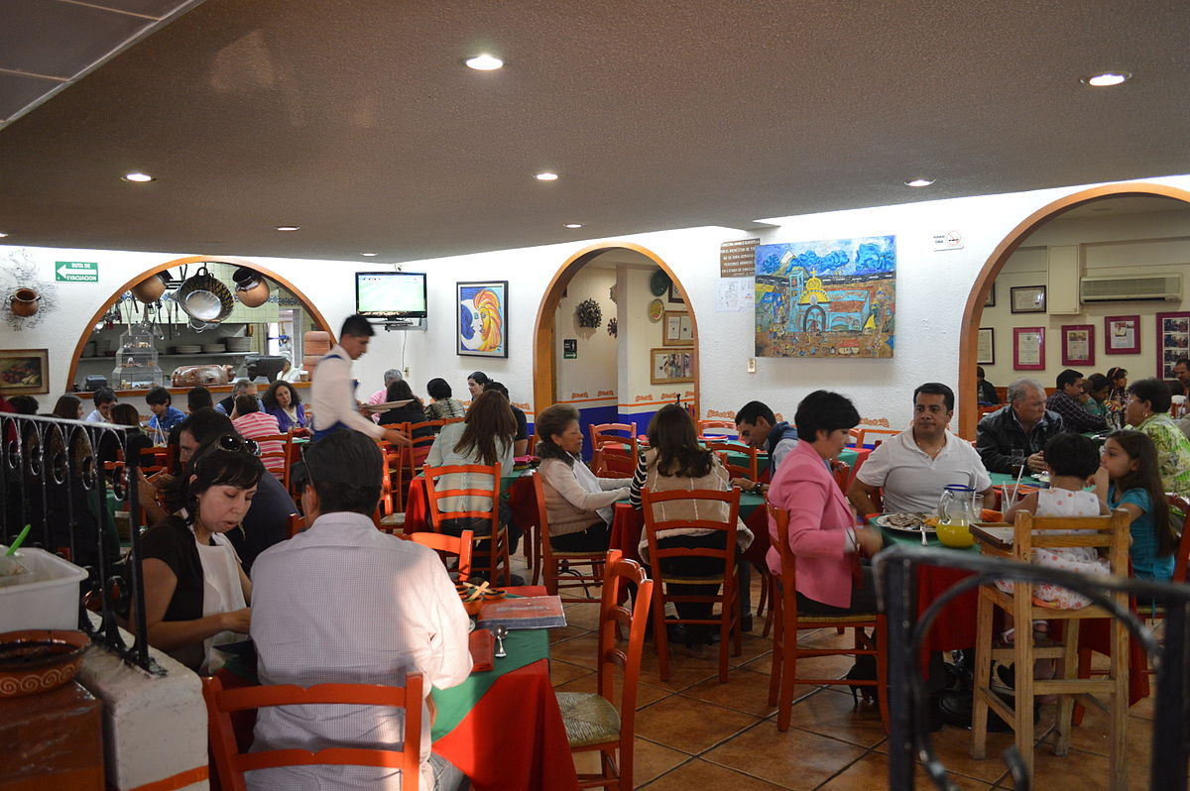

Network Access – Small Businesses
  Small businesses:
    DSL, Cable, Leased-Lines, Fiber
    Hundreds of connections
This Photo by Unknown Author is licensed under CC BY-SA
This Photo by Unknown Author is licensed under CC BY-SA-NC
Notes:
Today, small businesses have to deal with networking in ways they never imagined. Consider a busy restaurant with a hundred people trying to use their mobile phones at the same time as the front staff are trying get orders into the back kitchen. Or, the coffee shop that has become a remote office for many people. Despite having these extra demands, small businesses have the same last mile problem as most home users. Businesses have the additional problem of not trusting their users while having to protect vital network assets. So, while the technologies are similar between home and small businesses, the use cases and problems are different; and the stakes are even higher.

Slide 14
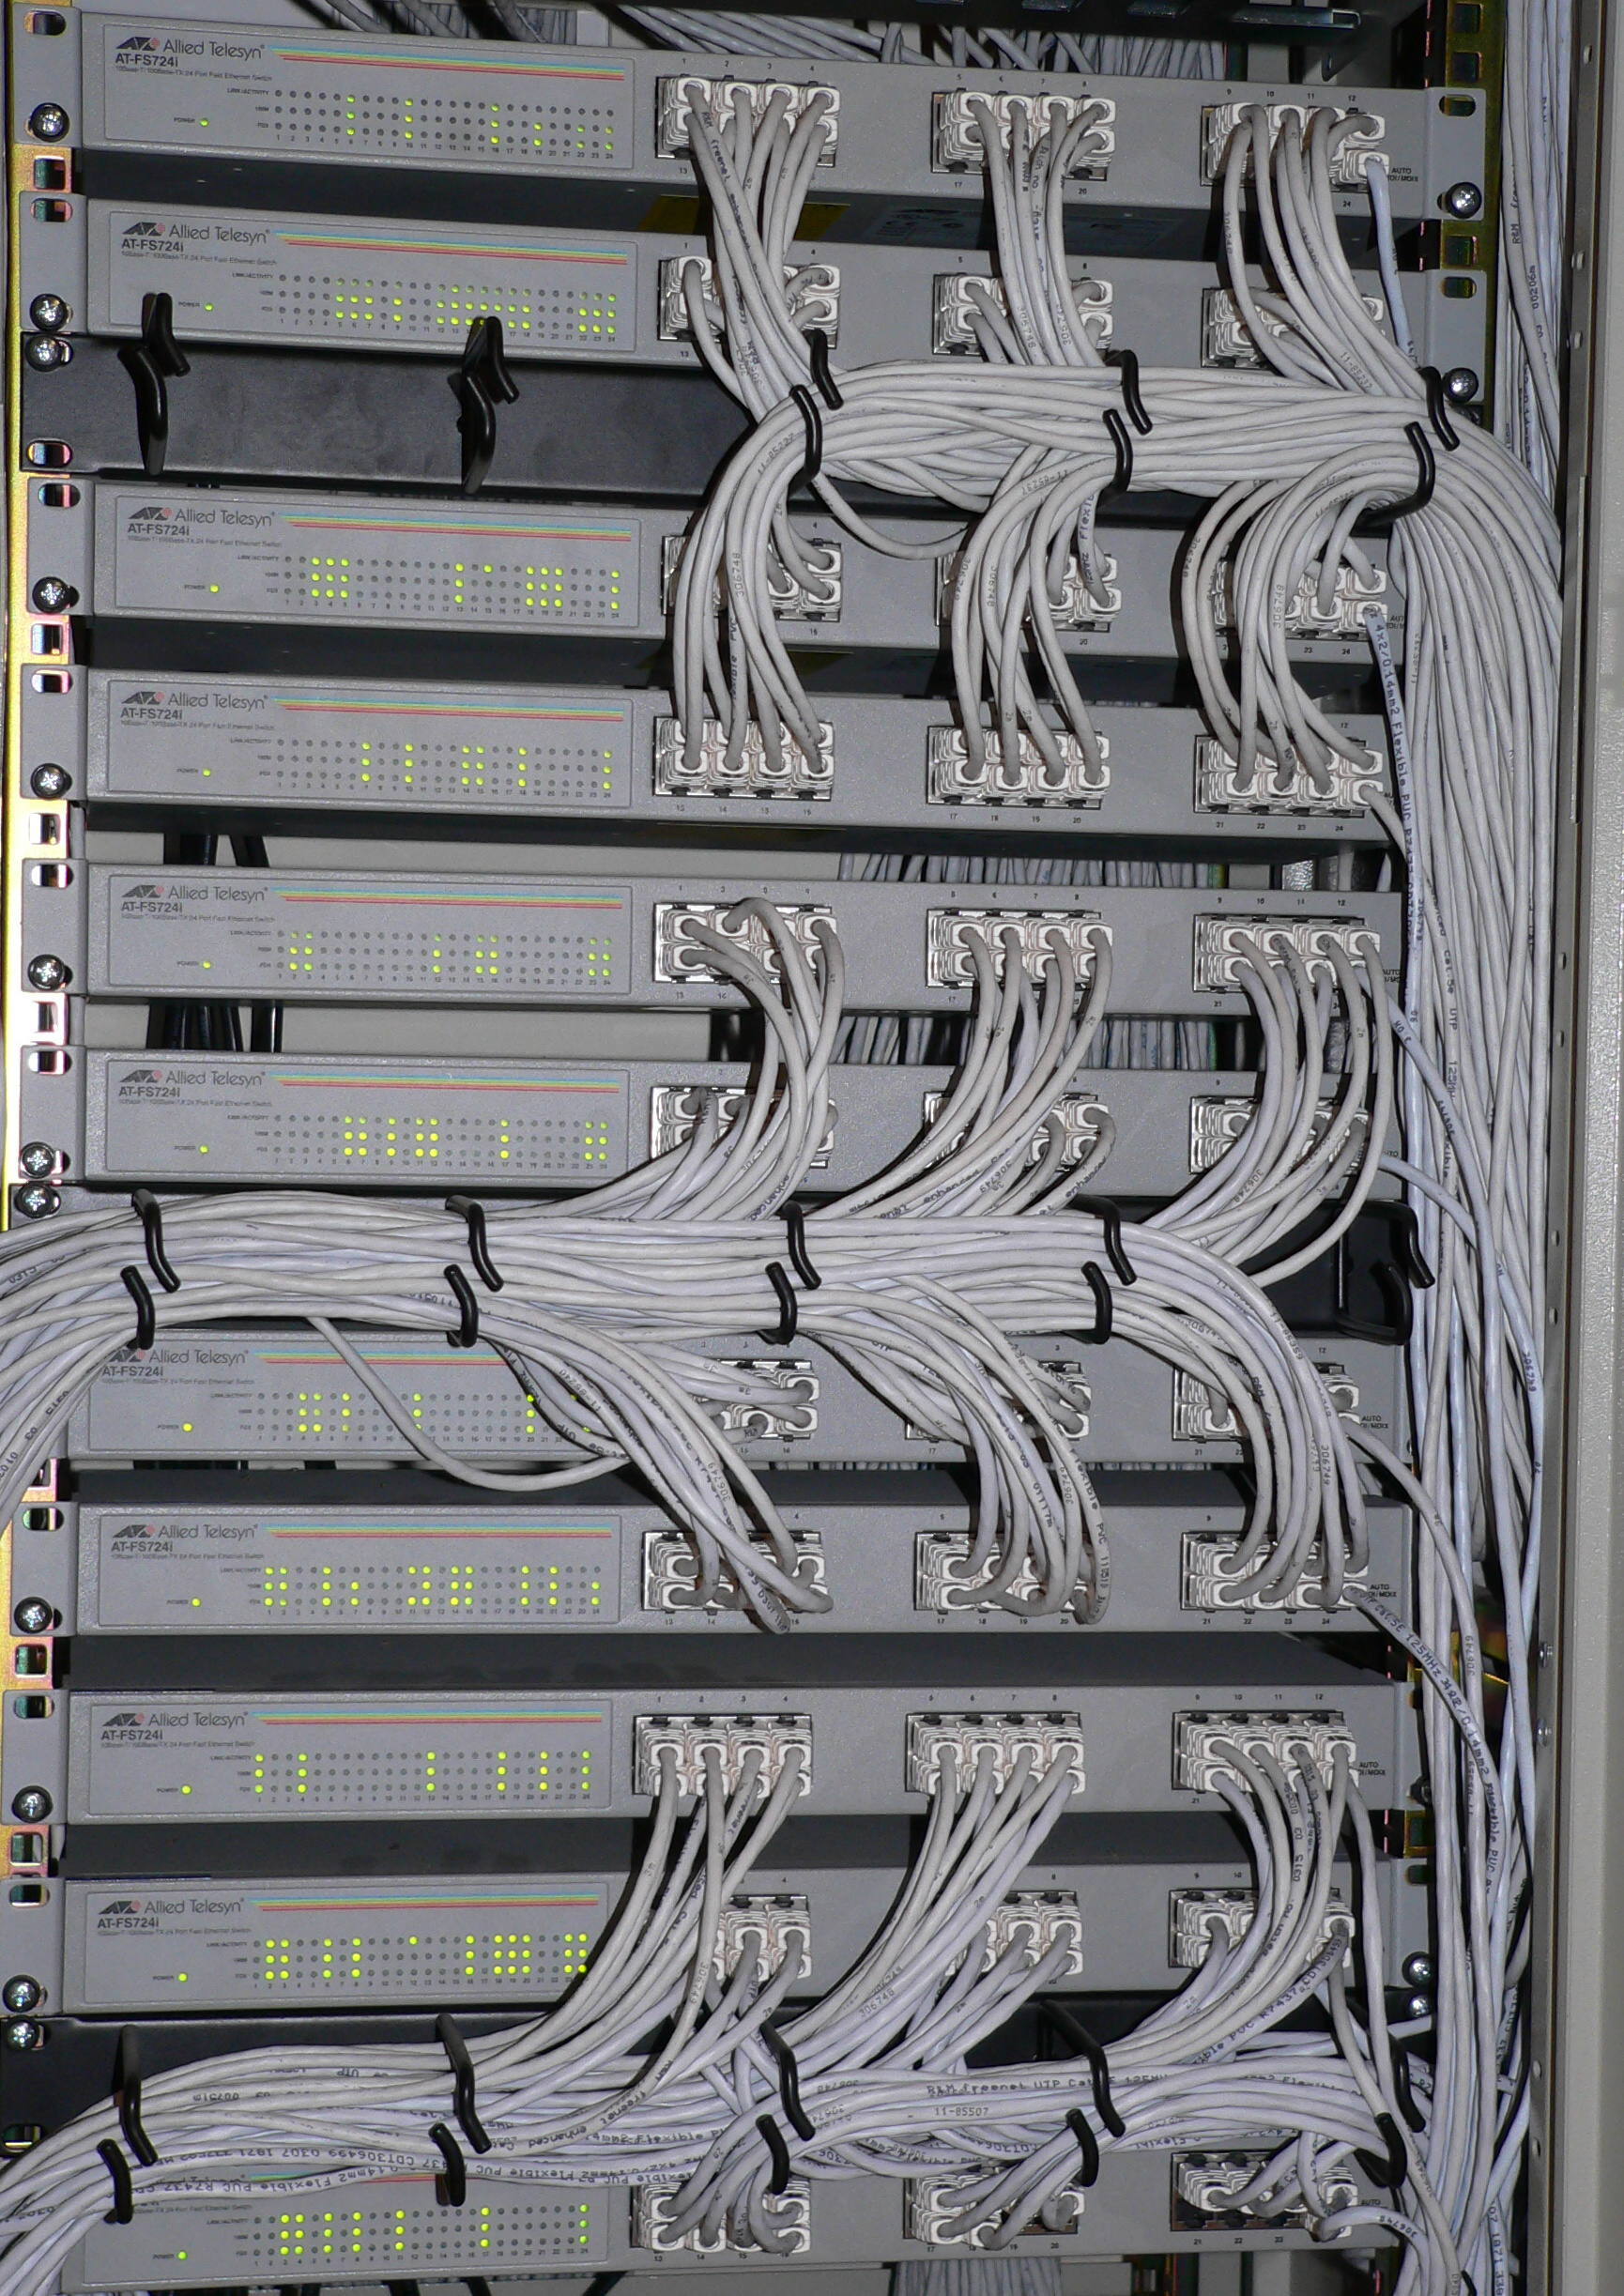
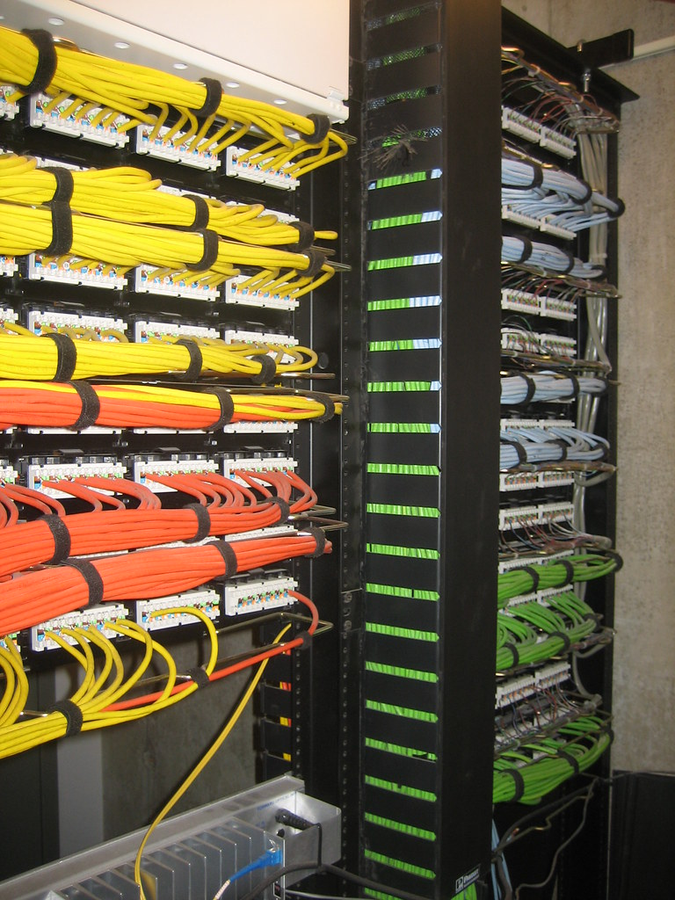
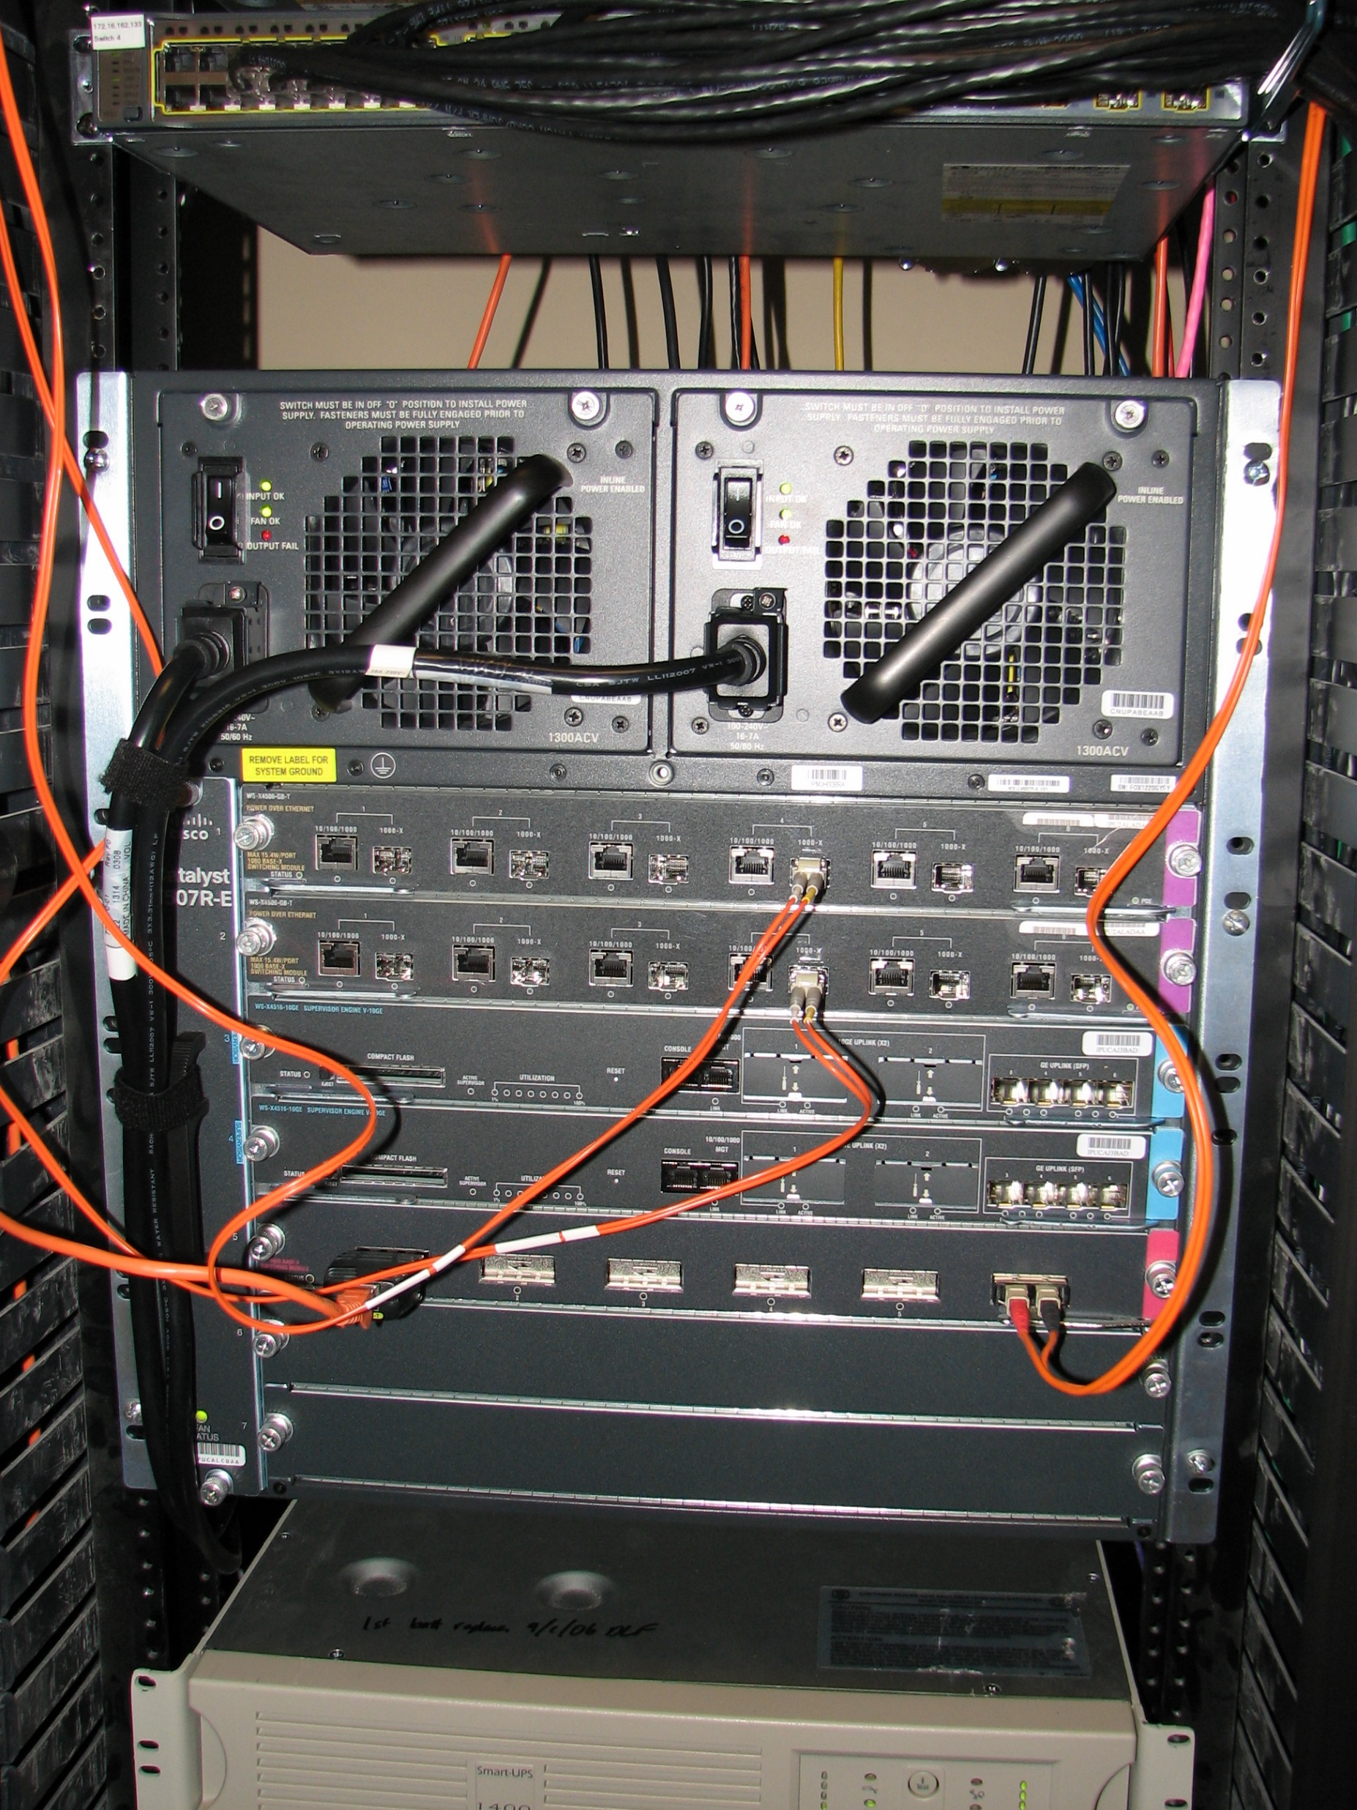
Network Access – Enterprise Systems
Enterprise systems:
  Ethernet (up to 100Gbps), Fiber,
  Microwave
  Massive “Core” routers handle > 1,000
  connections
  Mission critical infrastructure
This Photo by Unknown Author is licensed under CC BY-SA
Notes:
Enterprise systems are installed in large organizations that need to support many thousands of users. Often, because of their needs, these organizations will spend the money to “fix” the last-mile problem and have high-performance fiber optics or microwave stations installed to their network centers. Consider the campus network that needs to support everyone’s daily activities. We have multi-gigabit connections to the internet, and our on-campus connections are typically directly wired gigabit connections. Our routers and switches are all high-performance, high capacity devices that can be centrally managed, and can handle the significant loads placed our users.

Slide 15
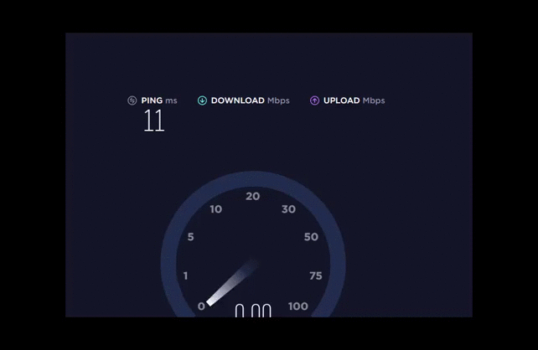
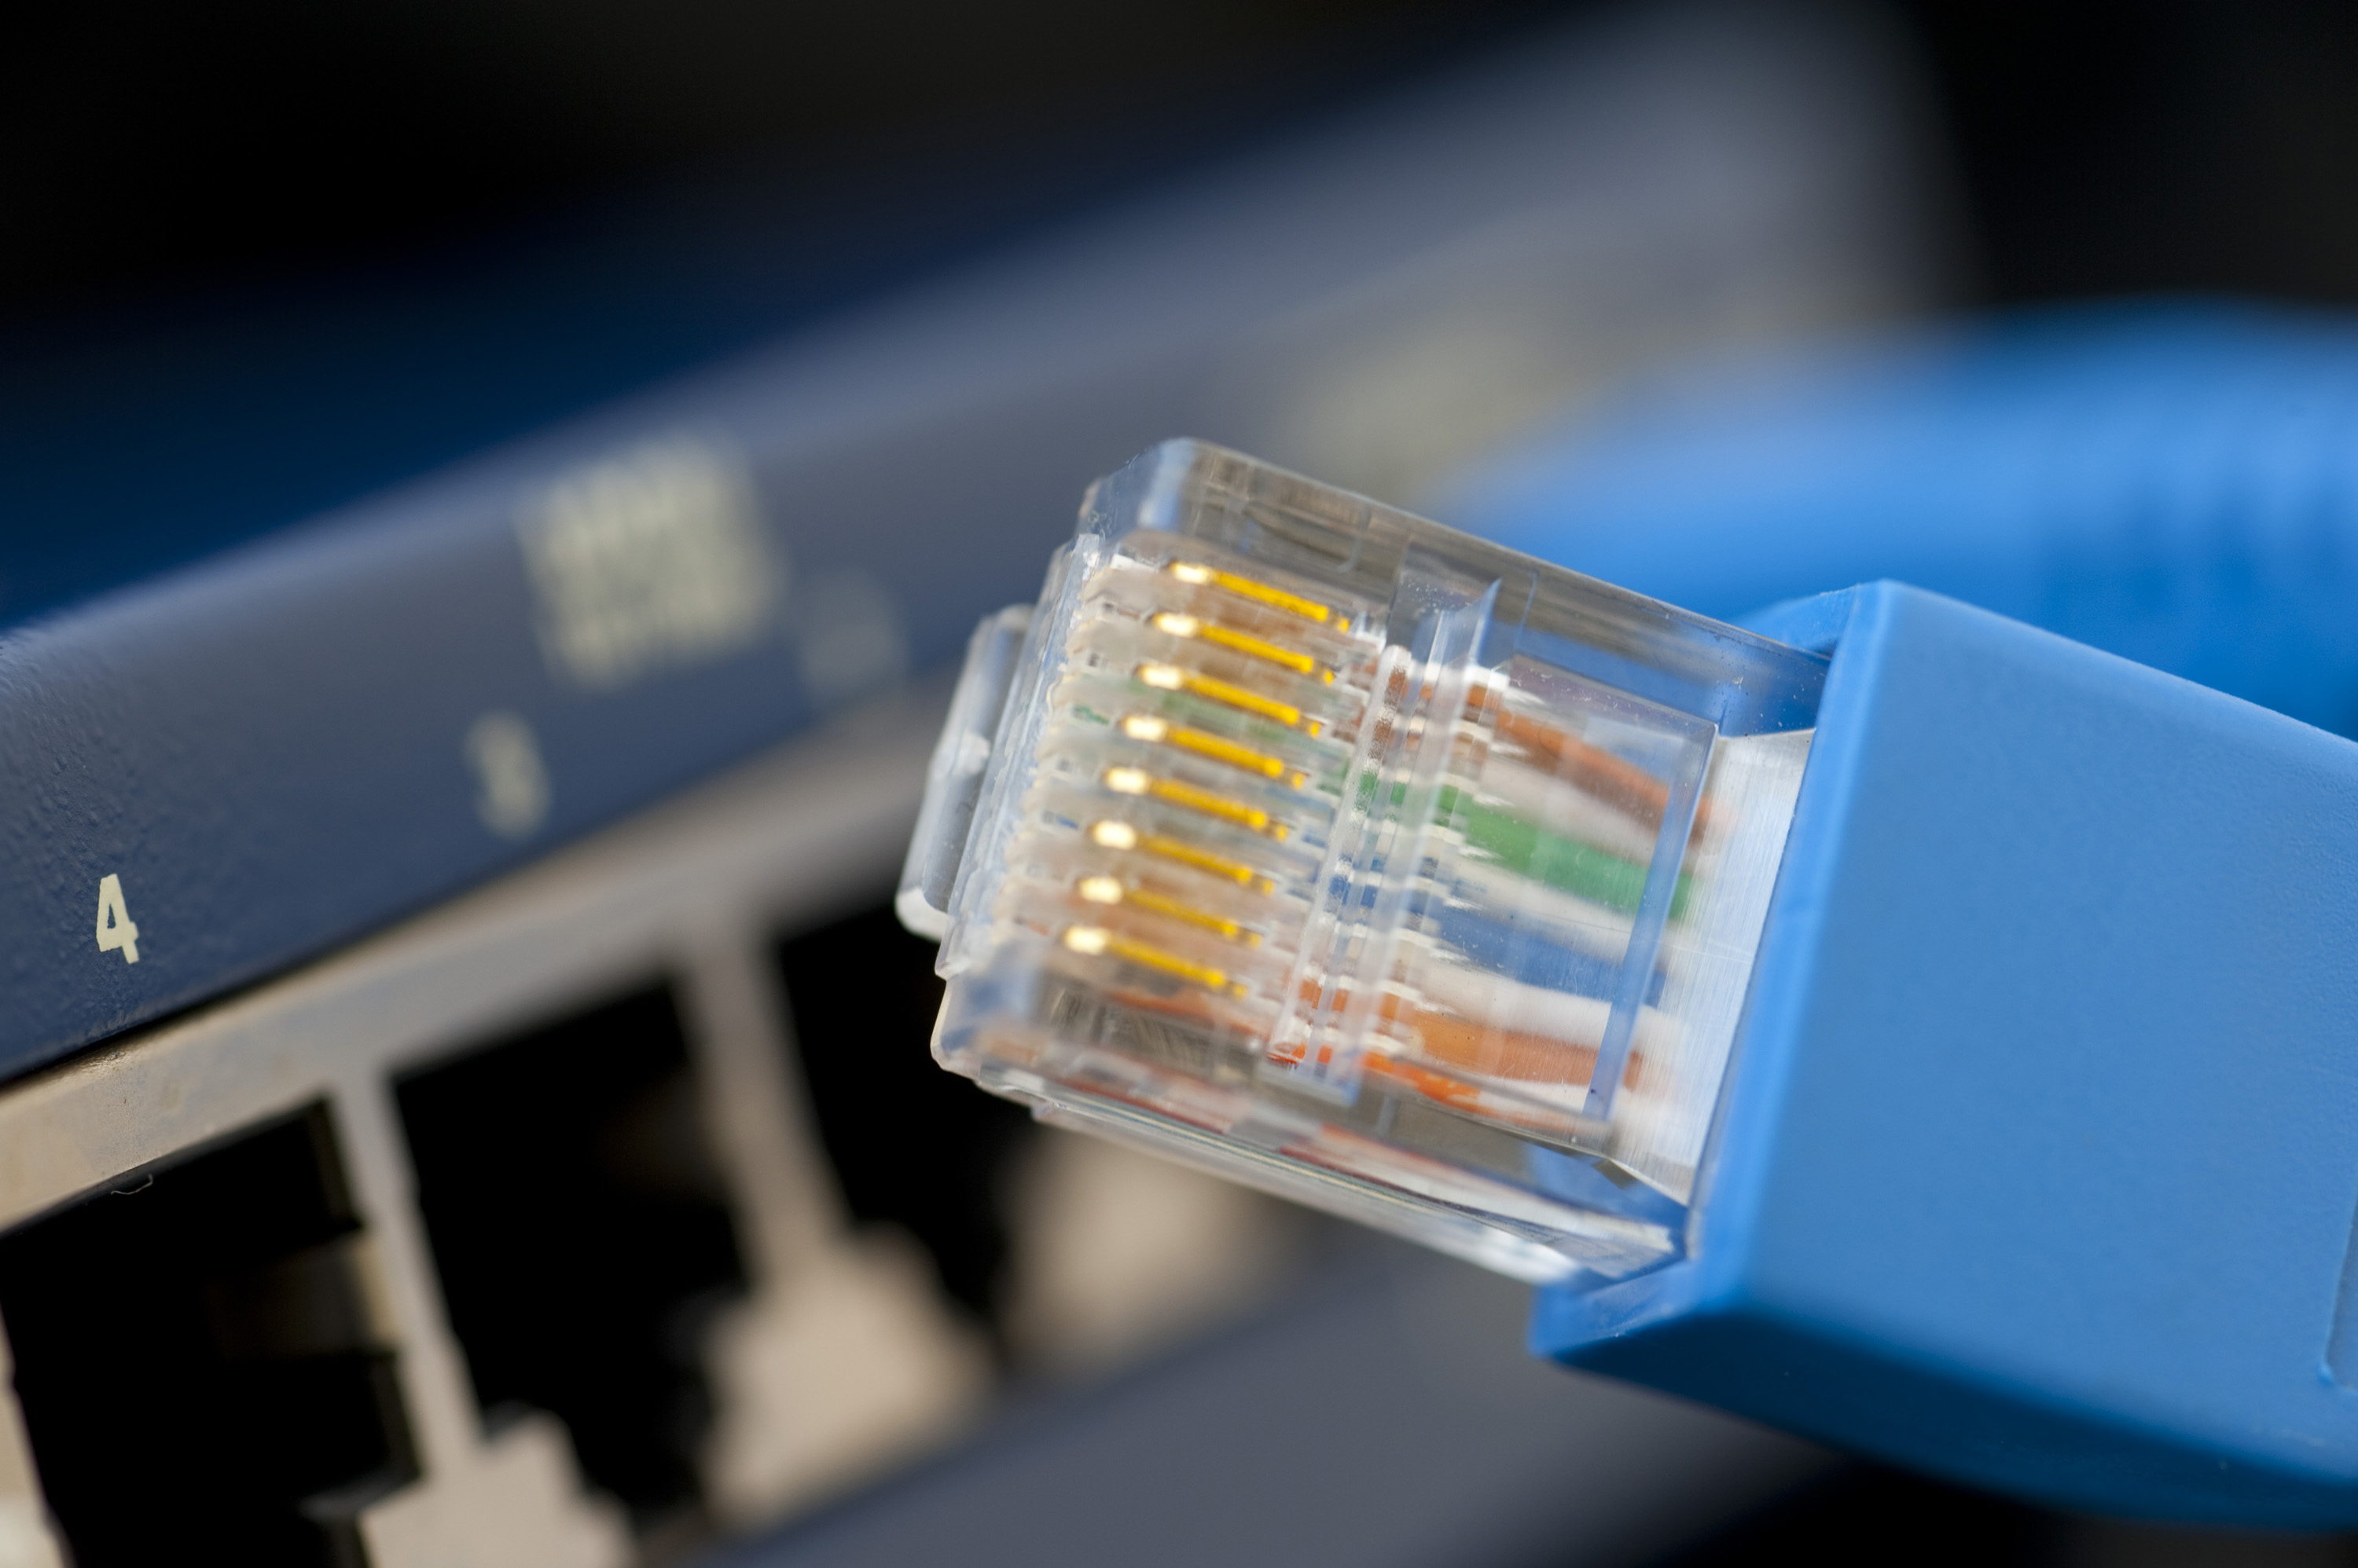
Local Area Network
Ethernet (IEEE 802.3)
  Speeds: 10, 100, 1G, 10G, 100G!
  Inexpensive wiring; Unshielded Twisted Pair
  Older, deader tech: Coax, Fiber to the Desktop (FTTD)
  Maximum runs 100m (1G), 55m (10g)
WiFi (IEEE 802.11)
  Ethernet frames embedded into wireless protocol frames
  Speeds up to 866Mbps (some even higher!)
Infiniband, Fiberchannel,
This Photo by Unknown Author is licensed under CC BY
Notes:
The technologies used for accessing local area networks has basically standardized on wired or wireless ethernet. For the most part, LAN connections are copper wires, typically unshielded twisted pair wiring (UTP), often called the “blue cable,” but they aren’t always blue! Earlier versions of ethernet were limited to 1 to 10 Mbps. Due to advances in signaling technology, speeds to the desktop are typically 100Mbps to 1Gbps. Today, computers can support 10Gbps, but that is seldom deployed to the desktop. Instead, the 10Gbps, and the emerging 100Gbps, are being used to link network infrastructure devices to create LAN backbones. 10Gbps is effectively as fast as we can get with copper wiring, but through clever signaling strategies, we can actually run different “channels” or “lanes” on the same cable at the same time; so 100Gbps is typically implemented as 10 x 10Gbps channels.
WiFi or just wireless, has become one of the most common ways of accessing a LAN. It has many advantages, from ease of deployment and minimal physical installation requirements. It also has some significant disadvantages – security is the first thing that comes to my mind. But it also has poor performance when there are lots of devices. In dense areas, such as college residence halls and apartments, it can be difficult to find an available channel for a wifi router, and then everyone’s performance suffers.
Two other technologies, Infiniband and Fiberchannel tend be to deeply embedded in data centers. For example, infiniband is used to network nodes of supercomputers together and to attach peripherals.

Slide 16
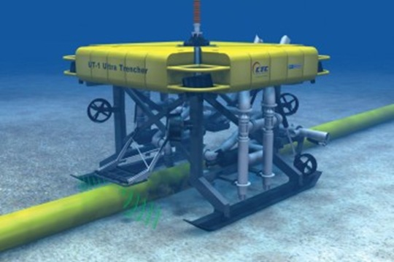
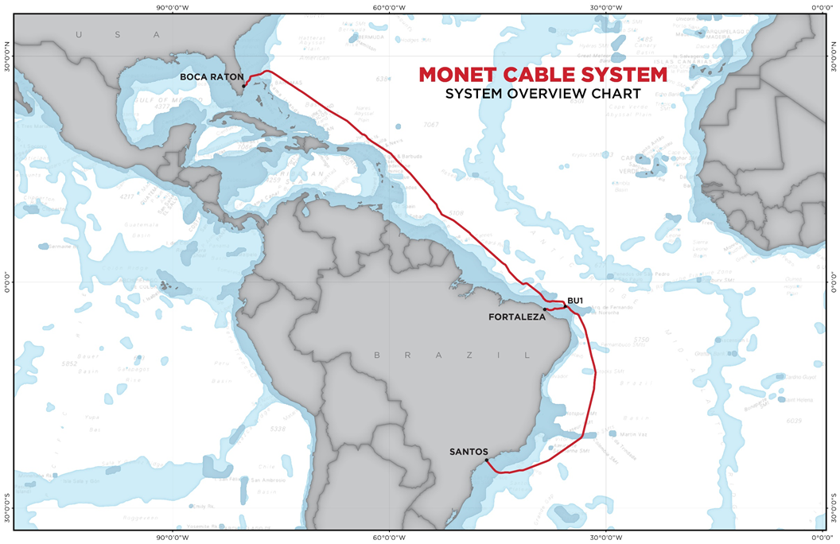
Wide-Area Network
Distance, reliability, cost are major factors
Backbone Dominant Technologies:
  High speed fiber
  Microwave
  Satellite
Last Mile Dominant technologies:
  Digital Subscriber Lines (DSL)
  DOCSIS (Cable modem)
  FTTH (Fiber to the home)
  Satellite
  Metropolitan WiFi
  Cellular
  Dial-Up
Notes:
Wide-Area Networks can span cities (called Metropolitan Area Networks), or large geographic regions. Given the large distances and installation costs, these networks are typically pushing the state of the art in speed and reliability. Cost is also a major factor in determining that these trunk lines typically go from ‘central office’ (CO) to CO. To be cost effectives, these CO connections need to be shared between a large number of customers.
This gives rise to the “last mile problem.” Getting data from the CO to the end-point requires making trade-offs between installation and maintenance costs, speed, and the ability for the service provider to recover those costs.
This picture shows an undersea fiber optic cable bundle. On the next slide, we’ll look at how they actually make and install these cables. But, to give a perspective, a single, modern fiber trunk like this can handle 64 Tb/sec!

Slide 17

Internet Deserts
Rank | Country | Avg DL Speed (Mbps) | Avg Cost (USD)
1 | Luxembourg | 375.78 | $48.16
2 | Japan | 102.34 | 40.33
3 | Iceland | 90.36 | 64.71
4 | South Korea | 86.98 | 25.52
5 | Switzerland | 79.58 | 72.10
6 | Sweden | 73.81 | 39.60
7 | Netherlands | 67.54 | 42.43
8 | Denmark | 61.49 | 48.23
9 | Spain | 57.86 | 39.38
10 | United States | 55.07 | 50.30
https://broadbandnow.com/report/2018-fcc-international-data-insights/
https://www.cable.co.uk/broadband/pricing/worldwide-comparison/
https://www.npr.org/2020/05/23/861577381/without-internet-access-students-and-teachers-in-rural-areas-struggle-to-keep-up
Notes:
Sometimes its hard to believe that in the country that started the Internet and that gave birth to Silicon Valley and the Tech Giants, that we have lost the global lead in access to the internet. In a recent survey, the US is 10th in the world in average broadband speeds. We are far behind other countries in peak home broadband speeds. For what access we do have, we pay more than many other developed countries where governments offset some of the cost, either through subsidies to subscribers or through government investment in the infrastructure.
While nearly 80% of people in the U.S. have access to the internet, that term, “access,” is broad – for many, especially in rural or impoverished areas, the only access to the internet is through a cell phone – which is one of the most expensive and least flexible methods. In 2019, less than 35% of the US population had access to “high speed” broadband. In the US, the FCC defines broadband service as “25Mbit/s down, and 3Mbit/s up.” For example, as of June 2020, CenturyLink charges $50/mo for speeds “up to 10Mbps broadband” to a downtown Shippensburg address, or $600 per year, where the median household income in $37,614 and nearly 20% of the population lives in poverty.
Its clear that something needs to change in our culture – as the recent Pandemic demonstrated, people need access to the internet to work, to attend classes, to order necessary items, and to keep in touch. Access to the internet is needed to apply for benefits, or apply for new jobs when your old one is lost. It has become a necessary tool for life in our technological society. Access to the internet has become as important as electricity – its no longer just a convenience. Lack of access can actually make it harder to climb out of poverty.
Unfortunately, in the US, we have regulatory bodies to regulate utilities, and require them to provide minimum viable services. We have public utility boards that set price caps and encourage competition. But we don’t treat the internet as a utility – even though both cable and telephone companies are regulated that way. In other countries, the government provides a competitive service which forces private companies to either offer better quality or higher speeds or reduced price. But we have the worst of both worlds, and as a result, only those who can afford the astronomically high prices can get truly high speed internet, while the rest of us lives in an internet desert.

Slide 18
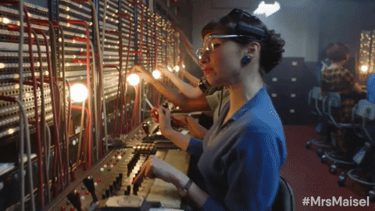
Connecting Endpoints
Earliest network – the Plain Old Telephone System (POTS)
  Create a circuit between two telephones – no, really, an actual circuit!
  Much of the early network technology developed based on telephone system
Physical Circuit
  Direct connection – dedicated wires
  Leased Lines – dedicated wires
  Wasteful if not used continuously
“Virtual Circuit”
  Circuit Switching – allocating wires on demand
  Packet Switching – allocating time on demand
  Leased Lines – guarantee leased wires are available
This Photo by Unknown Author is licensed under CC BY-SA
Notes:
Networks are all about connecting end points. There are really three ways that we have to do this:
(1) directly connect the end point together with wire. This was how the early telegraph systems worked, but then those wires were dedicated to those stations
(2) Circuit switching – connecting wires on demand, either manually or using a multiplexing strategy
(3) Shared circuit – everyone shares the circuit and just takes turns

Slide 19
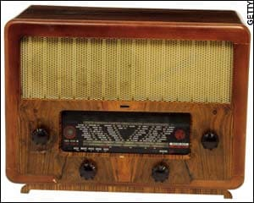
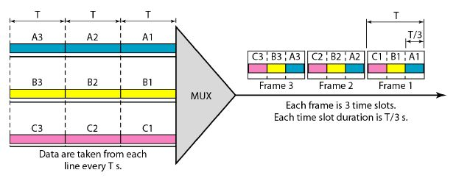
Circuit Switching
A circuit is reserved between sender and receiver
  Can be a physical connection – i.e. serial port
  Can be a virtual reservation – i.e. telco allocates a fraction of a large trunk line to you
    Frequency-division multiplexing (FDM)
    Time-division multiplexing (TDM)
Unused reservations waste capacity
Radios pick one station from all of the
ones being broadcast.
TDM allocates a slot to each channel, whether it
needs it or not.
Notes:
Circuit switching allows multiple devices to be active, but only one a time. A technique called multiplexing is used to take multiple streams of data and encode them as one, and then reverse the process on the receiver. Two techniques: frequency division multiplexing (FDM) and time division multiplexing.
FDM allocates different frequencies to each channel, and then they can send data simultaneously. Think radio or TV. However, there are physical limits to how much data can be sent at a time, so the individual inputs must respect the total available bandwidth, and also have to be spaced far enough apart to not interfere with one another.
TDM gives each device the full bandwidth of the circuit during its time slice, but they can only transmit / receive during their time. Again, TDM restricts the input speed to be some fixed fraction of the transmission line.

Slide 20
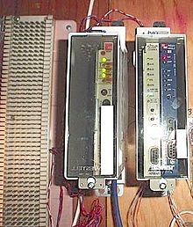
Circuit Switching Examples
The telephone company introduced the T-carrier (1962)
  Developed as the trunk lines between switches / “private branch exchanges” (PBX)
  Used Time Division Multiplexing to carry simultaneous phone calls
Type | Bandwidth | Voice Channels | Cost / month
T1 | 1.544Mbit/s | 24 | $250 - $500
T2 | 6.312Mbit/s | 96
T3 | 44.736Mbit/s | 672 | $4000 – $16,000
OC3 | 155Mbit/s | 2400 (100 T1) | $20,000 - $45,000
OC12 | 622Mbit/s | 4 OC3s
OC24, OC48, OC96,…
Left: A 66 block; center and right: Cabinets containing Smartjack network interface devices for T1 circuits. https://en.wikipedia.org/wiki/T-carrier
Notes:
Perhaps one of the best examples of TDM is from the telephone company. By the 1960’s, the telephone network’s growth demanded increasing capacities in the carrier’s trunks. Further, companies started expanding the number of telephone lines, and the telco needed to keep up. By the end of the 1960’s, demand for data was increasing as well. Bell Labs developed the T-carrier system, a type of trunk line that could be run across country, or from the telco’s central offices to businesses. For example, there may be several T3 lines between big cities, but maybe only a single T1 from a larger central office to a small town or to a company.
One can “rent” a trunk, but they aren’t cheap, and certainly beyond the reach of most home owners!

Slide 21
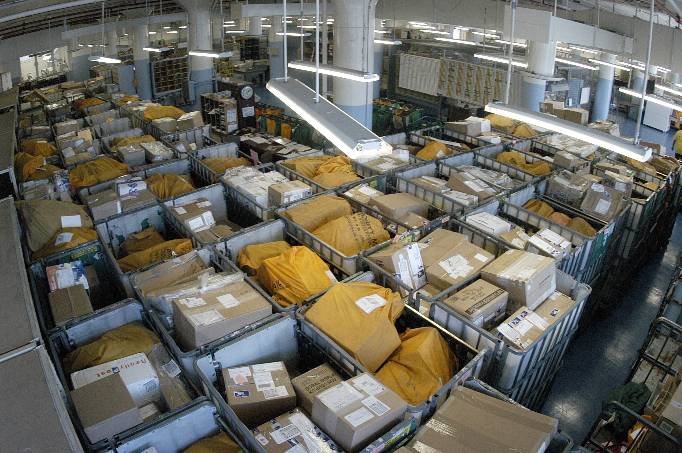
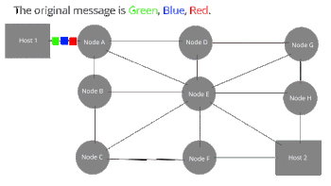
Packet Switching
The transmission media is shared on-demand
  Messages are broken up into “packets”
  Each sender takes turns sending packets
  Network has “rules” to help prevent starvation of a sender
  Often “first-come, first-serve” is the general rule
When no-one is transmitting, still have “unused” capacity
When many sources are transmitting, may
overwhelm capacity
Can be difficult to allocate equally
This Photo by Unknown Author is licensed under CC BY-SA
Notes:
Another form of sharing the “wires” is packet sharing. The idea was conceived after watching how computers actually send data. They tend to send data in bursts. A burst comprises sending a chunk of data, or a packet, to a receiver, and then waiting for a reply. During the idle periods, the wires can be used by another computer. Another advantage to packet sharing is that the packets can be sent out along the most available route.
Packet switching allows for many different computers to share expensive and limited transmission lines, on demand and without any central management. In theory, the same transmission lines can be used by many computers, each getting the full bandwidth of the transmission lines. On the other hand, with the wrong mixture of traffic can overwhelm and bog down the transmission line. Consider the following scenarios….

Slide 22
Show computers exchanging data in packet switch in efficient and inefficient manner

Slide 23
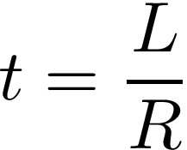
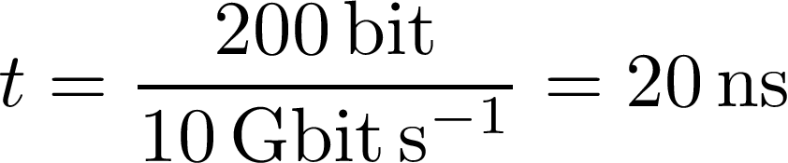
Data Rate
Systems exchange messages, which are embedded in packets
Packets have some length in # of bits (bits)
Transmission media has some rate, expressed in bits per second (bits s⁻¹)
Then the time to transmit a message is:

Slide 24
Data rate math example

Slide 25
An interesting thing about copper wires
Speed of light:
  300,000,000 m/s in vacuum
  200,000,000 m/s in copper
Can calculate:
  How “long” a frame is
  How many bits are on a wire at a time
  How much time it takes for a whole packet to travel down wire – propagation delay
Can conclude that propagation delay is negligible and mostly set at 0
Until we cant!

Slide 26
Copper wire math….

Slide 27
Store and Forward
How it works:
  Packets are received, bit by bit, into a receive queue
  Processor on board determines the destination for the packet (rule table)
  Queues up the packet on the destination port
  Transmitter sends data from its queue
Why do this?
  Alleviates urgency to handle incoming data
  Allows packet switching vs. circuit switching
What it means
  Queues are constrained by memory – fixed size limits # of packets
  More time on queue, more latency for packet delivery
Notes:
Store and forward is a crucial piece of packet switching. Store and forward is typically employed in the infrastructure devices that connect computers in a network. As a packet moves through the network, it is sent serially, or bit by bit. As the bits are received and reassembled, they are stored into the devices memory. After the packet has been received and verified to be a valid packet, it is queued up to be transmitted to the next device in the network.
Store and forward alleviates the urgency in handling incoming data – it allows one packet to be transmitted while the next packet is being received. It also allows an impedance mismatch between sender and receiver speed. On the other hand, the queues are based in memory, and are of fixed size, limiting the number of packets that can be queued up. Any new packets that arrive when the queue is full will be dropped from the network and will not be delivered. In between the empty and full queue, packets that arrive and are queued will be held in memory for a period of time, leading to additional latency to the delivery a packet.

Slide 28
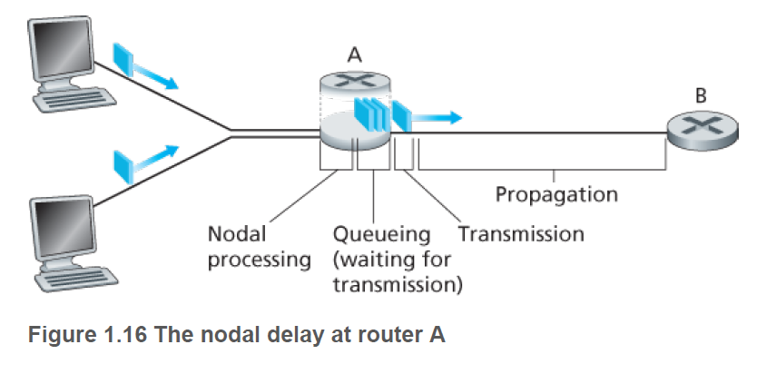

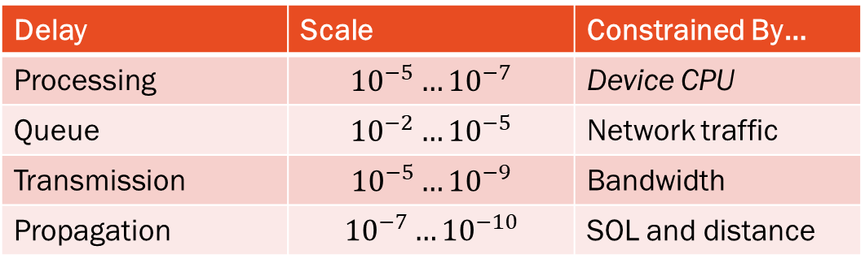
Delay, Loss, and Throughput
Types of delay:
  Nodal processing delay $D_{proc}$
  Queuing delay $D_{queue}$
  Transmission delay $D_{trans}$
  Propagation delay $D_{prop}$
  Total nodal delay $D_{nodal}$
Delay | Scale | Constrained By…
Processing | $${10}^{−5}…{10}^{−7}$$ | Device CPU
Queue | $${10}^{−2}…{10}^{−5}$$ | Network traffic
Transmission | $${10}^{−5}…{10}^{−9}$$ | Bandwidth
Propagation | $${10}^{−7}…{10}^{−10}$$ | SOL and distance
Notes:
We have already seen that time on the queue is one type of delay in store and forward networks. Several other types of delays are typically present in a store and forward network. The time spent by the device analyzing and checking the received packet for validity and managing the queue is represented by the processing time delay or Dpro and is typically measured in micro- or nano-seconds, depending on the network device. This is one area where one gets what they pay for… Dqueue is what we’ve already discussed, and can be measured anywhere from 10s of milliseconds through microseconds. Transmission delays represent how long it takes the transmitter to physically place the bits into the outgoing wire, while propagation delay is determined by how long it takes the wave front of the first bit to arrive at the receiver.

Slide 29
Do a couple of processing delay examples

Slide 30
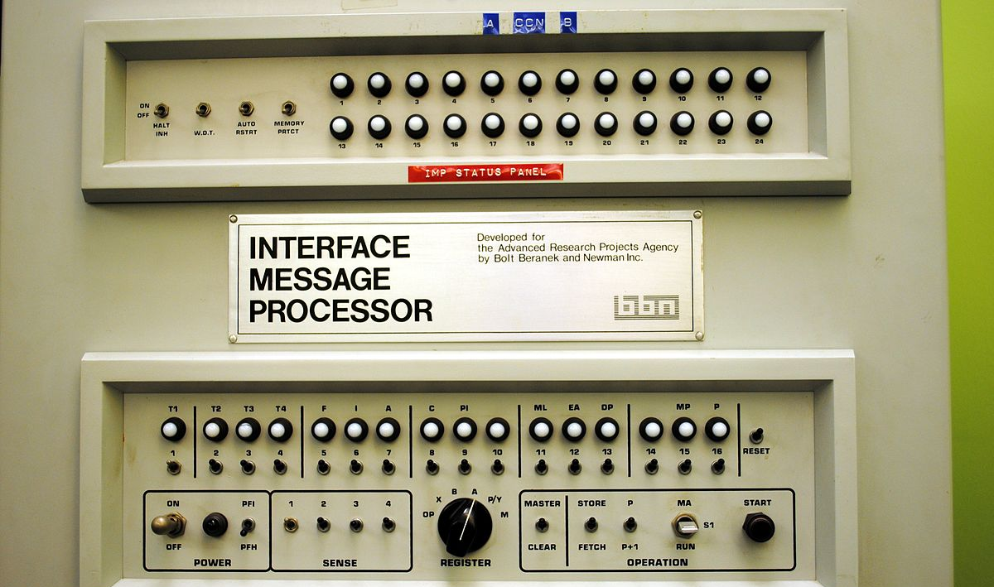
Part 3
Queueing Theory, Tools, and Internet Service Providers, A Little History
This Photo by Unknown Author is licensed under CC BY-SA

Slide 31
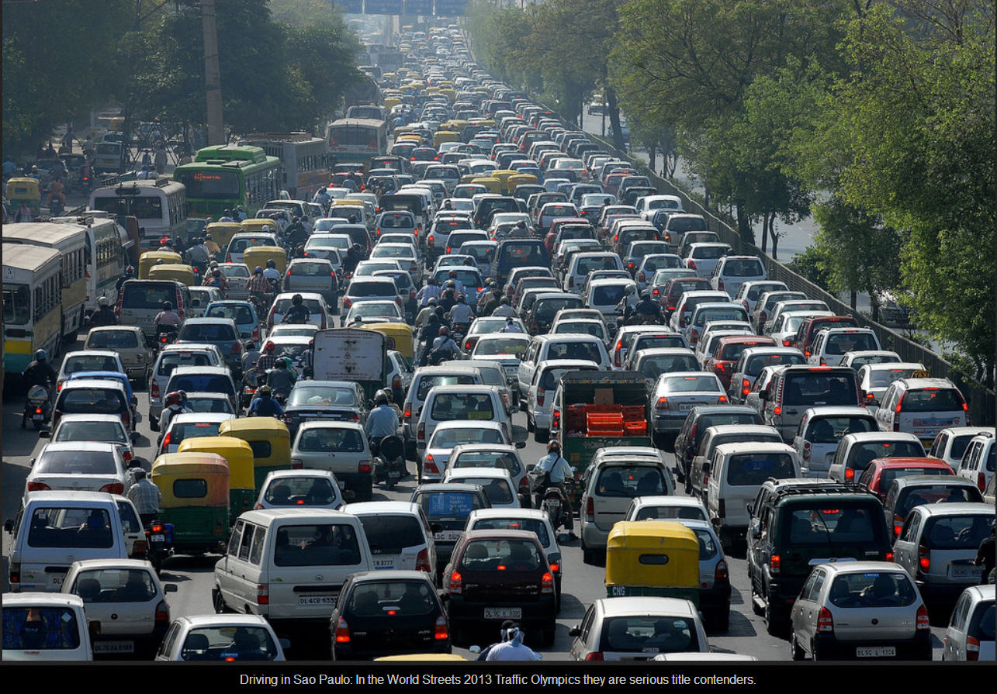
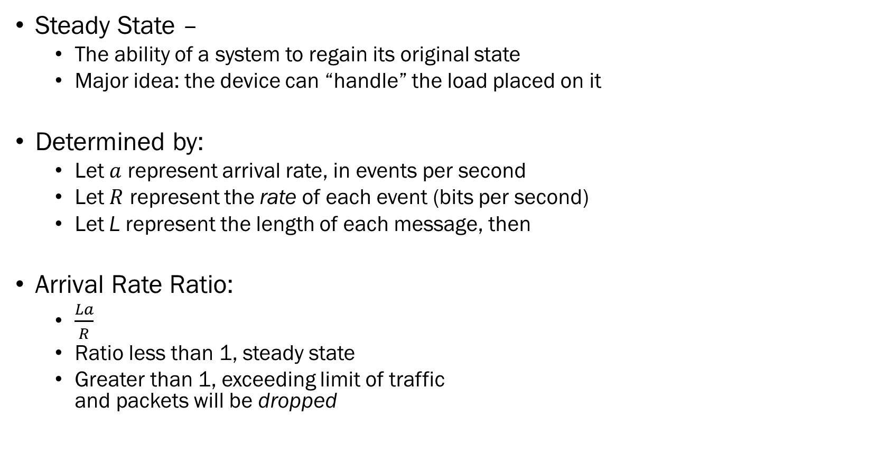
Queueing Arrival Rate & Steady State
Steady State –
  The ability of a system to regain its original state
  Major idea: the device can “handle” the load placed on it
Determined by:
  Let $a$ represent arrival rate, in events per second
  Let $R$ represent the rate of each event (bits per second)
  Let L represent the length of each message, then
Arrival Rate Ratio:
  $\frac{La}{R}$
  Ratio less than 1, steady state
  Greater than 1, exceeding limit of traffic
  and packets will be dropped
This Photo by Unknown Author is licensed under CC BY-NC
Notes:
In a packet switched, store-and-forward network, the arrival of a packet has to be stored somewhere before it can be forwarded on. Ultimately, we store these received packets in a queue.
Despite the fact that the arrival and potential departure of a packet seem like they are random events, operational research, a branch of mathematics, have developed math models that describe the characteristics of a queue. Let a represent the arrival rate of packets, in packets per second, R represent the bit rate for each packet, and L be the length of each message, we can compute the Arrival Rate Ratio. Notice that the ratio is unit-less, and is just expression the relationship between these quantities.
If the ratio is less than 1, the system is in steady state, and while there can be bursts of traffic, there will also be periods were there are no new packets arriving, and by and large, the system will gracefully handle the load and eventually return to humming along. Queue delay will have a finite maximum.
On the other hand, when the ratio exceeds one, then packets are arriving faster than they can be queued up, and the incoming packets will be dropped.
We can use this to calculate other factors, such as the average length of the queue (and use that to properly size the network device’s characteristics), or plan for additional routes for packets to follow.

Slide 32

Delays are Additive
Each “hop” in a packet-switching network will add its own delays
  Delivery of packets is complicated, and each “switch” has to “route” the packet one
  step closer to your desired destination.
  Each link adds its own delays, and probability of dropping the data.
  The return path may be different than the source path!
  Conditions change in the real world!
This Photo by Unknown Author is licensed under CC BY-NC
Notes:
Delays are additive. Every device along the way will store and forward the packet, adding delays to each link. In a simple network, if a network device is overwhelmed, there is nothing to do other than wait. In a complicated network with multiple paths to the same destination, as the delays start to add up we can start picking differing routes, picking less loaded routes that may have less load and can handle our data more efficiently. In fact, its possible that as large messages are sent through a network, every different packet of data could be sent along a different route, and even arrive at the receiver out of order, or not at all.
This is one reason why sometimes your internet can be “down,” some services (usually the ones you don’t care about) are up and fine, while others (the steam cloud) is down or just very slow. One tool that you can use is the traceroute utility that can be used to show your path through the internet, and how much delay each path is adding to your traffic.

Slide 33
Modeling Network Delays
Real World Analysis
  Use tools like Traceroute, Wireshark, or system utilities
MATLAB + SimEvent is an excellent tool to model a system mathematically
  Model complex behaviors
  Can be difficult to capture inter-relationships between devices (e.g. bursty traffic)
  Derive mathematically precise models of a given system
  Lacks “real-world” feel
Network Simulators (e.g. PacketTracer)
  Model “real world” devices
  Difficult to derive underlying relationships
  Easy to “fix” problems with configuration or new hardware
Notes:
There are three main ways of analyzing network delays: real-world, mathematically, or through simulation.
Real world analysis uses network analysis tools such as wireshark, traceroute, and other utilities to assess the actual performance of a system. Information in the real world is typically the most accurate, but because its real and the internet is constantly changing paths change as links become “hot” or “cold” or even going down, real world analysis is also, in many cases, the most difficult to obtain and analyze, and contains the least accurate picture of what is happening, and provides very little information about what can happen.
Mathematical analysis, often using tools such as MATLAB are excellent for modeling specific scenarios, but it can be very difficult to model real-world behaviors in these tools. For example, modeling the actual behavior of an specific application, such as a web browser surfing pages vs. watching Netflix, can be very difficult. On the other hand, we can derive a precise mathematical model of the system and do extrema analysis to determine maximum theoretical loads, or find bottlenecks before the loads actually happen.
Finally, we can use application specific network simulators, such as Cisco’s packet tracer to model real world device and protocols. With tools like packet tracer we can get close to real world accuracy, and still push a network to its limits, but we lack access to the underlying mathematical models and are therefore limited to what we can learn from simulation. On the other hand, tools like PacketTracer allows an engineering to model a system to recreate a problem (one can even replay traffic captured from real networks), and then work on building a fix before its deployed into a larger enterprise network.

Slide 34
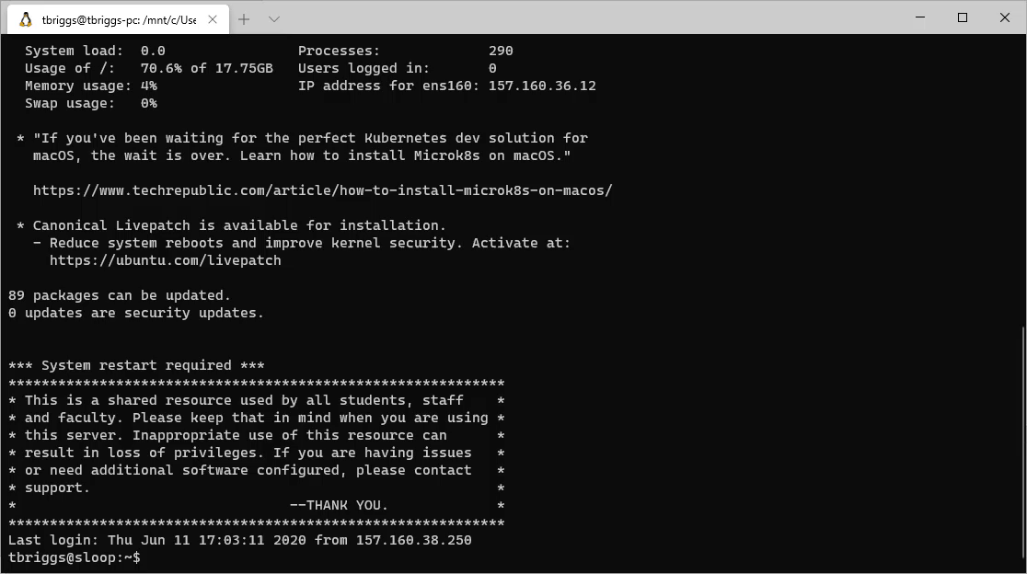
Real-World Analysis, Wireshark, Traceroute

Slide 35
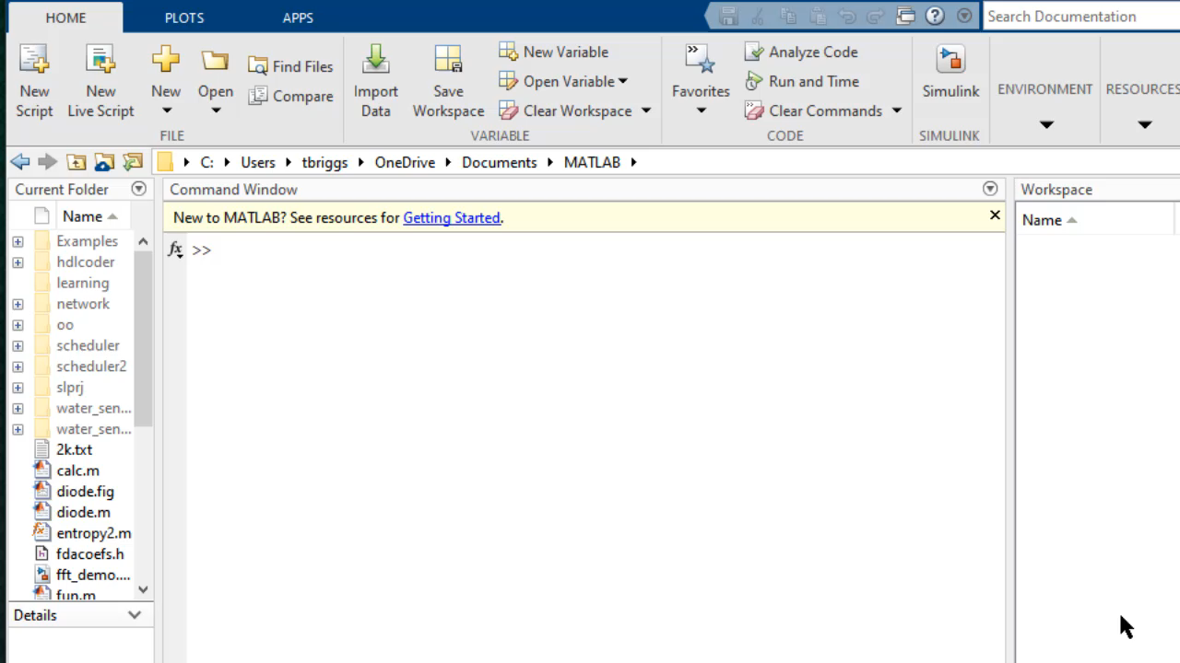
MATLAB & SimEvents Network Simulation

Slide 36
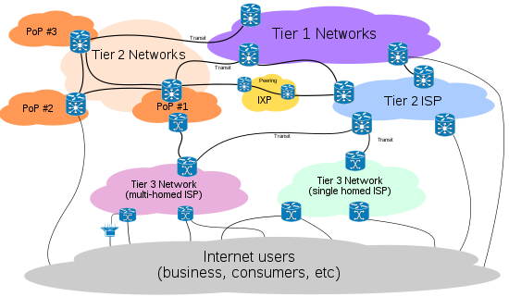
Internet Service Providers (ISP)
Internet is network of networks
  Internet Service Providers provide a connection from your network to theirs
Tiers and Peers
  Tier-1 ISPs are the large, international backbones that connect all of the other networks
  Tier-2 ISPs are the (still large) regional networks that interconnect with each other
  Tier-3 ISPs are the regional providers that typically resell service to direct customers
  PoP are Points of Presence in a particular region
Notes:
The Internet is a network of networks. To make it all work, networks need points of contact where they can exchange data from one to another in a shared traffic exchange point (IXP). By design, access to these global-scale IXPs is limited to the top networks to hand-off data between each other. The same strategy is replicated regionally, where the Tier-2 ISPs exchange data with each other (in that region) and with the Tier-1s. That strategy is also replicated locally, where the local ISPs exchange data with the Tier-2 ISPs.
Large companies may opt to skip layers of the network to gain better access to particular markets, and they will maintain a Point of Presence on a particular network. For example, if Netflix determined that the local networks could not deliver quality service to Netflix’s customers, they could purchase access to the regions exchange and maintain their own direct point of presence.

Slide 37
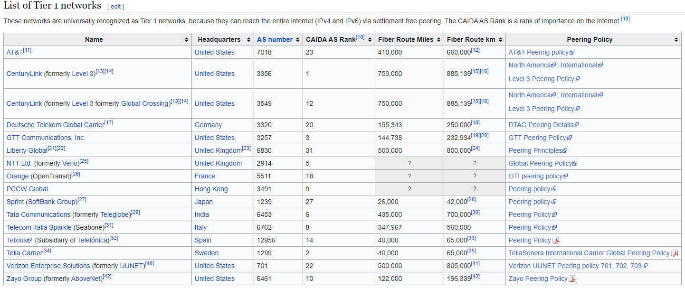
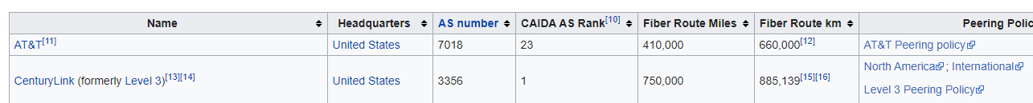
Tier-1 Providers
Loose definition of a Tier-1 Provider:
  All Tier-1 providers peer with every other Tier 1 globally and,
  The peering agreement allows access to all of the transit customers, which means that
  The Tier-1 network reaches all hosts every connected to the internet.
Notes:
Tier-1 providers are the largest internet carriers. There are only about 15 of them in the world, but their networks span the whole world. The Tier-1 IXPs exchange data between these networks, and access to these peerage sites is exclusive and expensive, and its members represent the largest telecoms in the world. By agreement, these companies do not charge each other for passing off of data, they share the costs of running the IXPs, and they give each other equal access to each others networks. Of course, they do not do this out of kindness and generosity.
To get an idea of the size of these networks, AT&T, based in the US, maintains an estimated 410,000 miles of fiber optic cables across the planet!

Slide 38
Internet Exchange Points
Locations where network providers lease space to exchange data
  Handle 10’s of Tb/s, may have hundreds to thousands of networks
  Always have presence from at least one of the Tier-1 providers
  High Security, Hard to get information…
Notes:
Internet exchange points are where these tier-1 providers meet the rest of us rabble. There are about one hundred of these facilities throughout the world, some huge ones, such as this one in New York City, others smaller and more regional. Most handle thousands of Gbps or Terrabits per second, some hundreds and thousands. Many of them handle telephone and other wireless communications as well.
Detailed information about these IXPs is hard to find, especially after 9/11. These physical locations are as important to our modern society as gasoline reserves and power stations, and many of these buildings are actually hardened physical structures. Take a look at this video.

Slide 39
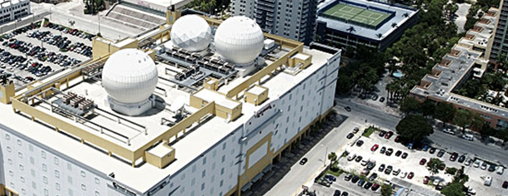
Example – Verizon’s NAP of the Americans
Nap of the Americas
  750,000 sq ft data center in Miami
  125,000 sq ft dedicated to “US Government”
  7 Tier-1 providers, 160 network carriers, 148 countries
  Every provider must have at least OC-48
  Design to survive Cat5 hurricane, 100 year flood
  Walls: 7in thick, steel reinforced concrete
  Cooling: 5 systems, 2000 tons of chilled water
  24-hour, armed security
  Power comes from two different
  electrical utility grids, directly
  powered by 13,200V feeds
Notes:
One of the largest IXPs in this country is Verizon’s Nap of the Americas…

Slide 40
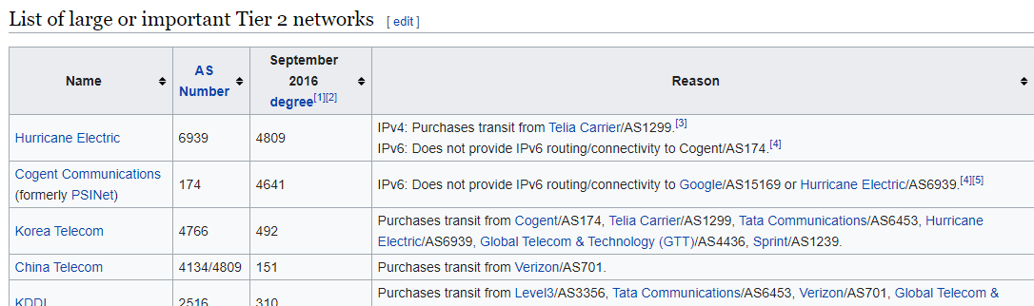
Tier-2 Provider
Tier-2 Providers…
  Peer with other networks (costs vary with local agreements)
  Purchase IP transit from Tier-1 Providers (costs determined by Tier-1)
  Resell access to Tier-3 Providers and PoPs
Notes:
Tier-2 providers, such as Comcast Xfinity and many national telecoms exchange data within their peers and subnetworks and rely on the tier-1 providers for interconnections traffic that they cannot handle. Like Tier-1 peers which exchange data for “free,” many Tier-2 providers agree to share costs between themselves. They make their money by reselling access to smaller ISPs and end-users.

Slide 41
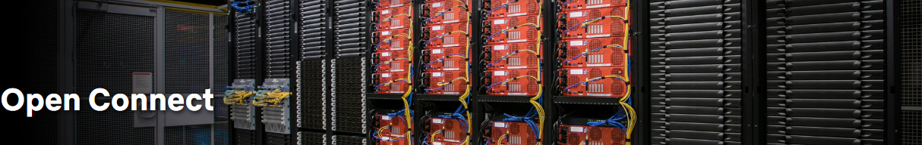
Content Provider Network / PoPs
Internet was not designed for services like Google, Netflix, and Facebook
  These companies maintain distributed datacenters around the world
  These data centers alleviate congestion and node delays by reducing the # of hops
  Google
    Maintains their own private TCP/IP global network, and then connects into many IXP
  Netflix
    Offers the “Open Connect” service to ISPs
    Places content servers directly into IXPs
Imagine competing with Netflix!
Notes:
When the internet was originally conceived, no one expected massive, global services such as Google, Netflix, and Facebook. In 2018, Netflix alone accounted for 15% of the global internet traffic. When the global pandemic shutdown much of the world, Netflix voluntarily disabled HD streaming because so many people were streaming that the regional internets were unable to handle demand.
For these companies services to scale-up to meet global demand, they have had to change the rules of the internet. For example, Google maintains its own global TCP/IP network, at times leasing “dark fiber” from the Tier-1 providers, at other times installing their own. With their own global network, Google is then able to participate in IXPs and deliver content faster and more reliably to users. Netflix has taken a different strategy, offering ISP’s access to “Open Connect” content servers that they can install on their networks. When a subscriber of that ISP starts to stream a movie, it can be served right from the local Netflix content server, leaving the more limited upstream network connections free for other subscribers.
Imagine what it would take to launch your own competitor to Netflix – this is clearly beyond the realms of possibility for most of us today. In other words, the days of some guys innovating something new in their mom’s garage are long over.

Slide 42
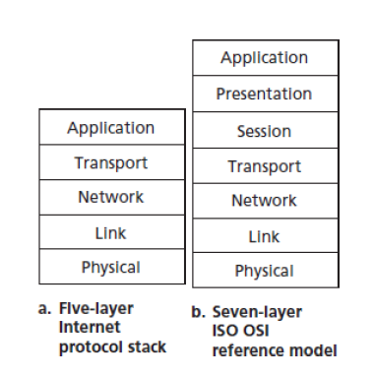
Protocol Layers
Each layer deals with a different representation and mechanism of moving data in a network
Application – data like an email message, a webpage
Transport – instructions to deliver data within a system
Network – instructions to deliver data between systems
Link – instructions to deliver between devices
Physical – electrical signaling
Presentation – how to interpret how data is exchanged
Session – synchronizing and delimiting data
Notes:
Throughout this lecture, we’ve talked about protocols – things like Ethernet which delivers data in frames across local wires or WiFi which delivers frames through the air. We’ve also talked about the Internet Protocol which can be used to send, route, and receive packets. IP packets can be wrapped into a WiFi or Ethernet frame and delivered locally to a router; the Ethernet frame doesn’t care what its sending, and the IP packet doesn’t care how its sent.
The reason that we can do this that each stage is just one layer of the 5- or 7-layer protocol layer-cake.
As the textbook points out, the 7-layer OSI model is the official standard held mostly by academics, while the 5-layer model is more practical and used by engineers.

Slide 43
Layer 1 - Physical
Protocol Data Unit: Symbol
Function: Transmission and reception of raw bit streams over a physical function
Example: Ethernet’s electrical encoding of bits
Common Types: Bluetooth, Ethernet, USB, CAN, …
Notes:
The physical layer deals with the mechanics of getting a digital bit from one location to another. At this layer, we’re taking data link frames and turning them into voltage differences or disturbances in the electromagnetic spectrum. At the receiver, we’re detecting these changes and turning them back into link frames.

Slide 44
Layer 2 – Data Link Layer
Protocol Data Unit: Frame
Functions: Reliable transmission of data frames between two nodes connected by a physical layer
Example:
  Medium Access Control (MAC) – Controlling how devices access the network
  Logical Link Layer (LLC) – Encapsulating network layer protocols, frame synchronization
Notes:
The data link layer deals with frames, and takes the network data and turns it into physical frames that can then be handed to a device for transmission. For example, the data link layer will wrap an IP message with an ethernet frame.

Slide 45
Layer 3 – Network Layer
Protocol Data Unit: Packet
Functions: Structuring and managing a multi-node network, including addressing, routing, and traffic control
Example: Internet Protocol (IP)
  Address remote, machine-independent addresses, routing, error checking
Notes:
The network layer is responsible for getting data from one computer to another, without respect to whether its local or not. This is the layer where internet routing occurs.

Slide 46
Layer 4 – Transport Layer
Protocol Data Unit: Segment / Datagram
Function: Reliable transmission of data segments between points on a network, including segmentation, acknowledgement, and multiplexing
Example: TCP and UDP
Notes:
The transport layer is responsible for taking application data from a program on one computer and getting to a program on another computer.

Slide 47
Layers 5,6,7 - Application
Protocol Data Unit: Data
Function:
  OSI 5 – Managing communication sessions
  OSI 6 – Translation of data between networking service and application, including character encoding, data compression, and encryption / decryption
  OSI 7 – High-level APIs, including resource sharing, remote file access
Example: Secure Shell (SSH)
  OSI 5 – The “Keep-Alive” protocol to keep channel open to remote
  OSI 6 – Encrypting / Decrypting and compressing the data
  OSI 7 – Emulating a remote terminal
Notes:
The application layer is the most vague and often not really considered by network engineers, except when the application isn’t performing very well. Basically, this layering, whether it is the just the top of the 5 layer model, or the full 3 layers of the seven layer model, is up to the application designer.

Slide 48
Encapsulation
Each layer in the cake wraps the data from a higher layer with its own envelope:
  User types a character, SSH encrypts, and sends to the network
  TCP layer wraps encrypted character with a TCP envelope, describing which connection this character belongs to (a virtual circuit!)
  IP layer wraps the TCP layer with the sender and destination IP addresses
  Network layer splits the IP packet, if needed into ethernet frames, sends out MAC addresses
  …
No layer can skip over another layer …
Notes:
Its important to note that each layer in the layer cake wraps the data from a higher layer with its own layer-specific envelope. Layers can’t be skipped, and the layer handlers can’t do anything with the data from another layer – so we would not expect an ethernet switch to pay attention to the IP packets – not all ethernet frames are IP packets, and not all IP packets will end up in an ethernet frame.

Slide 49
A little history…
Watch this video: https://www.youtube.com/watch?v=ILQeXZTOpkw
Notes:
History is always important, and one of the advantages that we have now is that many of our founders are still alive and willing to be recorded for posterity. For us, being able to see Vint Cerf give an interview is like a physicist being able to talk to Issac Newton. We should really take advantage of it, so watch this video about the history of the internet.
I think you’ll be surprised at how many of the terms used in this video you are already familiar with!

