Slide 1
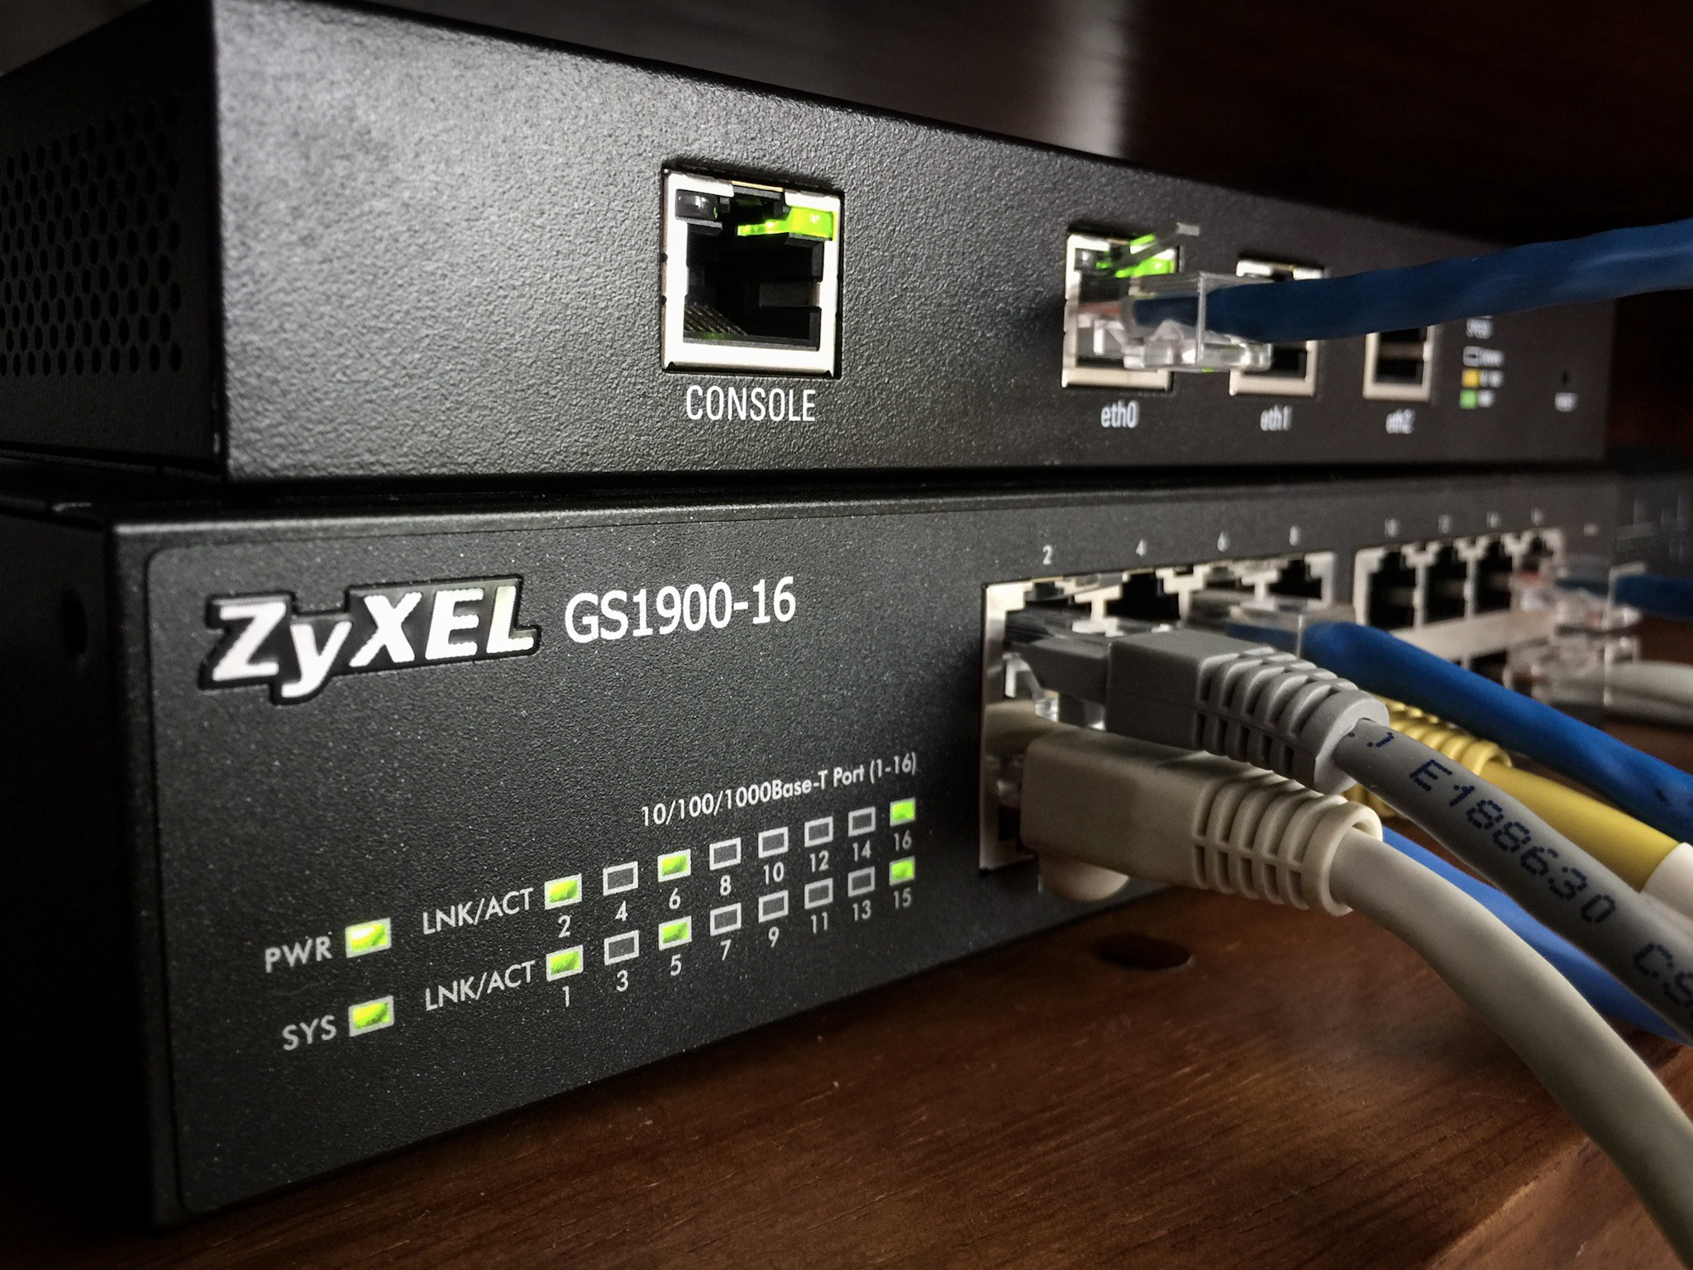
Network Layer
Chapter 4

Slide 3
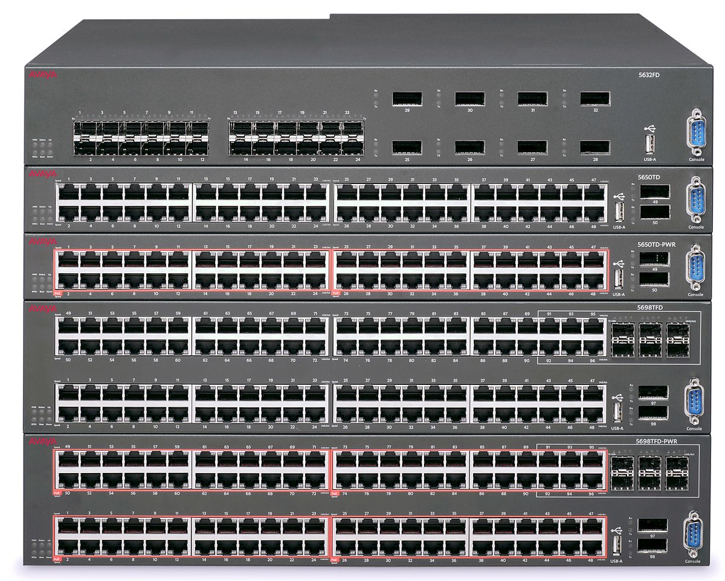
Routers & Switches
Part 1
This Photo by Unknown Author is licensed under CC BY-SA

Slide 4
Types of Networks
Local Area Network (LAN)
designed for high speed / low latency,
small-ish area, often a single building or small campus
typically involving only “customer premises equipment” (CPE)
Covered in chapter 5
Wide Area Network (WAN)
designed for long-haul, remote connections,
typically using lines leased from telephone / comms company
Interfaces to a LAN at a demarcation point

Slide 5
Wide Area Network Terms
Customer Premises Equipment – CPE
What the customer owns, manages, and is responsible for
Channel Service Unit (CSU) / Data Service Unit (DSU)
Used to connect data terminal equipment (DTE) to a circuit like a T1/T3
CSU/DSU provides common clock for line cards in a router to sync to telco
Demarc –
Physical point where provider’s responsibility ends and customer’s begins
Central Office / Switching Office
Connects customer’s network to providers’ switching network, also PoP
Local Loop –
Connects demark point to closest central office / switching office

Slide 6
Forwarding & Routing
Forwarding
Relaying packets from one network segment to another
Store & Forward or Cut-Through Switching
Routing
Uses information encoded in devices address to infer segment to forward to
Implies existence of rule table to make decision
Bridging
Makes no inference at all but broadcasts received data to all network segments
Usually only used for local decisions or to span media

Slide 7
Why Route?
Three types of segments:
Shared segment – all hosts share a single wire (10-base2)
Hub – multiple shares segments connect to a shared hub – still effectively shared
Switches – switch / store-forward traffic
LAN Congestion – “Collision Domain”
Too many hosts
Broadcast storms
Multicast traffic
Bandwidth mismatch
Different types of media
Routers are used to break-up broadcast domain, partition networks into different segments, but now we need a way to direct traffic to different segments.

Slide 8
Routing
Two criteria:
Ethernet / device IDs – globally unique, but seemingly random assignment
IP addresses – hierarchical, first bits assigned to a network, last bits assigned to a host
LAN / WAN
LAN may have routing with L2/L3 switches
WAN almost always uses L3 routers
Routers vs. Switch?
Router doesn’t forward broadcast message or multicast
Routers filter L3 messages, switches don’t
Switches work on device IDs, try to dynamically build map of devices connected to each port
Routers work on address, fixed hierarchy of routers

Slide 9
Forwarding Mechanisms
Source Routing
Packet includes a selected route determined by sender
Each router takes strips top instruction and resends, drops packets that don’t match
Typically used in constrained / local network
Sources need to know complete path or discover it
Variable (unbounded?) packet lengths due to lengthy paths

Slide 10
Forwarding Mechanisms
Virtual Circuits
Sender establishes a “virtual circuit” through negotiation with intermediate devices
Sent data always follows that circuit
Resembles circuit switching but still based on packet switched networks
More efficient – don’t need to inspect packet contents
More flexible – allowing different paths for each network flow
Allows bandwidth reservations
Finding / reserving a path incurs overhead, not suitable for ad hoc comms

Slide 11
Forwarding Mechanisms
Table of Global Addresses
Routers keep a list of next hops
Packets carry a destination
Routing decision based on selecting next “best” hop for a given destination
Routers need to communicate “best routes”
Source won’t know if a route exists or not
Global internet addressing means routers need to handle huge #’s of “best routes”

Slide 12
Network Service Model based on Routing
Network service model describes characteristics of delivery of packets
Describes what users of a network can expect – not implementation mechanisms
Services may include:
Guaranteed delivery (or not)
Bounded delays on delivery time (or not)
In-order or out-of-order delivery
Bandwidth guarantees (minimum or maximum)
Security
Internet’s network service model:
Best-effort service – packets, bandwidth, and latency aren’t not guaranteed
Network Neutrality – local provides treat packets equally (or not)

Slide 13
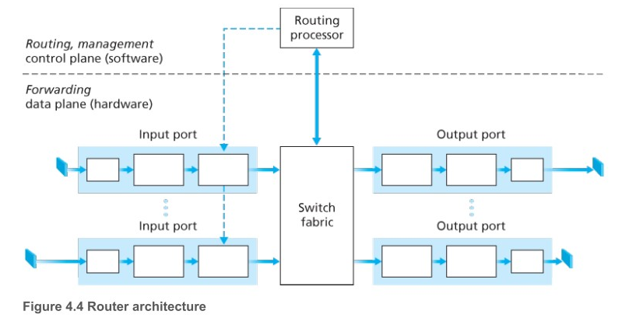
Routers
Primary functions
Read packets from input port
Determine an output port to queue for delivery (or drop)
Manage the routing tables used to map input to output
Two types:
Hardware routers – use a hardware accelerated switching fabric
Software routers – use CPU to make routing decisions
The end of software routers? Software has to forward packets at 51.2ns on a 10gbps link to avoid queueing.
Big impact coming for cloud computing!

Slide 14
Fast Address Matching
Routers match on address patterns to perform fast lookups
Principle of longest prefix match
Pattern | Interface
1100 1000 0001 0110 1000 0XXX XXXX XXXX | 0
1100 1000 0001 0110 XXXX XXXX XXXX XXXX | 1
1100 1000 0001 XXXX XXXX XXXX XXXX XXXX | 2
XXXX XXXX XXXX XXXX XXXX XXXX XXXX XXXX | 3
Which interface should 1100 1000 0001 0110 1000 0101 1101 0010
forward to?

Slide 15
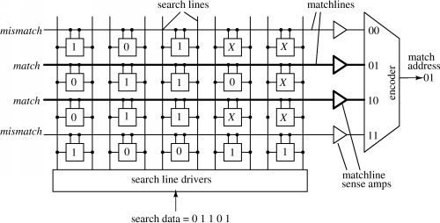
Content Addressable Memory
Hardware switching depends on content addressable memory (CAM)
Cisco calls theirs’ “Ternary Content Addressable Memory”
Formulation of content cells / priority encoding needs to be done during configuration. Software can assist in building these rules.

Slide 16
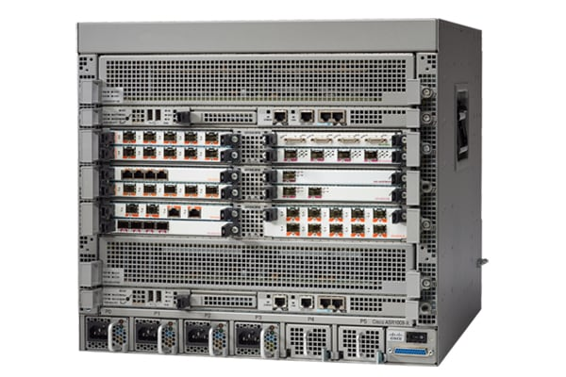
Switching Technology
Memory based
Input data is copied to an output queue on the selected output port
Example: Catalyst 8500 series routers
Bus based
Input is transferred directly to output by hardware
Can be the same “line card” or via shared bus
Example: Catalyst 9000 series router, 25.6 Tbps aggregate switching capacity
Interconnection Network based
Dedicated, but software controlled network of parallel busses to allow N simultanoues packets to switch at a time.
Example: ASR 1000 series, 200Gbps system bandwidth,

Slide 17
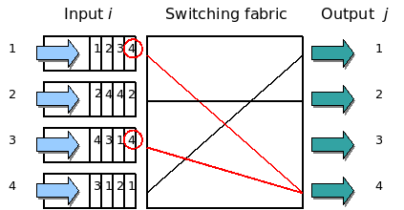
Queueing
Queueing – already discussed
Network congestion causes queues to fill
Router delays can add to congestion
Result the same – dropping packets
Head-of-line blocking occurs when switch fabric is insufficient
A packet is held due to switch capacity being used by other devices even though there isn’t contention for destination port.
Head-of-line blocking example: The 1st and 3rd input flows are competing to send packets to the same output interface. In this case if the switching fabric decides to transfer the packet from the 3rd input flow, the 1st input flow cannot be processed in the same clock cycle. Note that the 1st input flow is blocking a packet for output interface 3, which is available for processing.
https://en.wikipedia.org/wiki/Head-of-line_blocking

Slide 18
More Math!
Buffer sizes for adequate performance in queueing routers,
where $B$ is the buffer size (in bits), $RTT$ is the round-trip-time (in seconds), and $C$ is the link bandwidth:
$$B=RTT×C$$
Example: $RTT=250ms=2.5×{10}^{−1}$ and $C=10Gbps=10×10^9$, then $B=2.5×{10}^{−1}⋅1×{10}^{10}=2.5×{10}^{9}b=2.5×{10}^{8}bytes$ (per port!)
For large numbers of connections, individual flows are likely to be shorter, have similar window sizes, and smaller receive windows, and not constantly sending data: $B=RTT×\frac{C}{N}$

Slide 19
Packet Scheduling
Scheduling algorithms:
Similar, but a little different than process scheduling: no process blocking or starvation
FIFO – first in, first out
Priority – attach a priority method to each message, pick highest priority message
Round-Robin – create queues for each service class, pick from each queue
Weighted Fair Queueing – packets attached to each per-class queue, then WFQ pulls packets as in RR, but assigns each class a fraction of bandwidth based on weight
One problem similar to OS:
Buffers may fill with lower-priority traffic leading to priority inversion
Notes:
Priority methods: source, destination addresses or ports
Urgency encoded in packet
Service level encoding
Network control messages
Payment agreements (anti-net neutrality)

Slide 20
Generalized Forward Scheme / Software Defined Network
General forward scheme uses “match + action” rules
There are effectively 11 fields that can be used as matches: Note: inclusion of layer 2 – hardware MAC addresses, and layer 4 TCP/UDP port numbers.
Action: Forward, Drop, Modify-Field
Next generation routing – includes ‘firewall’ with routing decision

Slide 21
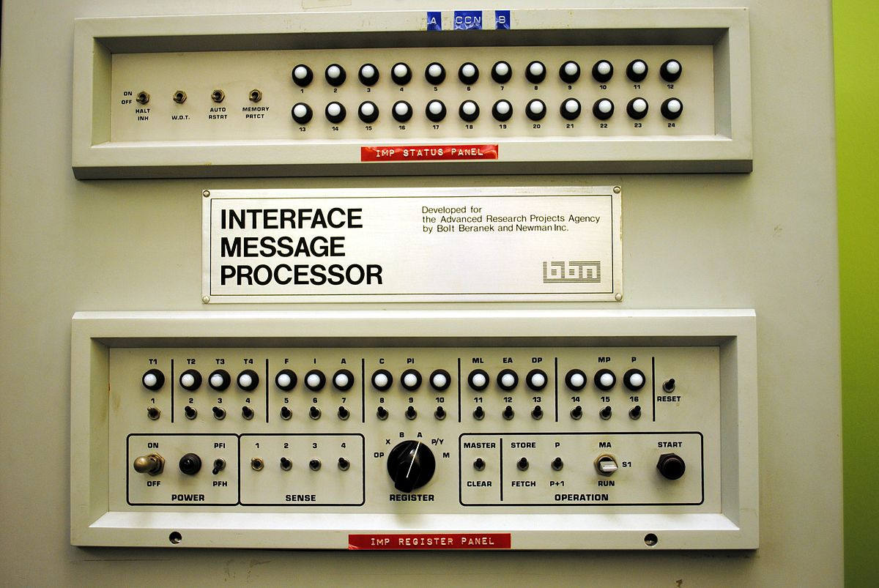
Internet Protocol
Section 2
This Photo by Unknown Author is licensed under CC BY-SA

Slide 22
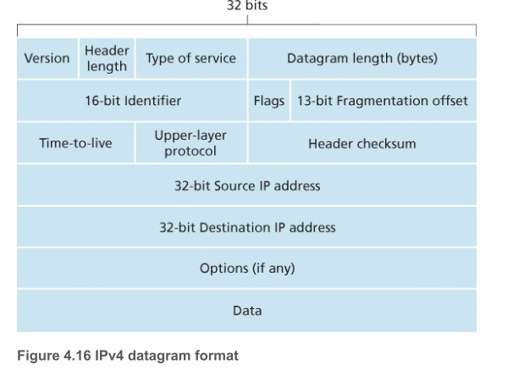
Internet Protocol
The Internet Protocol
Layer 3 of the Internet’s layer cake
IPv4 is “original” – based on 32-bit addressing scheme
4 billion internet addresses
Address space is effectively exhausted
IPv6 is “replacement” – based on 128-bit addressing scheme.
$3.4×{10}^{38}$ addresses
Notes:
Vint Cerf, 1978, later updated to IPv4 in 1983. IPv6 began development in 1998,

Slide 23
Internet Protocol v4
Four types of network addressing methods:
Unicast – A one-to-one addressing, sender sends to one receiver
Broadcast – A one to all addressing scheme, single datagram goes to all endpoints in the broadcast domain.
Multicast – One to many, or even many to many, datagrams are delivered to a group of recipients in the broadcast domain.
Anycast – A single destination has multiple routing paths to two or more endpoint destinations, routers will select the best path to one of them (i.e. send this to any one of these)
Geocast – Delivers to a group of devices in a geographic region.
Underlined means supported by IPv4
https://en.wikipedia.org/wiki/Anycast

Slide 24
IPv4 Header
Fields of IPv4 Header
Version – 4 bits
Header length - 4 bits (where payload begins)
Type of service – ECN, or other quality fields
Datagram length – length of IP packet (in bytes)
ID, Flags, Frag, Offset – Fragment / reordering fields
TTL – time to live
Protocol # - 6 – TCP, 17 – UDP¹
Checksum – 1’s complement
Source & destination addresses
Options
Payload
[1] https://en.wikipedia.org/wiki/List_of_IP_protocol_numbers

Slide 25
IP Datagram Fragmentation
Large IP packets may be fragmented into multiple IP packets
Layer 2 has an MTU, greater than this and link frames may be fragmented
Every router on path may use different MTU!
Packet may be split into multiple fragments (by routers) and reassembled (by routers)
On transmit
Sender stamps IP w/ a unique ID, source, and destination
Routers
Split into fragments, create smaller IP datagrams w/ same id, source, and destination
That means that a payload may not be UDP/TCP, but a fraction of one
Flag = 1 for all but last fragment, offset sets the location of the fragment
No retransmit – lost packets are just lost – depends on TCP to rexmit

Slide 26
IP Addresses
IP Addresses are 32-bit
Assigned to each host interface (1 to many)
Represented as: binary, hexadecimal, or “dotted quad” decimals Sloop: 157.160.36.12 / 10011101.10100000.00100100 .00001100 / 9D.A0.24.0C
Addresses must be global unique
Assigned to organization by IANA in “clumps” called a network address
Locally, organization can subdivide network into a subnet, or can leave whole
Organization can route (or not) network
Internet routes between networks, leaving subnets for local routing
For example,
globally, Ship is “157.160.X.X” – we only need one external route for the entire campus
Internally, Ship is subdivided into multiple subnets: 157.160.36.X is SoE

Slide 27
Classes Interdomain Routing - CIDR
CIDR is a representation for IP addresses
Describes the separation between subnet and local host addresses
Format: a.b.c.d/x – “dotted quad” plus # of bits in network address
Thus, routers only need to store the CIDR address for each entry:
Ship is : 157.160.0.0/16, SoE is: 157.160.36.0/22
CIDR makes it “easy” to determine the layout of the host addresses
Two host addresses are reserved – “.0” is the network #, “.255” is the broadcast, and typically, there is a router address, e.g. “.1”, but that isn’t required, so we say 2 reserved (hint: first / last addresses in subnet are reserved)
CIDR | Hosts | CIDR | Hosts
/30 | 4 – 2 = 2 hosts | /24 | 256 – 2 = 254
/29 | 8 – 2 = 6 hosts | /23 | 512 -2 = 510
/28 | 16 – 2 = 14 hosts | /22 | 1024 – 2 = 1022
/27 | 32 – 2 = 29 hosts | /21 | 2048 – 2 = 2046

Slide 28
IP Address Assignments
Internet Assigned Number Authority (IANA)
Sets standards for global IP address allocation and root zone management of DNS
Internet Corporation for Assigned Names and Numbers (ICANN)
Implements the standards set by IANA
Maintains central assignment databases
Assigns addresses to local registrars and maintains “WHOIS” database
Local registrars:
Assigns domains to assignment blocks
Assigns numbers to service providers
Service providers:
Assigns fractions of their IP space to their customers

Slide 29
IP Addresses – Network Classes
IP version 4 has five “classes” of networks
Initially used for `classful routing’
Class | Leading Bits | Size Net # | # Nets | Addrs / Net | Start / End
A | 0 | 8 | 128 | 16M | 0.0.0.0 – 127.255.255.255
B | 10 | 16 | 16384 | 64K | 128.0.0.0 – 191.255.255.255
C | 110 | 24 | 2,097,152 | 256 | 192.0.0.0 – 223.255.255.255
D | 1110 | NA | NA | NA | 224.0.0.0 – 239.255.255.255
E | 1111 | NA | NA | NA | 240.0.0.0 – 255.255.255.255
Shippensburg’s IPs start at 157.160, 157 in binary is: 1001 1101, our address starts with the “10” prefix, so we have on of the 16,384 class B networks ever assigned!

Slide 30
IPv4 Reserved Addresses
CIDR | # of addrs | Description
0.0.0.0/8 | 16M | Current network
10.0.0.0/8 | 16M | Local class A
100.64.0.0/10 | 4M | Shared range for CGN
127.0.0.0/8 | 16M | Loopback addresses
169.254.0.0/16 | 64K | Link local between hosts
172.16.0.0/12 | 1M | Private / Local addrs
192.0.0.0/24 | 256 | IETF Protocol Assignments
192.0.2.0/24 | 256 | TEST-NET-1
192.88.99.0/24 | 256 | IETF Reserved
192.168.0.0/16 | 64K | Private / local addresses
192.18.0.0/15 | 128K | Benchmark subnets
198.51.100.0/24 | 256 | TEST-NET-2
203.0.113.0/24 | 256 | TEST-NET-3
224.0.0.0/4 | 24M | Multicast addresses
240.0.0.0/4 | 24M | Reserved
255.255.255.255/32 | 1 | Broadcast address

Slide 31
Private Parts
Each routing class defines a range of private network addresses
These are never routed to the global internet (if they are, they’re dropped)
They can be used internally to organize a network or create a router backbone
Class | Range | Network Bits | # machines
A | 10.0.0.0/8 | 24 | 16M
B | 172.16.0.0/12 | 20 | 1M
C | 192.168.0.0/16 | 16 | 64K

Slide 32
IP Address Space Exhaustion
In 2011, IANA assigned its last block of IPv4 Addresses
Sub-registrars still have some space
Originally forecast to happen in the early 1990’s
New technologies have accelerated problem
Multiple addresses per device – your cell phone has wireless, Bluetooth, and cell!
Small Office / Home Office (SOHO) – 20 – 100 devices per location
New technologies have ameliorated the problem
NAT / Carrier grade NAT
IPv6

Slide 33
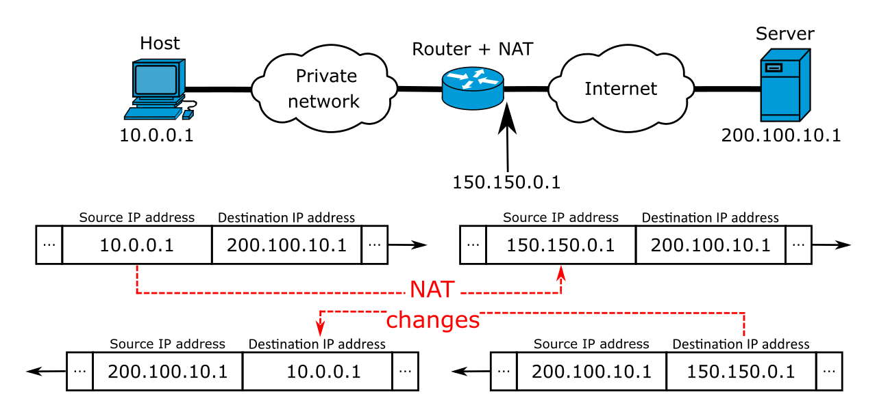
Network Address Translation - NAT
NAT is a method of remapping one IP address space into another
Public facing IP address – an address that is part of the IANA assigned address space
Private / internal IP address – a non-routable address that is provided by NAT service
NAT uses a “one to many” approach – one public address maps to many private addresses.
NAT tracks your outgoing requests and keeps a socket connection established for a flow.
NAT can also accept incoming requests and forward to a private machine to enable servers in the private network.
Only one service per IP

Slide 34
Carrier Grade NAT (CGN)
Carrier Grade NAT
Used for primarily residential networks, subscribers given a private network address
The subscriber’s traffic gets routed through ISP’s network and rewritten to face the public internet
Shifts NAT rewriting from local SOHO to middle-tier on ISP
Sometimes called NAT444 – connections pass through 3 different IPv4 addressing domains:
SOHO
ISP Middle Ware
Public Internet
Heavily used in mobile networks – internal routing can migrate through cells
464XLAT – Locally: IPv4, IPv6 in private network, and then rewritten to IPv4 in public

Slide 35
Critique of NAT
Breaks the end-to-end principle
Remember from chapter 2 – application specific features reside only in the end-nodes
NAT breaks this rule by embedded application specific re-writing in routing nodes
NAT has security, scalability, and reliability issues
Carrier has to reassemble traffic flow – opens potential for reconstructing data streams
E.g. ISP could, in theory, inject advertisements into your web pages
Hosting services
NAT makes it difficult, CGNAT makes it impossible to host services
Diminishes value to IP address exhaustion problem

Slide 36
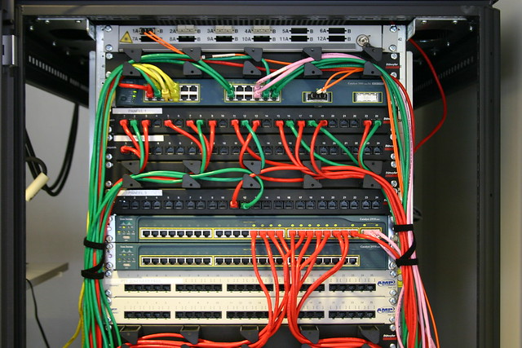
IP version 6
Part 3
This Photo by Unknown Author is licensed under CC BY-SA-NC

Slide 37
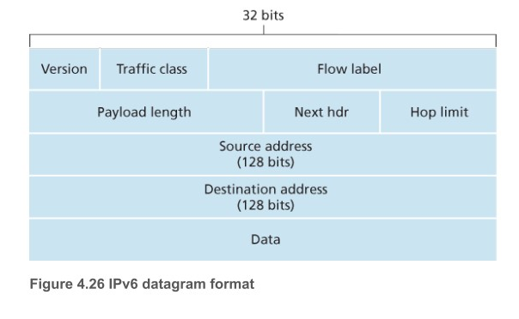
Internet Protocol Version 6
Addresses move to 128-bit
Allows: Unicast, Multicast, and Anycast
Streamlined 40 byte header
Flow labelling
Removes:
Fragmentation & Reassembly
Header checksum
Options
IPv5 was used for experimental Internet Stream Protocol, which predated VOIP & ATM networks

Slide 38
IPv6 Addresses
128-bit represented as 8 16-bit hex digits – hexatets or quibbles
Shorthand:
Leading zeros can be removed from any group: :00fd: = :fd:, :f00d: = :f00d:
One consecutive section of zeros can be replaced by ::
Example 1:
2001:0db8:0000:0000:0000:ff00:0042:8329
2001:db8:0000:0000:0000:ff00:42:8329 # rule 1, leading zeros
2001:db8::ff00:42:8329 # rule 2, consecutive zeros
Example 2:
2001:0000:0000:00db:0000:0000:0042:0001
2001:0:0:db:0:0:42:1 # rule 1, leading zeros
2001::db:42:1 OR 2001:0:0:db::42:1, but NOT: 2001::db::42:1!

Slide 39
IPv6 Link Local Addresses
All interfaces get a link local address that is valid only for the network segment or issuing broadcast packets (e.g. for configuration discovery)
IPv6 uses: fe80::/64 (upper 10 bits are fixed, the remaining 64-bits are selected randomly. Initially, the MAC address for the interface, but has since been replaced with a secure hash of the MAC address.

Slide 40
IPv6 Addressing Additional Features
Hierarchical address assignment
Formation of super networks
Allows for route aggregation – e.g. Comcast can be assigned 1 super network, and then the world only needs 1 entry for all of Comcast’s customers
No need for CIDR
Multicasting addresses built into subnet – no need for special addresses
Stateless Address Autoconfiguration (SLACC)
fe80::/64 – point to point local link – lower 64-bits pick by local machine
If no other IPv6 network present, this is sufficient for LAN machines to communicate!

Slide 41
But wait, there’s more!
Neighbor Discovery Protocol
Nodes can issue broadcast requests (over their SLACC assigned addresses)
Allows routes and network prefixes to be shared from neighboring computers
Alleviates the need for DHCP or other protocols
Internet Protocol Security (IPSec) and Internet Key Exchange (IKE)
Both are built into IPv6, allowing special header types to be encrypted
Simplified Routing
Headers are greatly simplified, match modern computer word sizes (128-bit not uncommon), no checksums, no fragments, and no options, thus no optional lengths
Mobility
Entire subnets can move to new routers without disrupting global routes – move within hierarchy
Jumbograms
Ipv6 can allow up to 4GB packets, though rarely fully supported today

Slide 42
An Example
Comcast has been assigned the global IPv6 net: 2601:980::0/32
That is, the first 32-bits are assigned to Comcast, given them $128−32=96$ bits of addresses. This is their “super-network.”
Comcast further subdivided this so that each customer is assigned another 32-bit range (e.g. c100:35). This allows 4 billion customers (more than current IP address!)
A SOHO subscriber’s router is assigned “2601:980:c100:35::1/64”
Without using NAT, subscribers can have up to $2^{32}$=4 billion machines in their SOHO network.
Locally, each interface is given a SLAAC address, e.g. 2601:980:c100:35:5130:4cac:402f:fc3e
Because of dhcp (coming up), each interface is also given an assigned address: 2601:980:c100:35::3eb

Slide 43
IPv6 Address Classification
Unicast Address – identify single interface
Link local format – non-routable / local subnet only
Multicast – globally routable
Routing Prefix >= 48 bits | Subnet Prefix <= 16bits | Interface 64-bits
Prefix 10-bits | Zeroes 54-bits | Interface 64-bits
Prefix 8-bits | Flag 4-bits | Service Agreement 4-bits | Group ID 112-bits
0 – reserved | 4 – admin local | 8 – org local | 12 – NA
1 – interface local | 5 – site local | 9 – NA | 13 – NA
2 – link local | 6 – NA | 10 – NA | 14 – Global
3 – real local | 7 – NA | 11 – NA | 15 - NA

Slide 44
IPv6 URL’s
URLs can be complicated, so a new notation was made:
http://[2001:db8:85a3::7348]:443/

Slide 45
Scoped Link-Local Addresses
Link-local addresses can be scoped to a specific interface:
BSD / OSX use this to identify which interface the address is attached:
fe80:3:……. // interface 3
Also: http://[fe80:3:d939:.....%eth2]/

Slide 46
IPv6 Special Addresses
Like IPv4, IPv6 has special addresses:
CIDR | # | Use | Purpose
::/0 | 2^128 | Routing | Default route
::/128 | 1 | Software | Unspecified address
::1/128 | 1 | Host | Loopback / Local machine
::FFF:0:0/96 | 2^32 | Software | IPv4 mapped address
::FFFF:0:0:0/96 | 2^32 | Software | IPv4 translated
64:FF9b::/96 | 2^64 | Global inet | IPv4/v6 translated
100::/64 | 2^100 | Routing | Discard
2001::/32 | 2^96 | Global Inet | Terredo Tunnel
2001:20::/28 | 2^96 | Software | ORCHID v2
2001:db8::/32 | 2^112 | Documentation | Example address space
Fe00::/7 | 2^121 | Private network | Unique link local
Fe80::/10 | 2^118 | Private Link | Link-Local
FF00::/8 | 2^120 | Global Internet | Multicast

Slide 47
Subnets
Part 4
This Photo by Unknown Author is licensed under CC BY-SA

Slide 48
Subnetting
Subnets
Reasons for subnetting:
Balance performance
Extend the distance of the network
Isolate problems and reduce odds of catastrophic failure
Reduce collision domains & broadcast storms
Partition network into separate independent regions
Possibly reduce costs
Costs to subnetting
Need to join subnets together at L2 or L3
Additional routing hardware (incurs extra cost !?!)

Slide 49
Segments using Bridges
Recall bridges
Connect two or more LAN segments, irrespective of media
Bridges retransmit data between segments, can do some filtering

Slide 50
Segments using Switches
Switches work on L2
Connect multiple LAN segments
Lead to a “star” topology
Switch on device addresses
Can also extend distances
Pass data simultaneously
Switches can act as bridges
Security

Slide 51
Segments using Routers
Routers work on L3
Need rules to determine when to forward data
Media transitions
Routers don’t just work on ethernet (or compatible)
Broadcast control
Packet filtering
VLAN communications
Large packet / fragmentation into multiple device frames

Slide 52
Things to know when creating subnets
Steps to create:
Determine # of required network IDs
One for each LAN subnet
One for each WAN (router) connection
Determine number of hosts on each subnet
One for each host / interface
One for each router interface
One for broadcast address
One for network address
Create subnet mask
Assign mask for entire network
Subnet ID for each segment
Range of host IDs for each segment

Slide 53
Example – Class C Address
Suppose we have a class C address: 192.168.10.0 / 25
What is the subnet mask?
How many subnets?
How many hosts per subnet?
What are the valid subnets?
What are the broadcast and network addresses for each subnet?
Valid hosts?
Notes:
Netmask: 255.255.255.128 / 24 + 1 bit
Subnets: class C has first 24 bits fixed, so we have 1 bit left, so two subnets
How many hosts per subnet? 7 bits for hosts, but we lose two: 2^7-2 = 126
Valid subnets? 192.168.10.0 and 192.168.10.128
Broadcast for each subnet? 192.168.10.127 and 192.168.10.255
Valid hosts: 192.168.10.1 … 192.168.10.126, and 192.168.10.129 .. 192.168.10.254

Slide 54
Subnet Example
A company has four different “zones” to their network configuration:
Server Zone – publicly facing IP addresses for servers, 7 of them
NAT zone – supports NAT to about 45 users in the various departments, including printers
VPN zone – supports remote workers / VPN & remote desktops (16 connections)
Intranet Zone – internal servers, not public accessibly (hopefully) qty 15.

Slide 55
Example – Subnet with two hosts
Design a network mask that allows two hosts to communicate point-to-point

Slide 56
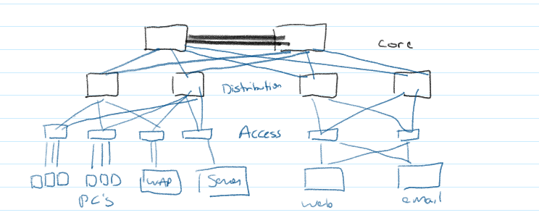
Network Topology, ala Cisco
3-Tier Network for Routing: Core, Distribution, Access
Core
Switch traffic as fast as possible
Failure in core results in catastrophic network failure (locally)
Never slow down traffic, so
No access lists
No routing between VLANs
No packet filtering
No workgroup access
Design of core:
Highly reliable
Speed & redundancy
Optimize / rebalance routing tables dynamically

Slide 57
3 Layer Routing Topology - Distribution
Distribution
Workgroup / Aggregation layer
Provide routing, filtering, and routing to WAN
Determines how packets enter core
Distribution layer is where policies are enforced
Routing
Access list, filtering, queueing
Security & network policies
NAT
Firewall
Routing VLAN
Define broadcast /multicast domains

Slide 58
3 Layer Routing Topology - Access
Access Layer
Controls user and workgroup access to resources
Network resources users need locally should be here – e.g. local file servers, print servers
Helps to unload distribution layer

Slide 59
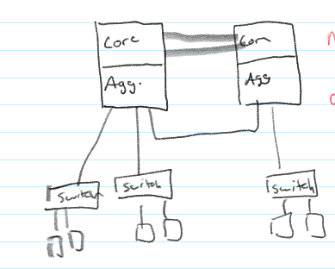
Collapsed Core (2-tier)
Collapses the core and distribution routers into one unit
Takes advantage of Moore’s law…
Main reason: cost savings
Disadvantages: scalability, size is limited to core capabilities

Slide 60
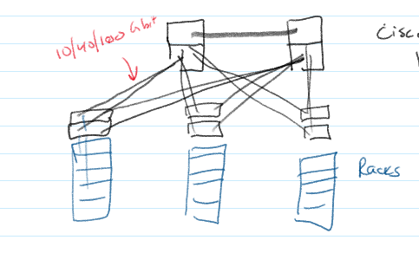
Spine-Leaf Topology
Another Cisco topology is the spine-leaf topology
Uses “Top of Rack” switches in each network chassis
Servers are redundantly connected to two ToR switches
Cisco has purpose-built Nexus switches for this purpose
Spine only connects to other ToR switches
All ToR switches have same latency
High bandwidth uplinks handle load-up, prevent slow downs to shared Core

Slide 61
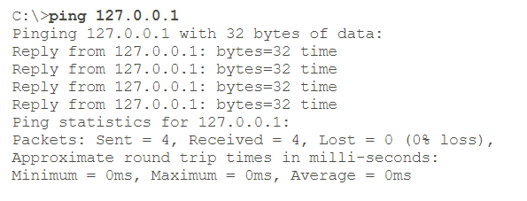
Basic Troubleshooting - Ping
Ping
Uses ICMP to send messages to remote IP address
Ping localhost – if fails, local configuration issue
Ping local IP address – if fails, network card b0rked
Ping gateway – if it fails, physical LAN cable or router problem
Ping remote server – if it fails, problem with WAN connection
Ping “well known” server like 8.8.8.8 – if it fails, probably a nearby WAN problem

Slide 62
Basic Troubleshooting – Traceroute
Traceroute
Uses ICMP messages to passively guess route traffic is following
UNIX: tracroute, Window: tracert

Slide 63
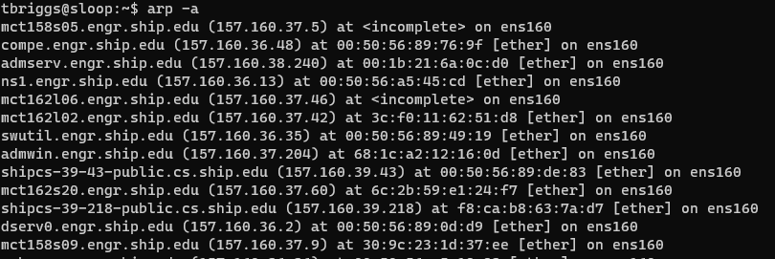
Basic Troubleshooting - ARP
ARP – Address Resolution Protocol
Layer 2 “ethernet” requires the hardware MAC address of receiver
“arp –a” command lists IPs and hardware MACs – if not found, or mismatch, then there is a layer 2 problem, not a layer 3 problem:

