Slide 1
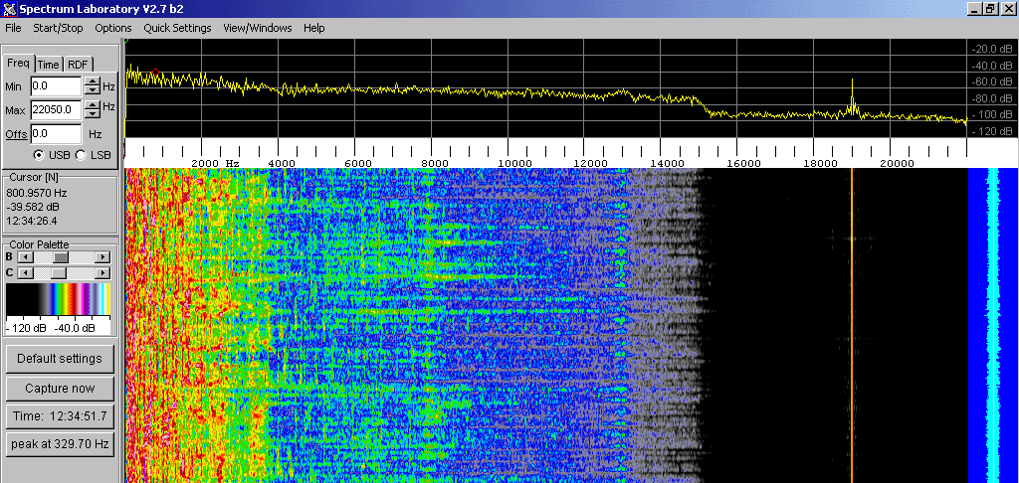
Wireless Networks
Chapter 7
This Photo by Unknown Author is licensed under CC BY-SA

Slide 2
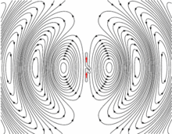
Radio Wave
Radio waves are a type of electromagnetic radiation
Coupled electric and magnetic field (EM)
Wave lengths in EM spectrum, longer than infrared light
30 Hz (length = 10,000 km)
300 GHz (length = grain of sand)
Same properties as light waves:
Standing waves
Refraction
Diffraction
Polarization

Slide 3
Speed, Wavelength, Frequency
Speed
Radio waves in vacuum travel at speed of light, marginally slowed based on permittivity and permeability of the material
299,792,458 meters / second
Wavelength
Distance from one peak of the wave’s field to the next, inverse of frequency

Slide 4
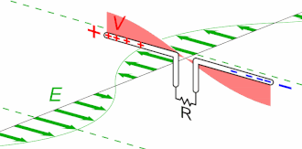
Sending & Receiving
Sending radio waves
Radiated by charged particles, accelerated by time-varying electric currents
Electrons flow back-forth in a specially shaped conductor called antenna
Radio transmitter applies oscillating electric current to antenna and antenna radiates the power as radio waves
Receiving
An antenna is used to capture received radio waves
Received particles push and pull electrons in the conductor
Radio waves induce a current flow in the antenna, results in a voltage across the receiver.

Slide 5
Propagation Characteristics
Radio waves propagate differently than light waves due to long wave lengths
Line of Site –
Travel in a straight line from the transmitting antenna to receiving antenna
At low RF, can pass through objects (buildings, foliage, etc).
Only method available > 30MHz
Limited by curvature of earth to 64km / 40 mi
Ground Waves –
Due to diffraction, vertically polarized waves follow surface contours of earth
Used by military for earth-wide messages (e.g. sub underwater)
Skywaves –
Bounce off ionosphere, “over the horizon” communications

Slide 6
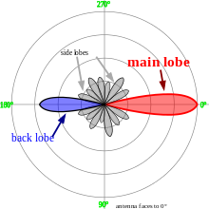
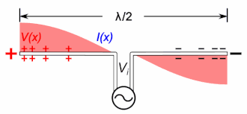
Antenna
The primary interface between transmitter and receiver in radio application
Specially designed to act as a resonator for a particular frequency
Size and shape of an antenna
Depends on frequency of the signal
Determines the sensitivity / transmission power
Shape of the radiation field around the antenna

Slide 7
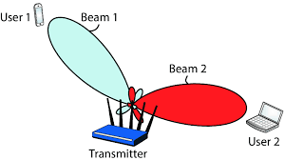
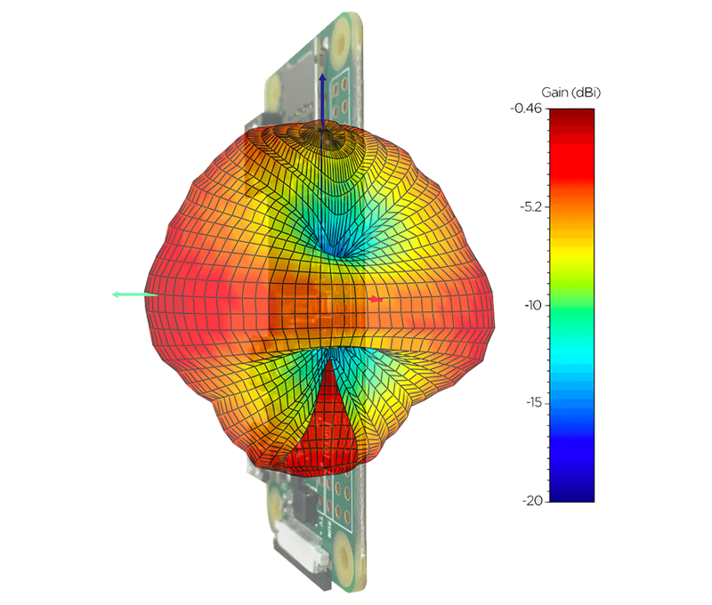
Beamforming
Signal processing technique using sensor arrays for directional signal transmission and reception.
Uses an antenna array using constructive interference to amplify a signal along a particular phase angle, and destructive interface at other angles
Used in all new high-speed techniques: 3G, 4G, 5G, WiFi AC, …

Slide 8
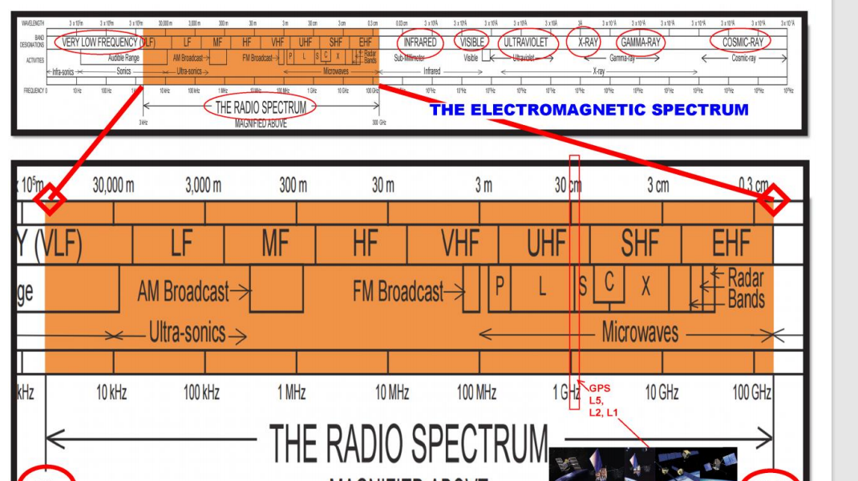
Radio Frequency Spectrum
The frequency spectrum is divided into different “bands”
Managed by FCC to control access and keep people from jamming airwaves

Slide 9
Classification of Wireless Networks
 | Single Hop | Multi-Hop
Infrastructure | 802.11 4G LTE | Zigbee Mesh networks
No Infrastructure | Bluetooth | Mobile ad hoc networks Vehicle ad hoc networks
Infrastructure – Requires use of a base station, often an end node
Hops – # of radios that the signal can pass through to arrive at a destination

Slide 10
Wireless Link Characteristics
Wired Network | Wireless Network
Signal strength remains constant through cables | Signal strength drops due to attenuation over distance
Latency controlled by distance | Latency may be impacted by many factors
Cabling prevents cross-talk | Other emission sources can interfere, e.g. microwaves and 2.4GHz
Cables are point-to-point | Emissions are broadcast into the atmosphere, can bounce off of other surfaces, resulting in blurring at the receiver, or surprisingly distant reception
Error measured in BER | Error measured in BER and SNR
Largely immune from location, orientation of cables, etc. | Performance depends heavily on location, orientation of antennae

Slide 11
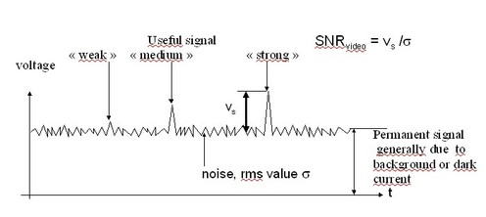
Signal to Noise Ratio (SNR)
SNR is a measure of the strength of received signal over the “noise floor”
$$SNR=20\log{\frac{Vs}{Vn}}$$
Larger SNR is better (either more signal or less noise)

Slide 12
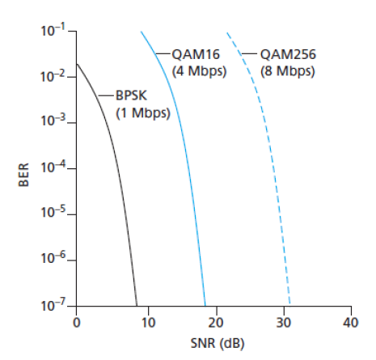
Bit Error Rate (BER)
Probability that a transmitted bit is received in error
We’ve seen this before!
Probability is screwy – its not independent samples, but often correlated in time
Related to SNR through the encoding
Some encodings use repeated transmissions at a higher rate (chipping rate) to overcome error

Slide 13
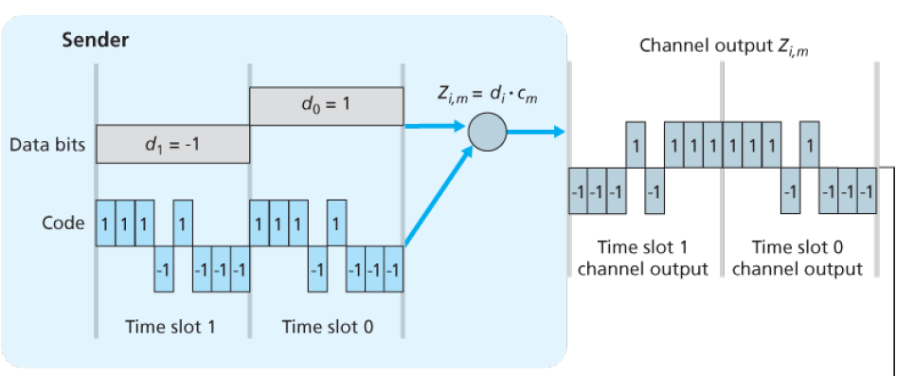
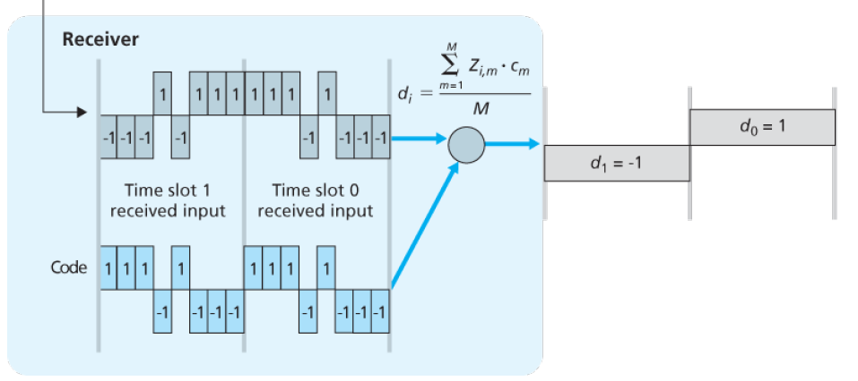
Code Division Multiple Access (CDMA)
Each bit is sent a higher chipping rate
Suppose each sent bit requires one-bit time slot, then $d_{i}$ is the data bit for the $i$th slot
Data is represented as “0” and “-1” in this example
Each bit slot is divided into $M$ mini slots (e.g. M=8)
CDMA uses a string of code bits, $C_{m}, 0≤m≤M$, each taking value +1 or -1.
Multiple “channels” are created by using time division in each slot
Each sender has a different “code” string

Slide 14
Additivity of Signals
Tensor product over the code:
$$a ⨂b=[ a_{1}⋅b, a_{2}⋅b, …, a_{n}⋅b]$$
Signals are additive, meaning that a receiver will see the sum of the energy sent by multiple senders.
Careful selection of code words means multiple receivers can send data and multiple receivers can receive data simultaneously
Signals that are “in phase” they will add to twice the amplitude of each signal, out of phase, they subtract and give a signal that is the difference in amplitudes. Can be modelled digitally through addition of vectors, component by component.
Sender 0: Code = [ 1, -1 ] Data = [1, 0, 1, 1] Encoded = [1, -1, 1, 1] Signal = encode $⨂$ code = [ 1 * [1, -1], -1 *[ 1, -1 ], 1 * [1, -1], 1 * [1, -1] ] = [1, -1, -1, 1, 1, -1, 1, -1] | Sender 1: Code = [1, 1] Data = [0, 0, 1, 1] Encoded = [ -1, -1, 1, 1 ] Signal = encode $⨂$ code = [ -1 * [1, 1], -1 *[ 1, 1 ], 1 * [1, 1], 1 * [1, 1] ] = [-1, -1, -1, -1, 1, 1, 1, 1, ]
Combined signal: [1, -1, -1, 1, 1, -1, 1, -1] + [-1, -1, -1, -1, 1, 1, 1, 1, ] = [0, -2, -2, 0, 2, 0, 2, 0 ]
Both receivers: = [0, -2, -2, 0, 2, 0, 2, 0 ]
Decode [ (0,-2) * (1, -1) = (0+2) = 2, (-2, 0) * (1, -1) = (-2+0) = -2, (2, 0) * (1, -1) = (2 + 0) = 2, (2, 0) * (1, -1) = (2 + 0) = 2 ] [2, -2, 2, 2] = 1, 0, 1, 1 | Decode [ (0,-2) * (1, 1) = (0-2) = -2, (-2, 0) * (1, 1) = (-2+0) = -2, (2, 0) * (1, 1) = (2 + 0) = 2, (2, 0) * (1, 1) = (2 + 0) = 2 ] [-2, -2, 2, 2] = 0, 0, 1, 1

Slide 15
CDMA Issues
CDMA has its issues
CDMA codes have to be carefully chosen – limits the # of simultaneous xmitters
Rigid timing constraints have to be met (there is an asynchronous version)
Amplitudes of signals may not be equal on the receiver
Channels capable of higher bit rates are divided down by the number of chips, more chips = more simultanenous xmitters and more noise immunity, but lower speed

Slide 16
WiFi / 802.11 LANs
IEEE 802.11 standard for wireless LAN
Uses same MAC (CSMA/CA) for broadcast media
Same frame structure for link-layer
Note the relationship between speed and distance
Standard | Date | Frequency (GHz) | Speed (Mbps) | Range (in/out)
802.11 | 1997 | 2.4 | 2 | 20m / 100m
802.11a | 1999 | 5 / 3.7 | 54 | 35/5km
802.11b | 1999 | 2.4 | 11 | 35 / 120m
802.11g | 2003 | 2.4 | 54 | 38 / 140m
802.11n | 2009 | 2.4 / 5 | 600 | 70 / 250m
802.11ac | 2013 | 2.4 / 5 | 450 / 1300 | 35 / 0
802.11ad | 2012 | 60 | 6.7Gbps | 3.3m
802.11ah | 2016 | 0.9 | 347 | 1km

Slide 17
802.11 Architecture
Basic Service Set (BSS)
BSS contains one or more wireless stations and a central base station / Access Point
Access Point is the “edge” node, connects to wired network
Uses same MAC address scheme – allows interoperability with DHCP & ARP
Channels and Associations
Each wireless station associates with an AP
AP is configured with a Service Set Identifier (SSID) and a channel number (next slide)

Slide 18
WiFi Channel Numbers
802.11 standard creates different frequency ranges
900MHz, 2.4Ghz, 3.6GHz, 4.9GHz, 5GHz, 5.9GHz, and 60GHz
Allocated from public spectrum in that country (e.g. US’s FCC)
Range divided into channels, separated by 5MHz, but transmitters use 20MHz.
Different AP’s overlapping each other will cause interference, and slow-downs
Goal: keep channels separated by 4 or more channels to avoid overlap.
Non-overlapping channels can be bonded together for increased bandwidth.
WiFi jungle – wireless spectrum filled with access points, each competing for bandwidth which each other.

Slide 19
802.11 MAC Protocol
802.11 is different than 802.3 (wired networks)
802.11 uses CSMA with collision avoidance (CSMA/CA) rather than CSDMA/CD
CSMA/CD isn’t effective because the strength of a received signal is so small, a radio cannot detect when its transmitting and receiving (collision), and may not even detect the collision if it exists because of reflections and the “hidden terminal” effect
Once a frame has begun, it sends to completion (no CD)
802.11 adds a link layer acknowledgement and retransmission (ARQ) due to higher BER rates than wired networks. When AP receives valid frame it sends an ACK
Avoidance techniques:
When station senses idle, transmit frame after short distributed inter-frame space
If not idle, station chooses random backoff time using exponential binary backoff
If packet is ACK’d, its done sending. If not, it increases the back-off time and retries.

Slide 20
IEEE 802.11 Frame
802.11 frame is similar to 802.3 frame, but has some differences:
Address field: four addresses (instead of 2):
Address 1 – MAC address of wireless station to receive frame
Address 2 - MAC address of wireless station transmitting frame
Address 3 - MAC address of access point / BSS routing address
Address 4 – Used by access points in ad hoc mode to forward packets to each other
Sequence # - used by ARQ
Duration – the allocated time a channel is reserved and time to ACK
Frame Control Fields – many subfields used for handling different types of messages

Slide 21
802.11 Adaptability
Rate Adaptation
With different BER / SNR, different encoding schemes provide better throughput, WiFi allows rate adaptation to changing conditions.
Power Management
Nodes can enter “sleep” states and be awoken by receipt of data (i.e. receivers take far less power than transmitters)
Output power on transmitters can be adapted dynamically to changing conditions
Beam forming and other modes enable better performance with less power

Slide 22
Personal Area Networks – 802.15.1 & .4, Bluetooth
IEEE 802.15.1 networks
Short range, low power, low cost
Trades performance for ease of use, lack of infrastructure
Bluetooth (named for a Viking ruler) uses 2.4GHz spectrum
Uses TDM – 625usec slots
Each time slot, sender transmits on one of 79 channels
Each time, channel changes in a predictable but random fashion – frequency hopping
Bluetooth networks are ad-hoc
There is always a master node and slaves
Slave can only communicate in slot immediately after the master has communicated with it
There can be up to 8 slaves, but up to 255 “parked” devices – devices that the master does not communicate with

Slide 23
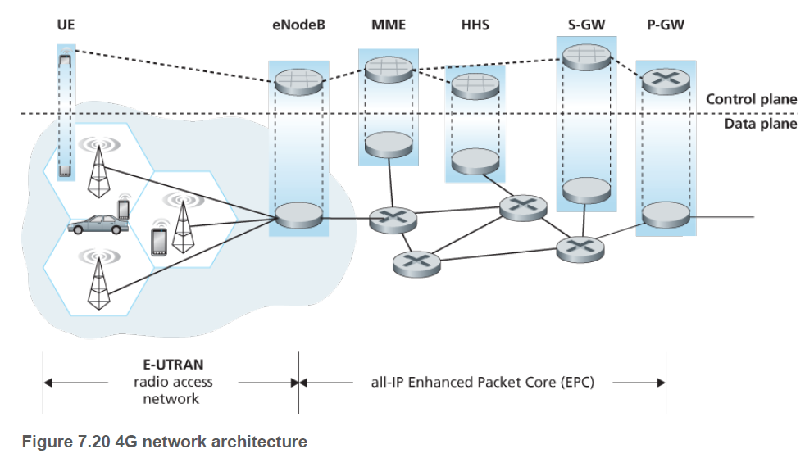
Cellular Internet Access
Most cell access uses 4G LTE (Long Term Evolution)
Cellular refers to the organization of geographic area into cells
4G network architecture:
eNodeB – forward datagrabs between UE (tower) and P-GW
P-GW – Packet Data Network Gateway allocates IP addresses to UEs, and performs QoS enforcement
MME – Mobility Management Engine performs connection & mobility management on behalf of UEs in the cell it controls.
HHS – Home Subscriber Service contains UE information, including roaming access capabilities, QoS profile, and authentication info.

Slide 24
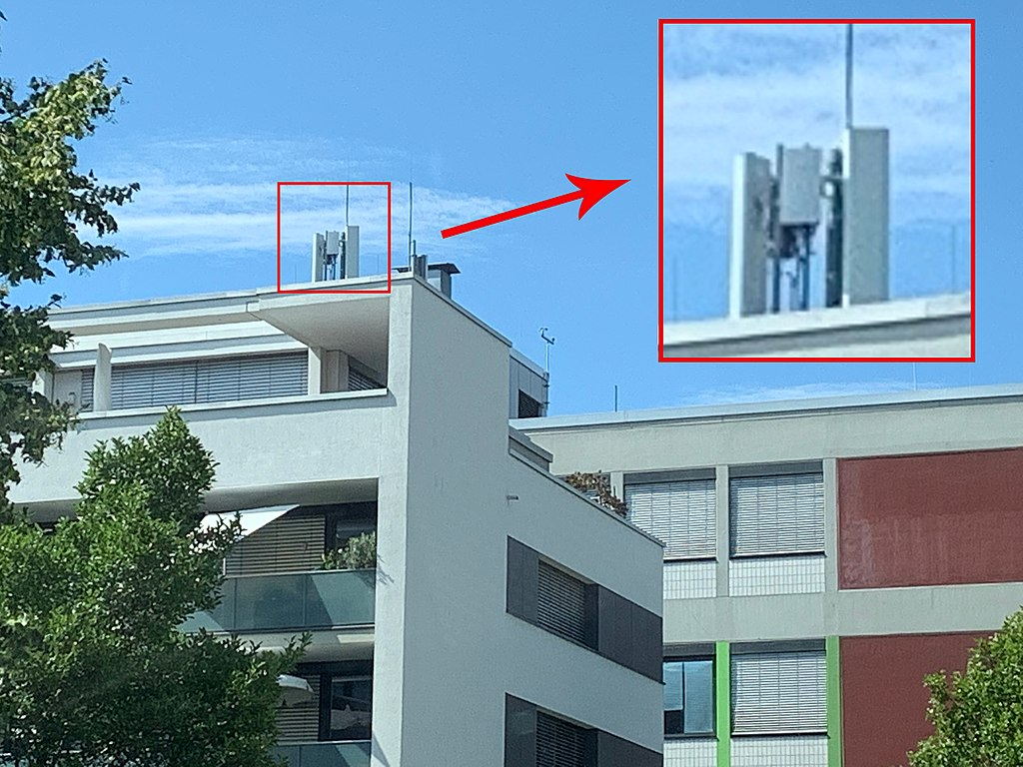
5G Technology
5G technology aimed at higher bandwidth, lower-latency
Speeds up to 10Gbps, not aimed at cell phone users, but wireless distribution nets
Three frequency bands:
Low – 600-700MHz, speeds 30-250Mbit, speed and coverage similar to LTE
Mid – 2.5 – 3.7GHz, speeds 100-900 Mbit, several miles in radius
High – 35 – 39GHz, speeds of Gbps, needs line-of-sight, no obstructions, limited distance

Slide 25
Mobility Management
Mobile networks are, well, mobile…
IP addresses typically assigned by subnet – and are fixed!
As a user moves from cell-to-cell (or AP to AP) – how does their communication change?
Home Network approach
The location of the “home agent” that stays fixed in position and the wireless device uses to access the global internet
As user / device moves it stays in contact to the home agent through foreign networks
Leads to the “triangle routing problem”

