Slide 1
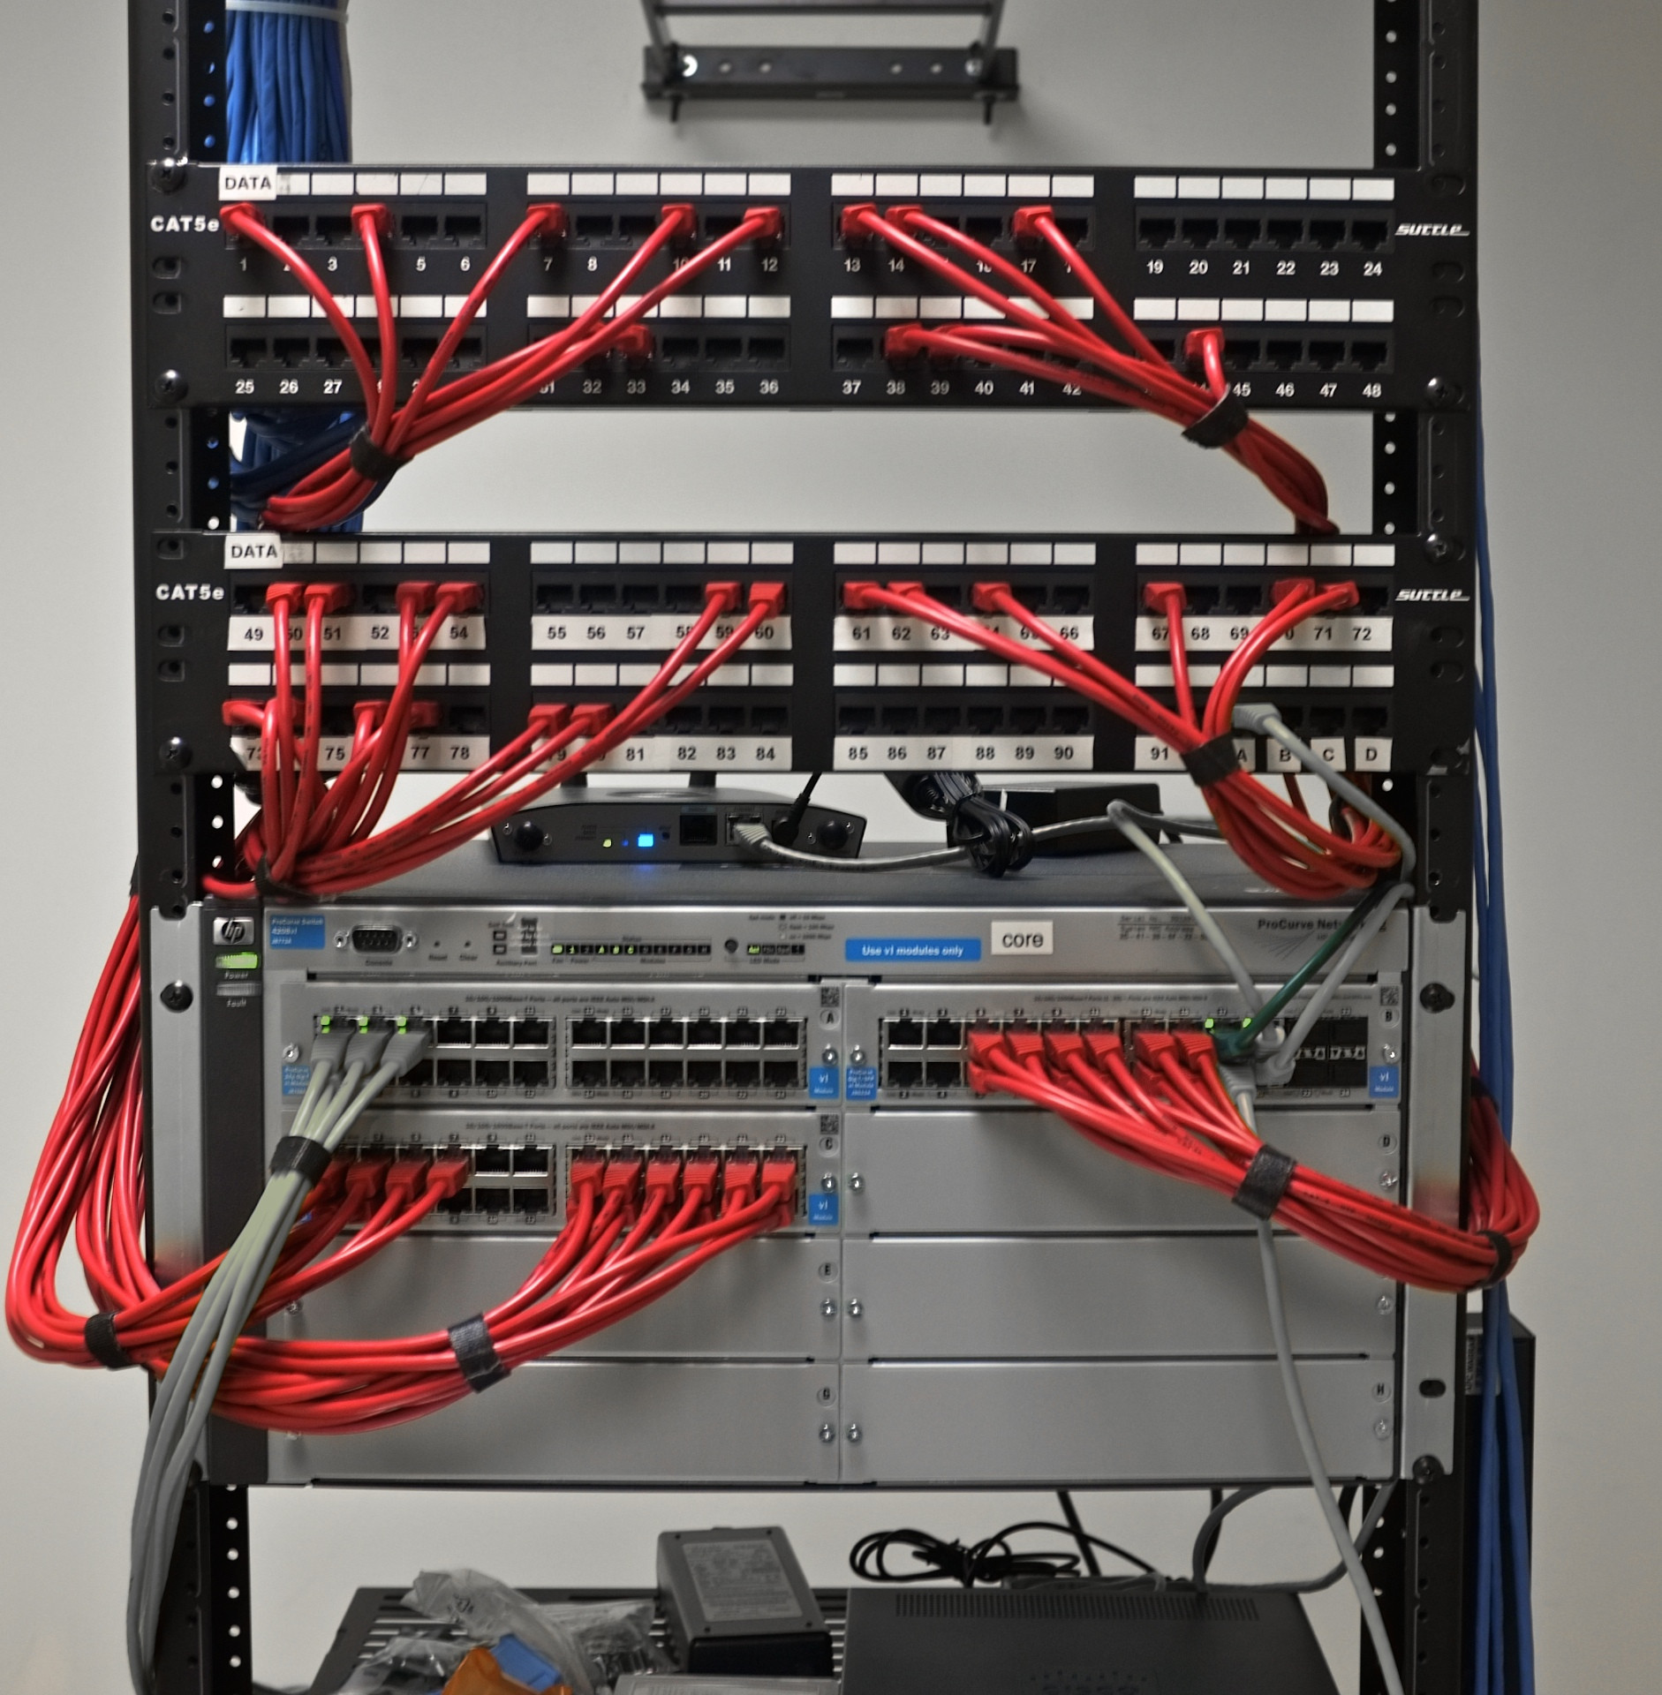
Link & Physical Layers
Chapter 6
This Photo by Unknown Author is licensed under CC BY-SA

Slide 2

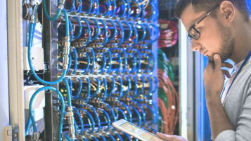
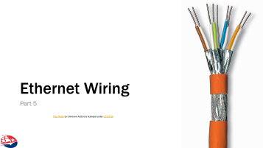
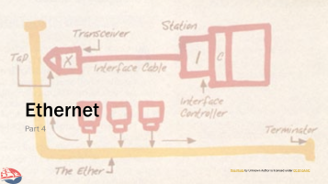
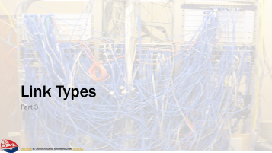



Slide 3

Introduction
Part 1

Slide 4
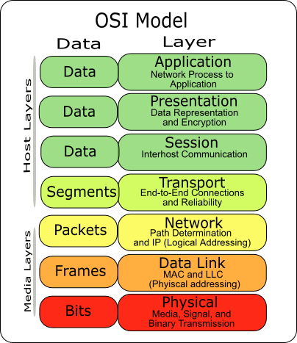
Link Layer
Group of methods and protocols used to enable end-points to communicate.
  OSI model splits into link / physical
  Internet often treats it the same
“To communicate on its directly-connected network, a host must implement the communication protocol used to interface to that network. We call this a link layer or media-access layer protocol.
There is a wide variety of link protocols, corresponding to the many different types of networks.” – RFC1122 §1.1.3
This Photo by Unknown Author is licensed under CC BY-SA

Slide 5

Link Layer Services
The link layer needs to provide:
  Framing
    an atomic sequence of bits that exchanged over a network
    typically used to encapsulate data from network layer
    used to keep sender and receiver synchronized
    May be fixed or variable length
  Link Access
    Link provides an access protocol to control when devices send frames on the shared media
  Reliable Delivery (?)
    In high-BER media, shifts retransmissions & reliability to link layer
  Error Detection & Correction
    Adds parity, ECC, checksums
This Photo by Unknown Author is licensed under CC BY-ND

Slide 6
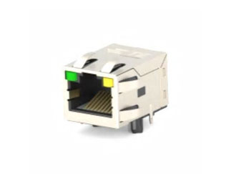
Link Layer Implementation
Hardware
  Network interface cards (NIC) w/ special purpose PHY chips
  Necessary for high-speed link operation
  Magnetics / Isolation Transformer
Software
  Framing can be done in OS, stream of bytes written to PHY
  In this relationship, PHY just reads/writes bytes – e.g. serial port protocols
  May still have a bit level framing in the physical layer!
Link Layers can be stacked
  E.g. PPPoE, PPPoA, …

Slide 7
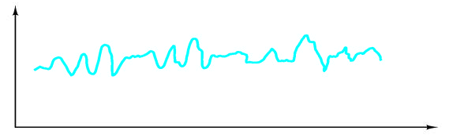
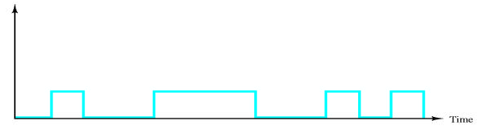
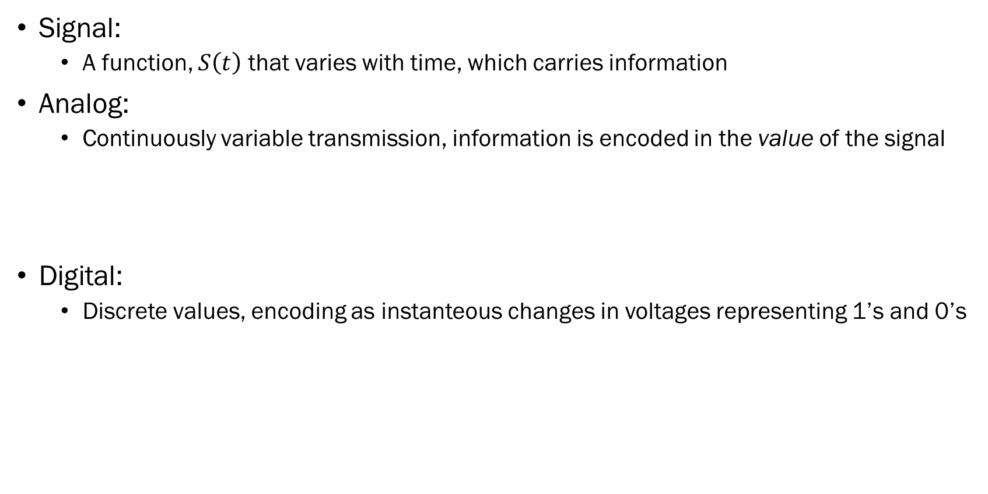
Communications Theory (sorry)
Signal:
  A function, $S\left(t\right)$ that varies with time, which carries information
Analog:
  Continuously variable transmission, information is encoded in the value of the signal
Digital:
  Discrete values, encoding as instanteous changes in voltages representing 1’s and 0’s

Slide 8
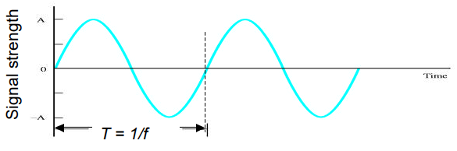
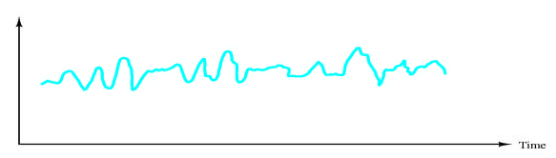
Signals
Periodicity
  Periodic – A signal can repeat over and over within some fixed unit of time (e.g. hertz)
  Aperiodic – A signal may have no defined pattern in its output values:

Slide 9
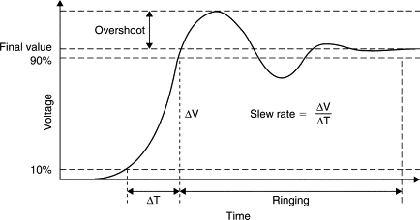
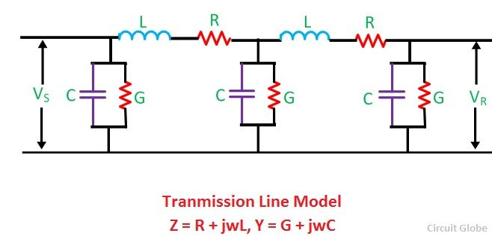
A little communications theory…. (sorry)
Electrical wiring is used to connect devices
  Ideal wiring has no resistance, capacitance, or inductance
    Resistance resists current
    Capacitor resists change in change in voltage
    Inductor resists change in current
  Note that the term “resistance” is not strictly correct rather its “impedance.”
    Impedance is the opposition to flow in an AC (changing) circuit.
  Parasitic Effects:
    Slew – due to capacitance, reduces “rise” and “fall” time for a square wave
    Over- and Under-shoot – due to inductance
    Cross-coupling – due to parasitic capacitative coupling of wires

Slide 10
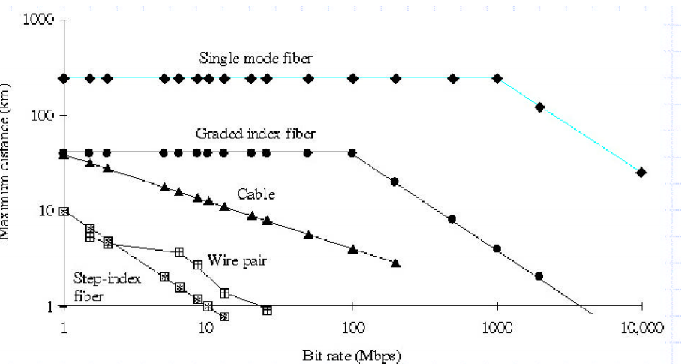
Attenuation of Signals

Slide 11
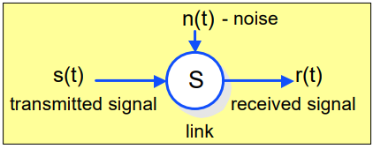
Noise
A signal will tend to degrade as it propagates through space & time:
  Distortion
  Fading
  Crosstalk
Noise can often be “filtered” but is always
present in a system.
Digital systems tend to have more “noise immunity”
than strictly analog systems.

Slide 12
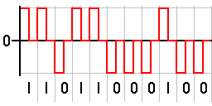
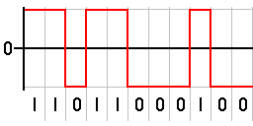
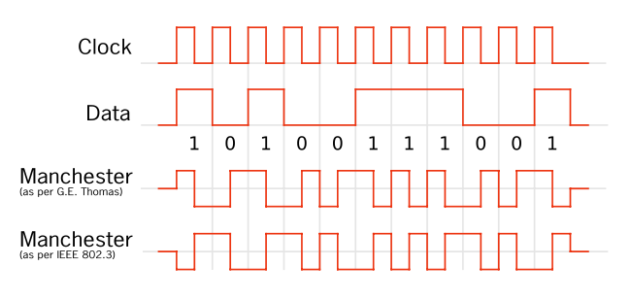
Encoding Bits
Return to Zero
  Signal drops back to “zero” in between bits, even if the signal would otherwise stay the same.
Non-Return to Zero
  One’s represented by one condition (e.g. positive voltage), 0’s by another (e.g. negative), and no swing back to zero.
Manchester Code
  Each data bit is encoded as a “phase shift” – one is a transition (e.g. low to high) and zero is another (high to low)
  Data has to “swing” through one half of a clock edge
  to be ready for next pulse.

Slide 13
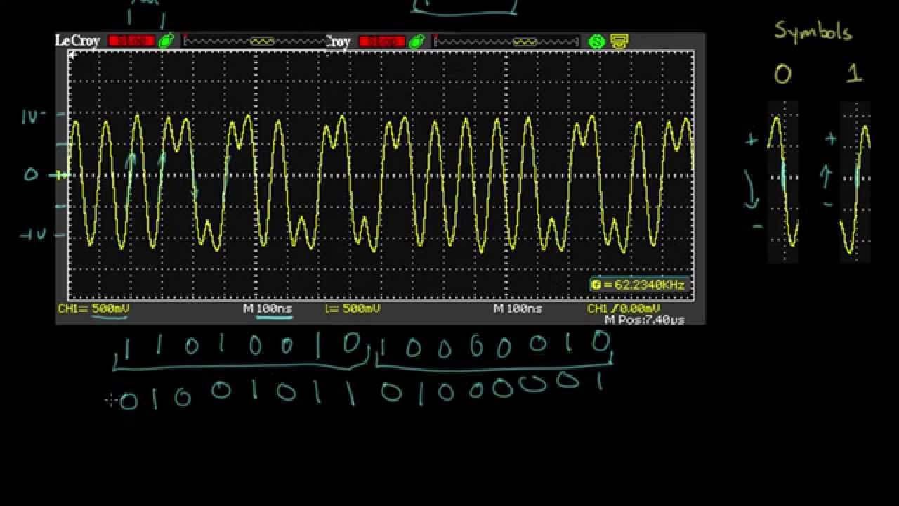
Ethernet Encoding

Slide 14
Encoding Bytes
8-bit “octet” bytes
  Bytes are encoding as 8-bits, either LSB or MSB first
8b10b encoding
  10-bits are used to encode 8-bits, specially chosen
  Counts of 1’s and 0’s in a string of at least 20 bits is no more than 2
  No more than 5 1’s or 0’s in a row
  Features
    DC-Balance – no DC offset builds up due to frequent changes
    No need to use lower-bandwidth portions of channels
    Clocks can be recovered from data channel – eliminates jitter and skew effects
    Allows “special” encodings for control / framing characters

Slide 15
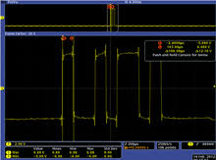
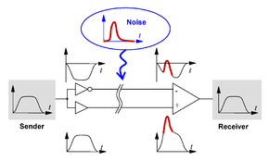
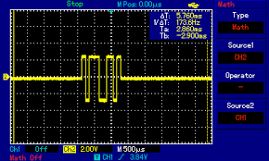
A little communications theory…. (still sorry)
Digital
  Singled-Ended –
    Information (bits) sent using a varying voltage
    Signal wire & reference voltage (ground)
    Serial - One wire carries one bit at a time, Parallel – multiple wires, multiple bits
    Impacted by transmission line theory:
      Slew, overshoot, undershoot, signal reflection
  Differential –
    Pair of wires for each bit, difference in voltage
    Higher common mode noise rejection
    Less slew, faster transitions

Slide 16
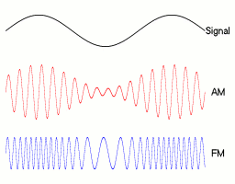
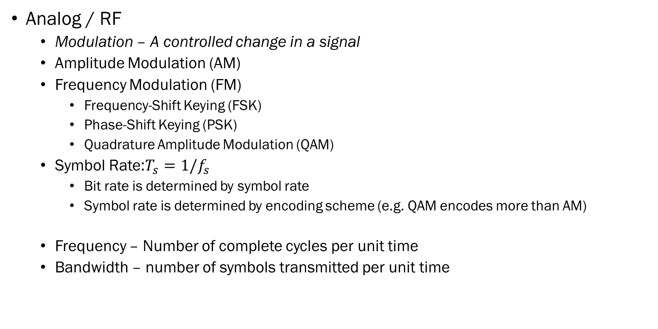
A little more communications theory…. (really sorry)
Analog / RF
  Modulation – A controlled change in a signal
  Amplitude Modulation (AM)
  Frequency Modulation (FM)
    Frequency-Shift Keying (FSK)
    Phase-Shift Keying (PSK)
    Quadrature Amplitude Modulation (QAM)
  Symbol Rate:$T_{s}=1/f_{s}$
    Bit rate is determined by symbol rate
    Symbol rate is determined by encoding scheme (e.g. QAM encodes more than AM)
  Frequency – Number of complete cycles per unit time
  Bandwidth – number of symbols transmitted per unit time

Slide 17
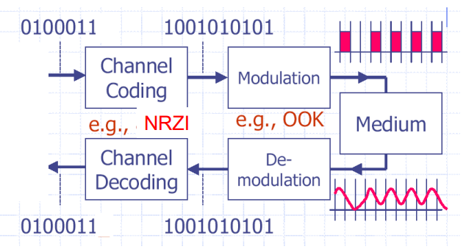
Block Encoding Schemes

Slide 18
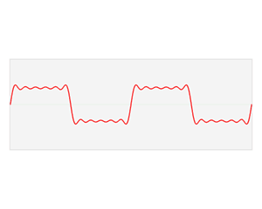
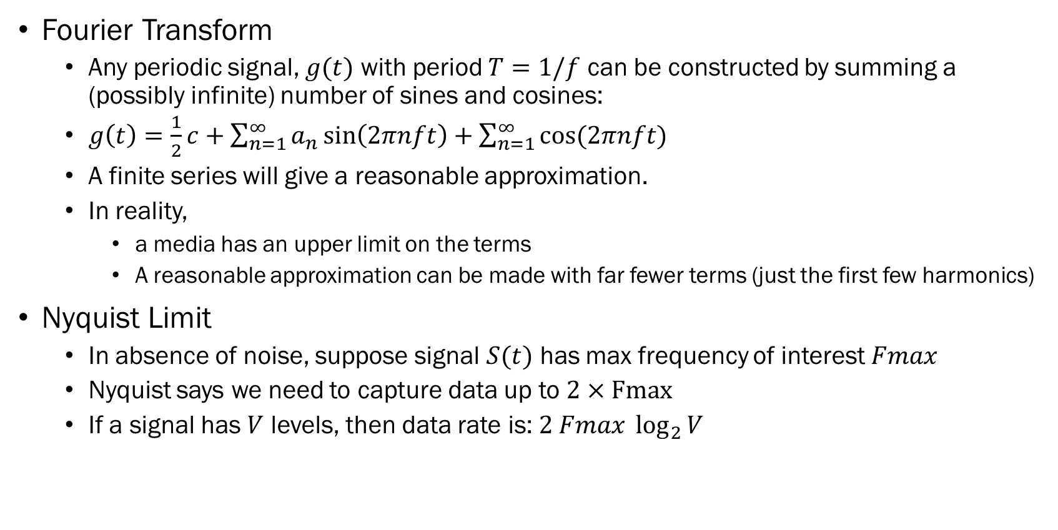
Gah! More, still more communications theory!
Fourier Transform
  Any periodic signal, $g(t)$ with period $T=1/f$ can be constructed by summing a (possibly infinite) number of sines and cosines:
  $g\left(t\right)=\frac{1}{2}c+\sum_{n=1}^{∞}{a_{n}\sin\left(2πnft\right)+\sum_{n=1}^{∞}{cos⁡(2πnft)}}$
  A finite series will give a reasonable approximation.
  In reality,
    a media has an upper limit on the terms
    A reasonable approximation can be made with far fewer terms (just the first few harmonics)
Nyquist Limit
  In absence of noise, suppose signal $S(t)$ has max frequency of interest $Fmax$
  Nyquist says we need to capture data up to $2×Fmax$
  If a signal has $V$ levels, then data rate is: $2 Fmax \log_{2}{V}$

Slide 19
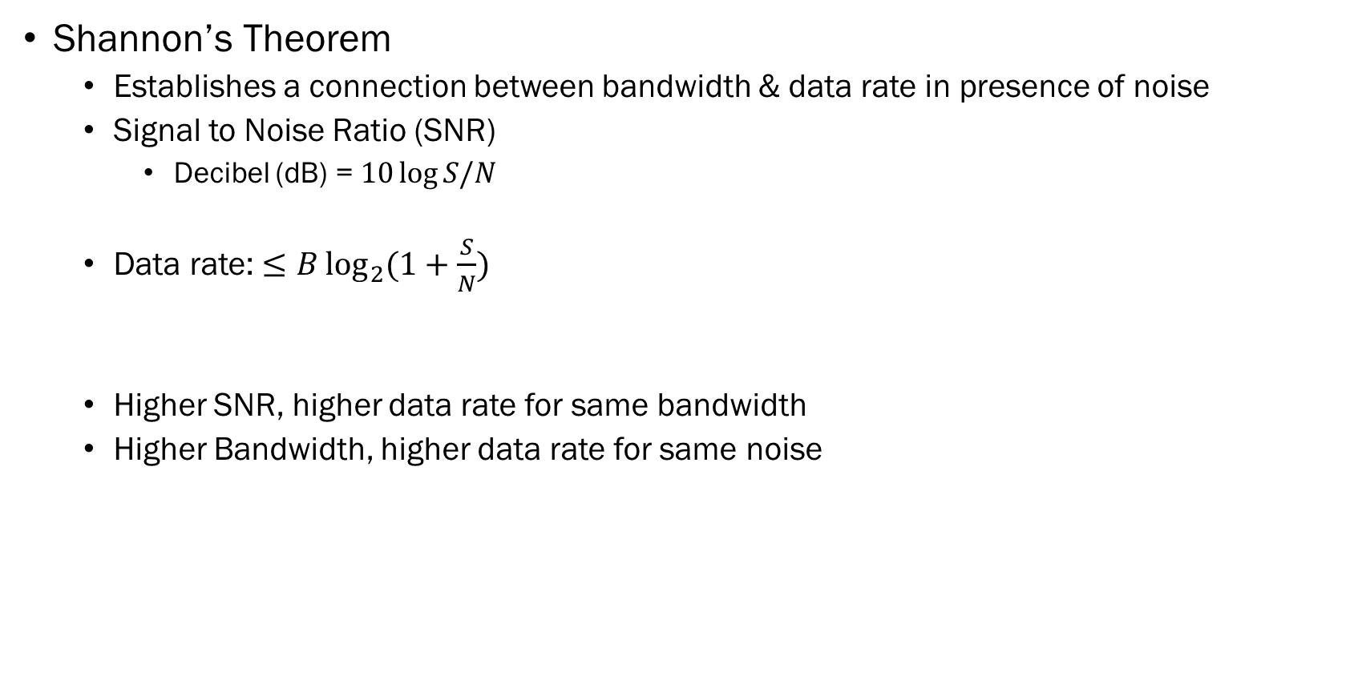
Just a little bit more….
Shannon’s Theorem
  Establishes a connection between bandwidth & data rate in presence of noise
  Signal to Noise Ratio (SNR)
    Decibel (dB) = $10\log{S/N}$
  Data rate: $≤B\log_{2}{(1+\frac{S}{N})}$
  Higher SNR, higher data rate for same bandwidth
  Higher Bandwidth, higher data rate for same noise
Power | dB
0.1 | -10 dB
10 | 10 dB
100 | 20 dB
1000 | 30 dB

Slide 20
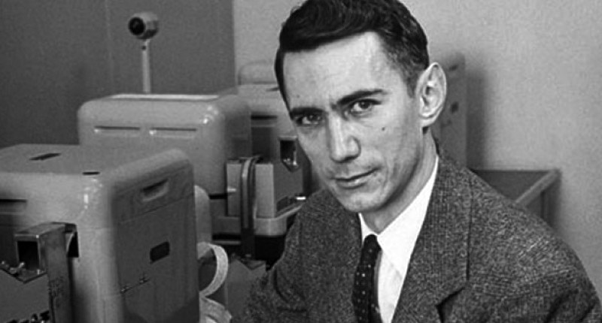
Error Detection & Correction
Part 2
This Photo by Unknown Author is licensed under CC BY-NC-ND

Slide 21

Error Detection & Correction
There are many different techniques
Detection
  Parity
  Checksums
Correction
  Physical filtering
  Quadrature Encoding
  Digitization
  Hamming Code
  Forward Error Correction
“The Bit Flipper”

Slide 22
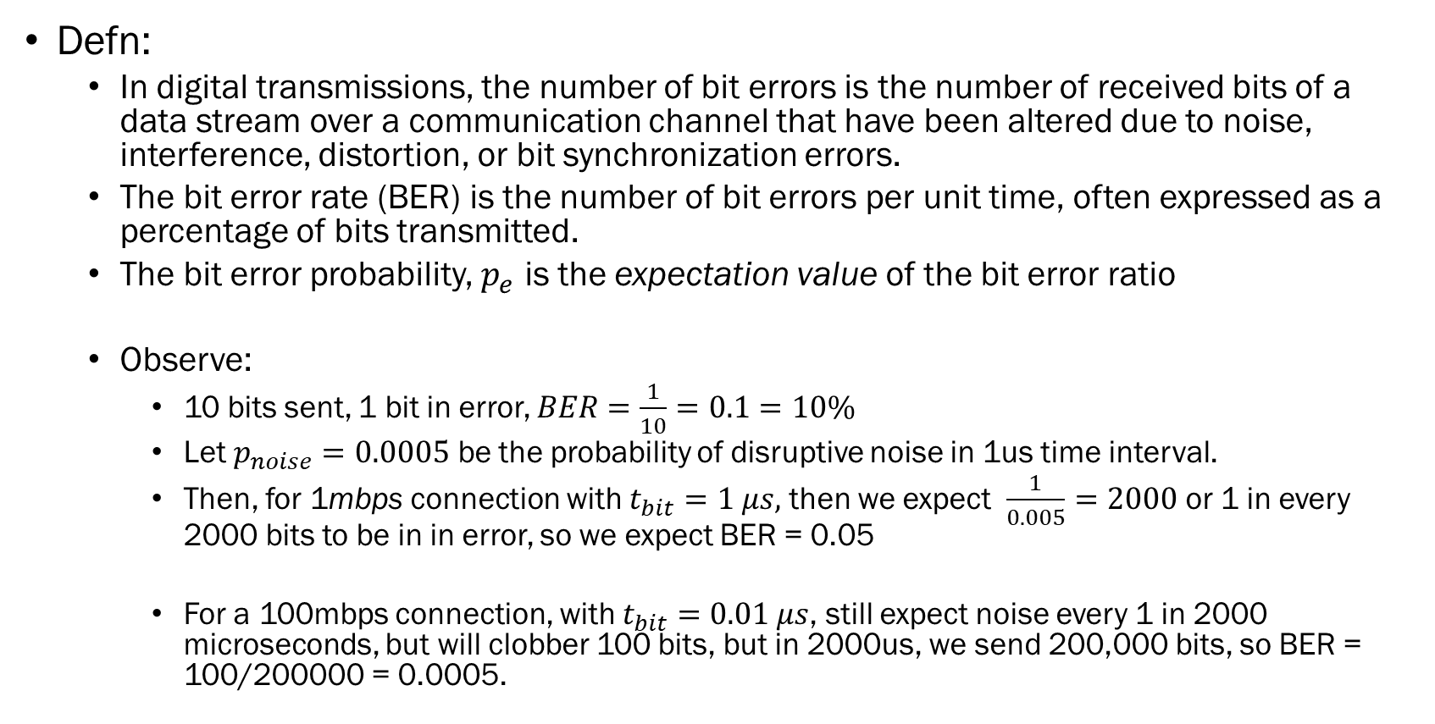
Bit Error Rate
Defn:
  In digital transmissions, the number of bit errors is the number of received bits of a data stream over a communication channel that have been altered due to noise, interference, distortion, or bit synchronization errors.
  The bit error rate (BER) is the number of bit errors per unit time, often expressed as a percentage of bits transmitted.
  The bit error probability, $p_{e}$ is the expectation value of the bit error ratio
  Observe:
    10 bits sent, 1 bit in error, $BER=\frac{1}{10}=0.1=10\%$
    Let $p_{noise}=0.0005$ be the probability of disruptive noise in 1us time interval.
    Then, for 1mbps connection with $t_{bit}=1 μs,$ then we expect $\frac{1}{0.005}=2000$ or 1 in every 2000 bits to be in in error, so we expect BER = 0.05
    For a 100mbps connection, with $t_{bit}=0.01 μs$, still expect noise every 1 in 2000 microseconds, but will clobber 100 bits, but in 2000us, we send 200,000 bits, so BER = 100/200000 = 0.0005.

Slide 23
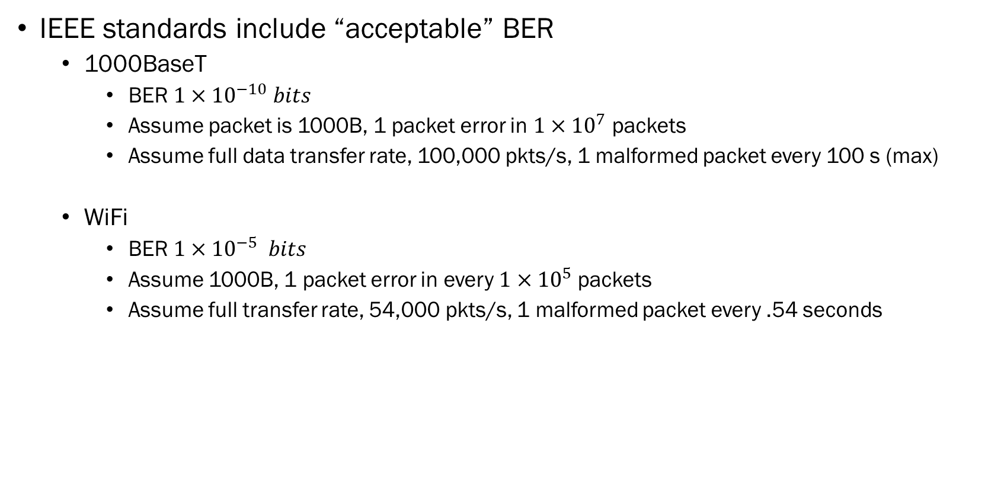
Acceptable Bit Error Rates
IEEE standards include “acceptable” BER
  1000BaseT
    BER $1×{10}^{−10} bits$
    Assume packet is 1000B, 1 packet error in $1×{10}^{7}$ packets
    Assume full data transfer rate, 100,000 pkts/s, 1 malformed packet every 100 s (max)
  WiFi
    BER $1×{10}^{−5} bits$
    Assume 1000B, 1 packet error in every $1×{10}^{5}$ packets
    Assume full transfer rate, 54,000 pkts/s, 1 malformed packet every .54 seconds

Slide 24
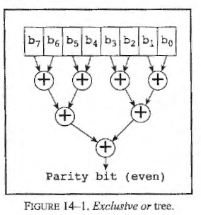
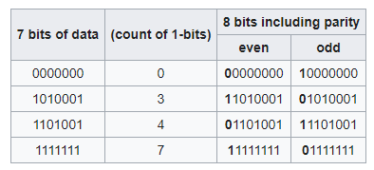
Parity
Parity or Check Bit
  A bit added to a string of binary code
  Simplest form of error detecting code
  Generally applied to smallest units of a protocol (e.g. 8-bit byte)
  Can also be applied to entire message
Even or Odd
  Sender adds bit to ensure that the number of set bits (1’s) is even or odd
  Receiver checks to ensure value received correctly
  Typically implemented as a bitwise XOR over the data bits
  Adds an extra bit to stream of data (8 bits req. 9 bits)
“Parity Bit.” In Wikipedia, June 9, 2020. https://en.wikipedia.org/w/index.php?title=Parity_bit&oldid=961547327.
Warren, Henry S. Hacker’s Delight. Pearson Education, 2013.

Slide 25
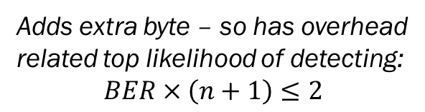
Parity in Two Dimensions
Parity can be applied in two dimensions
  Detect two errors
  Correct one bit error
Adds extra byte – so has overhead
related top likelihood of detecting:
$$BER×\left(n+1\right)≤2$$
Bit
7 | 6 | 5 | 4 | 3 | 2 | 1 | 0 | Parity
1 | 0 | 1 | 1 | 0 | 0 | 1 | 1 | 1
0 | 1 | 1 | 0 | 0 | 1 | 0 | 1 | 0
0 | 0 | 0 | 1 | 0 | 0 | 0 | 0 | 1
1 | 1 | 0 | 0 | 0 | 1 | 1 | 0 | 0
Sent Bits:
Bit
7 | 6 | 5 | 4 | 3 | 2 | 1 | 0 | Parity
1 | 0 | 1 | 1 | 0 | 0 | 1 | 1 | 1
0 | 1 | 1 | 0 | 1 | 1 | 0 | 1 | 0
0 | 0 | 0 | 1 | 0 | 0 | 0 | 0 | 1
1 | 1 | 0 | 0 | 0 | 1 | 1 | 0 | 0
Received Bits:
error in one bit
Receiver sees
a parity error in
row and column,
can “flip” bit to correct

Slide 26
Error Correction
Hamming Codes – Error Correction
  Uses k bits of parity to detect two bits of error and correct one of them.
  Inserts parity into word (adding to its length)
    For each power of two in the bit #, it is a parity bit
    E.g. 8 bits of data, d1,d2,d3,d4,d5,d6,d7,d8
    Needs 4 bits of parity P1,P2,P4,P8
    Becomes 12-bit # : P1,P2,d1,P4,d2,d3,d4,P8,d5,d6,d7,d8
  Each parity bit “covers” positions that have its power of two-bit set.
    P1 -> 0001=1, 0011=3, 0101=5, 0111=7, 1001=9, 1011=11,
    P2 -> 0010=2, 0011=3, 0110=6, 0111=7, 1010=10, 1011=11
    P4-> 0100=4, 0101=5, 0110=6, 0111=7, 1100=12
    P8-> 1000=8, 1001=9, 1010=10, 1011=11, 1100=12

Slide 27
Compute Parity Bits
Compute parity bits
  XOR is usually used
  Store parity bits into the respective fields
On retrieval, repeat computation
  Include previous parity bits in computation
  Each parity bit should be zero – if it isn’t then one of the covered bits is wrong
  The pattern of failed covered bits informs which bit is failed

Slide 28
Example
Store & Retrieve the 8-bit value: 8’b1100_0100

Slide 29
Drawback to hamming
Main drawback
  Number of parity bits is relatively large for small values
  Wider memories aren’t as bad

Slide 30
Checksums
Defn:
  A small-sized datum derived from a block of digital data for the purpose of detecting errors that may have been introduced during its transmission or storage. By themselves, checksums are used to verify data but are not relied upon to verify authenticity (i.e. cryptographic strong authenticity)
Types:
  Simple hash functions (e.g. 1’s complement)
  CRC
  Cryptographic hash functions (another course)

Slide 31
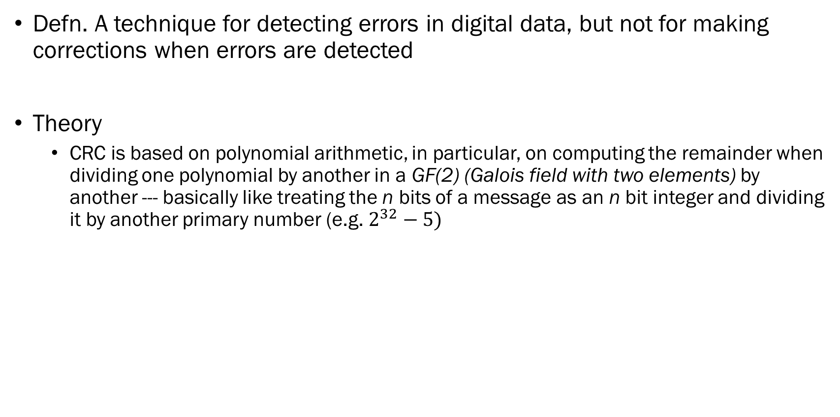
Cyclic Redundancy Check (CRC)
Defn. A technique for detecting errors in digital data, but not for making corrections when errors are detected
Theory
  CRC is based on polynomial arithmetic, in particular, on computing the remainder when dividing one polynomial by another in a GF(2) (Galois field with two elements) by another --- basically like treating the n bits of a message as an n bit integer and dividing it by another primary number (e.g. $2^{32}−5)$
Warren, Henry S. Hacker’s Delight. Pearson Education, 2013. (chapter 14)

Slide 32
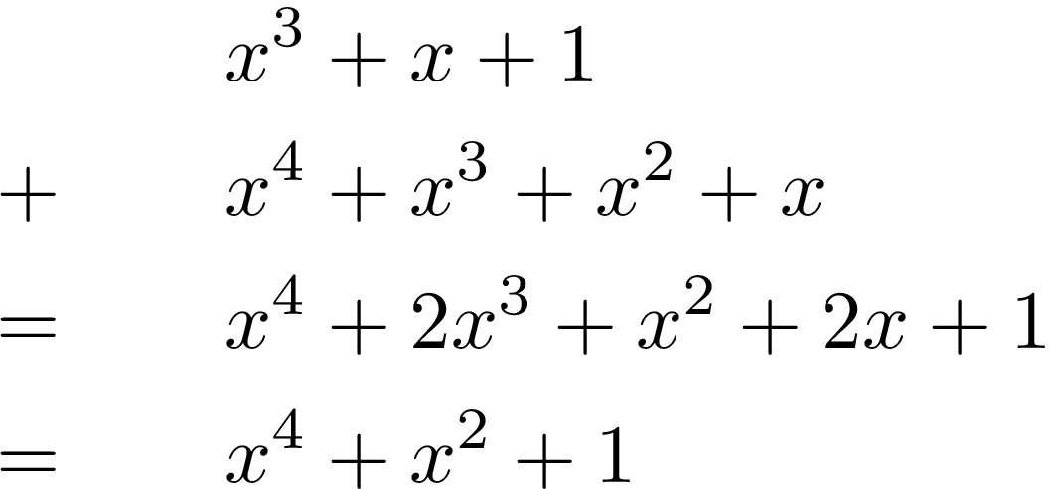
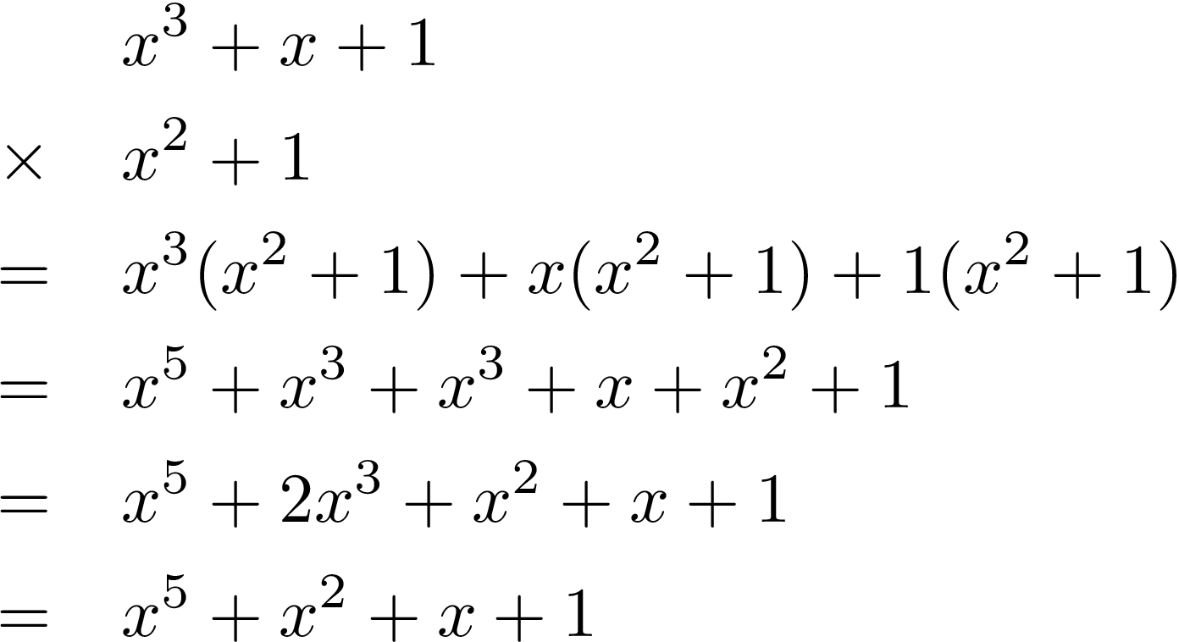
Polynomials in GF2
  A polynomial in GF(2) is a polynomial in a single variable x,
  whose coefficients are 0 or 1.
  Addition and subtraction are done module-2 – they are both the exclusive or!
  Multiplication of polynomials is the product of coefficients using AND

Slide 33
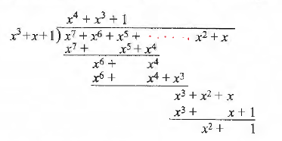
Polynomials in GF2
Division can be done same as long division
  Keep in mind that a term that remains is a “1” bit, while the term that’s missing is “0”

Slide 34
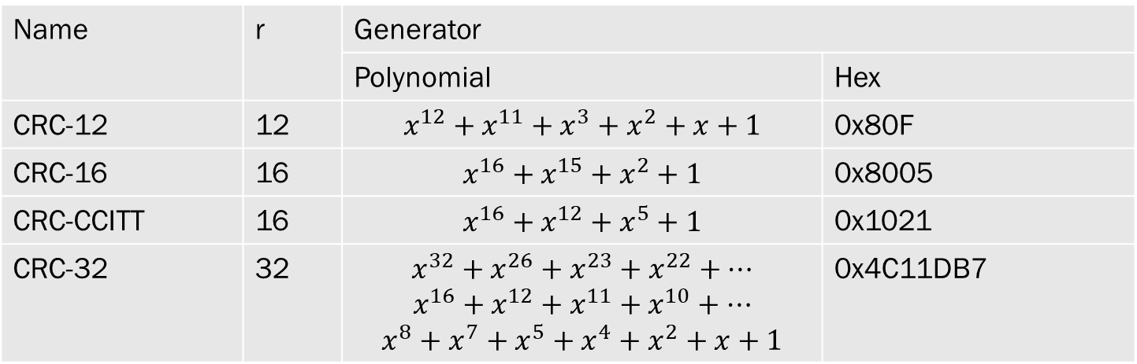
CRC Algorithm
The algorithm
  Treats the message as a polynomial in GF(2)
  Compute the message (an n-degree polynomial) divided by the CRC generating polynomial, and the remainder is the CRC value
Name | r | Generator
 |  | Polynomial | Hex
CRC-12 | 12 | $$x^{12}+x^{11}+x^{3}+x^{2}+x+1$$ | 0x80F
CRC-16 | 16 | $$x^{16}+x^{15}+x^{2}+1$$ | 0x8005
CRC-CCITT | 16 | $$x^{16}+x^{12}+x^{5}+1$$ | 0x1021
CRC-32 | 32 | $$x^{32}+x^{26}+x^{23}+x^{22}+…$$ $$x^{16}+x^{12}+x^{11}+x^{10}+…$$ $$x^{8}+x^{7}+x^{5}+x^{4}+x^{2}+x+1$$ | 0x4C11DB7

Slide 35
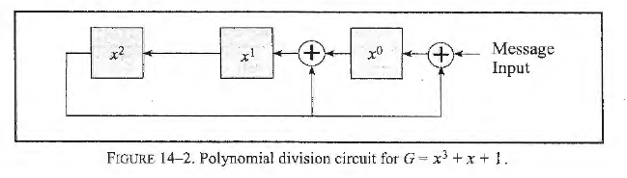
Calculating CRC
In hardware
  Essentially build a “division by trial” to compute remainder with repeated shifts & XORs
Compute 3-bit CRC with
message M=11100110
CRC | Step | Bit | CRC’
XXX | Initialize CRC contents |  | 000
000 | High order bit still 0, shift in bit 7 | 1 | 001
001 | High order bit still 0, shift in bit 6 | 1 | 011
011 | High order bit still 0, shift in bit 5 | 1 | 111
111 | High order bit 1, shift in bit 4 and XOR with 011 (110 ^ 011) = 101 | 0 | 101
101 | High order bit 1, shift in bit 3 and XOR with 011 (010 ^ 011) = 001 | 0 | 001
001 | High order bit is 0, shift in bit 2 | 1 | 011
011 | High order bit is 0, shift in bit 1 | 1 | 111
111 | High order bit 1 is, shift in bit 0 and XOR with 011 (110 ^ 011 = 101) | 0 | 101

Slide 36
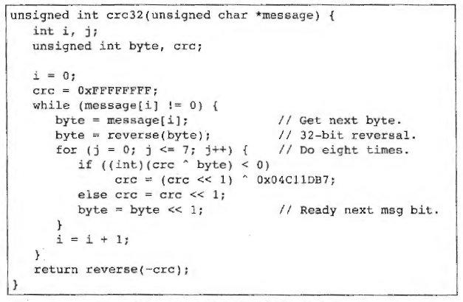
Software Implementation

Slide 37
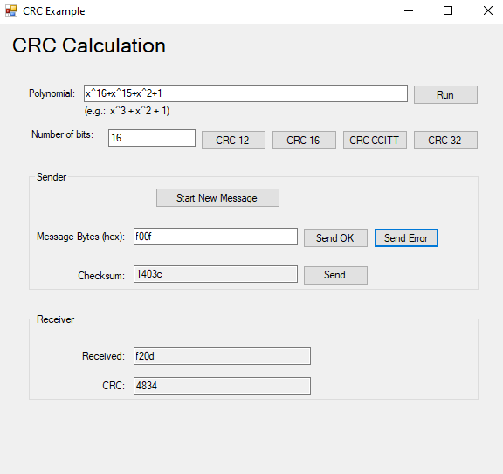
Checksum Demonstration

Slide 38
Handling Errors
Ignore
  Assumes that there is some other mechanism to handle errors higher in stack
Protocol can ACK/NACK
  A protocol can use an ACK or NACK signal on receipt of data to indicate success or fail
  Use parity or checksum to determine that there has been error
Forward Error Correction
  Using parity / ECC code to detect and correct error on the receiver w/out the sender having to retransmit
  Requirement for noisy link (low signal to noise ratio SNR)
  Requirement for broadcast links – each receiver may have different errors

Slide 39
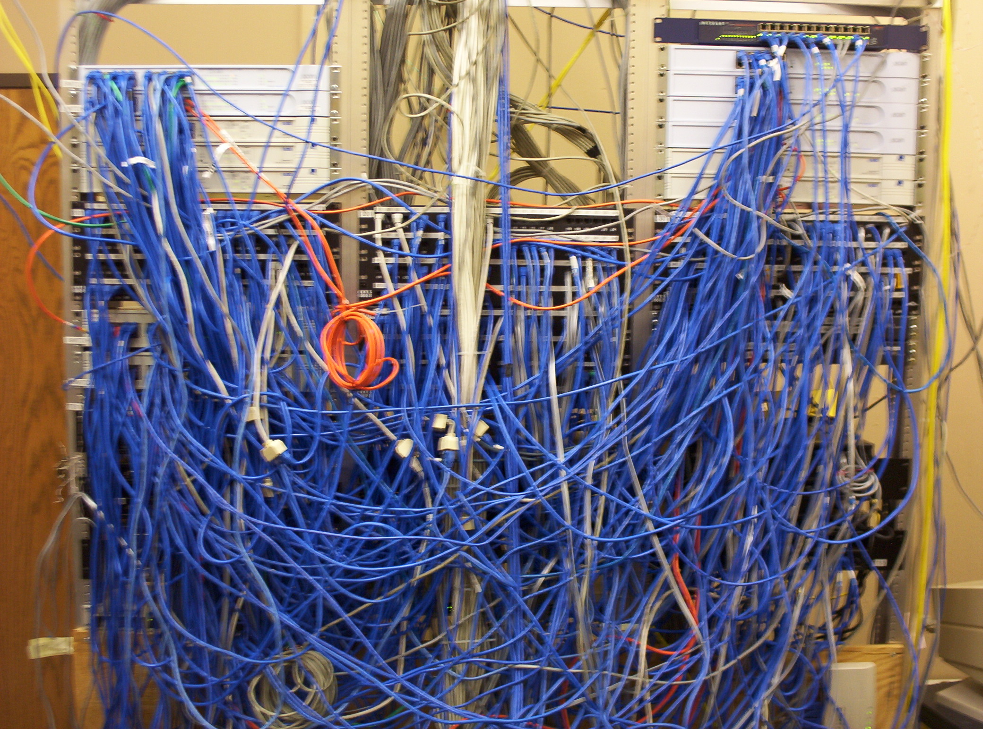
Link Types
Part 3
This Photo by Unknown Author is licensed under CC BY-SA

Slide 40
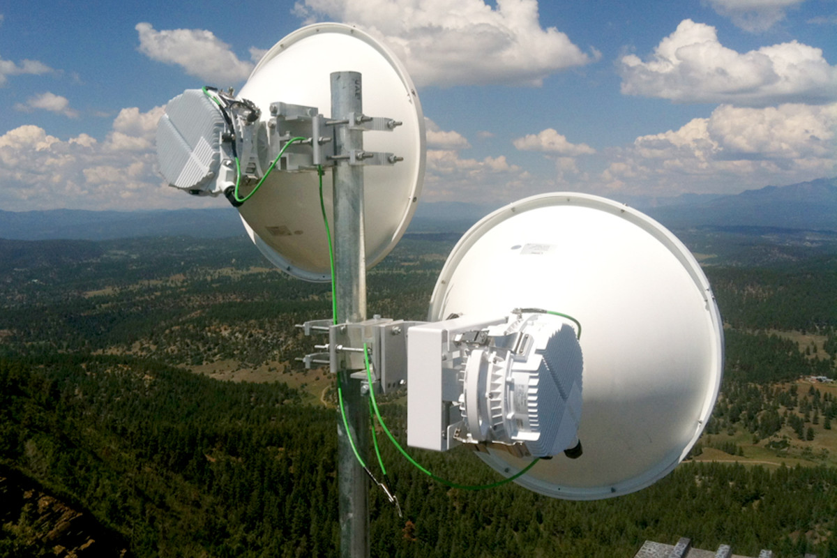
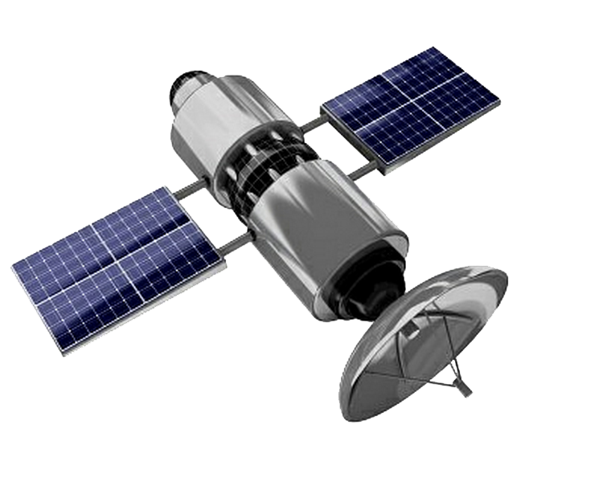
Link Types
Point-to-Point Links
  One sender, one receiver, one link between
  Maybe full or half duplex
  Switched ethernet, HDLC Fiber, serial port connections
Broadcast Links
  All devices share a common transmission line
  Ethernet, wireless networks
  Leads to “collisions”
This Photo by Unknown Author is licensed under CC BY-NC

Slide 41

Media Access Control
When sharing media, need rules to determine who can send
  Avoid collisions
  Strategies
    Channel Partitioning
    Random Access
    Turn-Taking
  Goals
    When only one node is sending, it gets R bps (full bandwidth)
    M nodes have data to send, then each node averages R/M data rate (not simultaneously)
    Protocol is decentralized – no master node / controller
    Protocol is simple, inexpensive to implement on “simple” hardware
This Photo by Unknown Author is licensed under CC BY-NC-ND

Slide 42
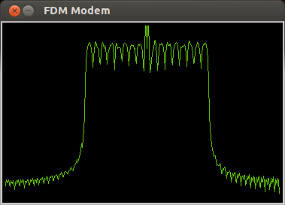
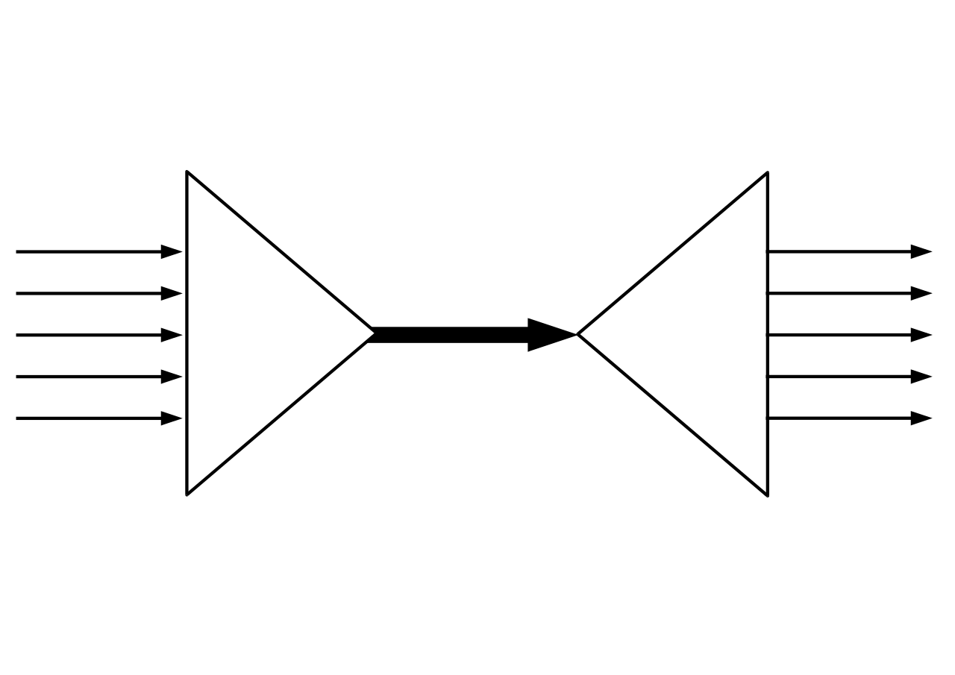
Channel Partitioning
Time Division Multiplexing
  Each node is given a window to send data
  Single node is rate limited to R/N (misses goal #1)
  Node must always wait its turn, so no collisions
  But, necessarily makes a larger channel into a smaller channel, even when its not used
Frequency Division Multiplexing
  Creates smaller channels from larger bandwidth
  R/N bps out of a larger R bps channel, each node is limited to R/N
Code Division Multiple Access (CDMA)
  Assigns different code prefix to each node, each node uses this code to encode its data. Careful selection of code allows simultaneous use of channels.
https://en.wikipedia.org/wiki/Frequency-division_multiplexing

Slide 43

Random Access Protocol
Allows any node to begin sending at any time
  Sender checks medium, if clear, begins sending
  If two or more senders collide,
    All pick a random number to wait, and try again
  As # of nodes increases, performance begins to decrease super-linearly
    Random waits create “dead-time” on network, other nodes can jump in, create transmission storm, and reduce performance.
  Basis for the Carrier Sense Multiple Access (CSMA) that is used in Ethernet!
This Photo by Unknown Author is licensed under CC BY-SA

Slide 44
ALOHA Slotted Protocol
ALOHA slotted protocol
  Developed in UofH 1971, first public demo of wireless packet data network
  ALOHA channels used in 1980’s on “1G” mobile networks, and later expanded into 2 and 3G networks with widespread adoption of GPRS.
  Basics of Operation
    All frames are fixed at L bits
    Time divided into L/R seconds (time to transmit one frame)
    Nodes start to transmit frames only @ beginning of assigned slot
    Nodes are time synchronized so each node knows when a frame starts
    If two or more frames collide then all nodes detect event before end of slot
  Retransmits
    During collision, all nodes wait a random time, and retransmit with probability p

Slide 45
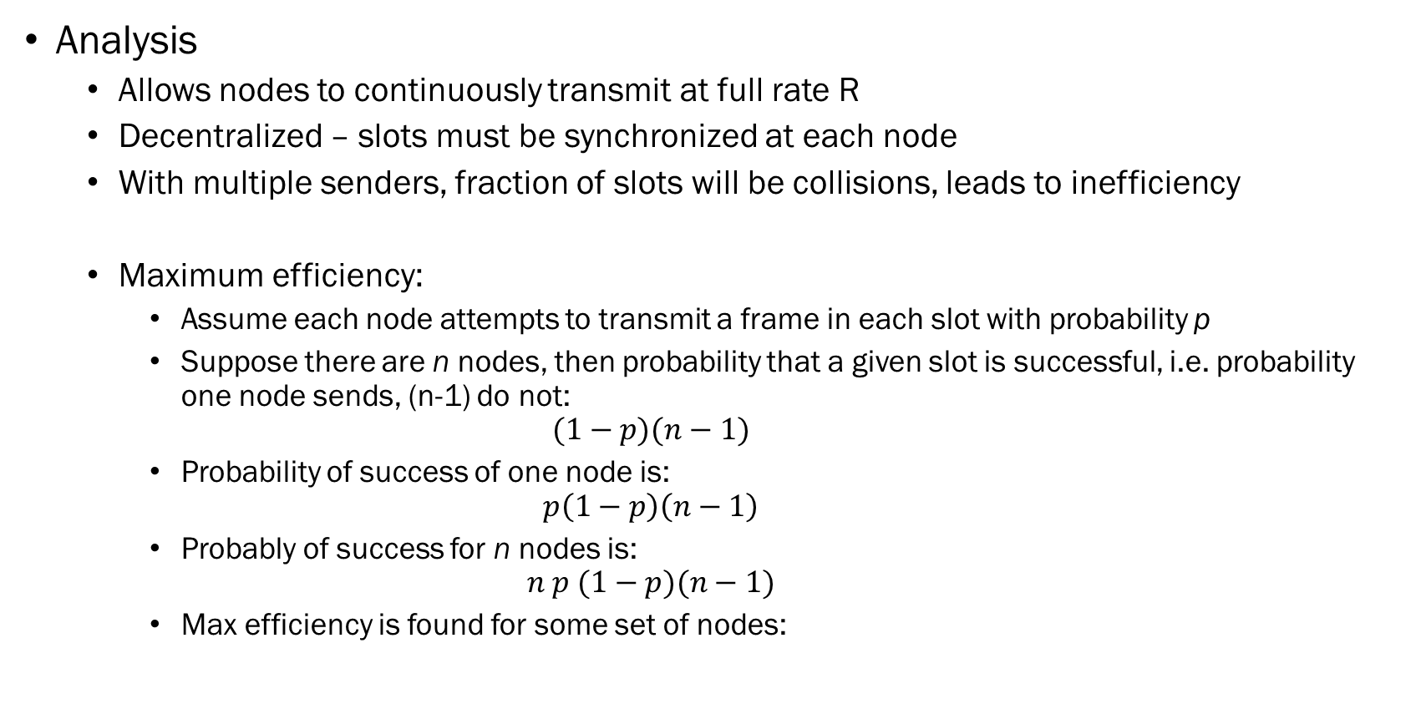
ALOHA Analysis
Analysis
  Allows nodes to continuously transmit at full rate R
  Decentralized – slots must be synchronized at each node
  With multiple senders, fraction of slots will be collisions, leads to inefficiency
  Maximum efficiency:
    Assume each node attempts to transmit a frame in each slot with probability p
    Suppose there are n nodes, then probability that a given slot is successful, i.e. probability one node sends, (n-1) do not:
    $$(1−p)(n−1)$$
    Probability of success of one node is:
    $$p\left(1−p\right)\left(n−1\right)$$
    Probably of success for n nodes is:
    $$n p (1−p)(n−1)$$
    Max efficiency is found for some set of nodes:

Slide 46
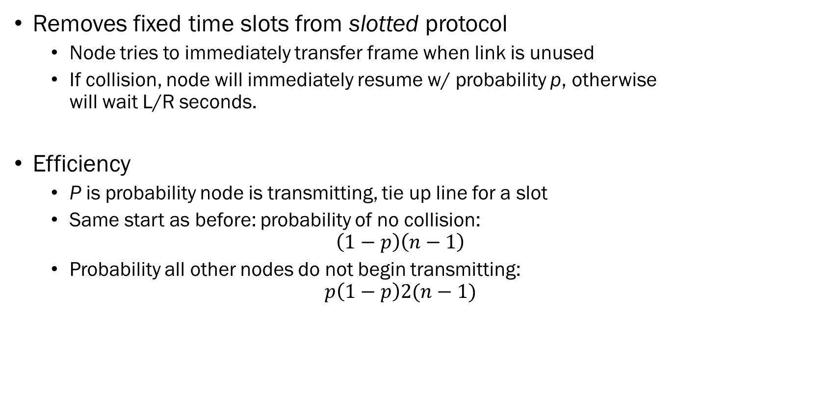
ALHOA Unslotted
Removes fixed time slots from slotted protocol
  Node tries to immediately transfer frame when link is unused
  If collision, node will immediately resume w/ probability p, otherwise
  will wait L/R seconds.
Efficiency
  P is probability node is transmitting, tie up line for a slot
  Same start as before: probability of no collision:
  $$\left(1−p\right)\left(n−1\right)$$
  Probability all other nodes do not begin transmitting:
  $$p\left(1−p\right)2(n−1)$$

Slide 47

Signal Propagation
ALOHA (just studied) and CSMA (up next) both sense transmission line
  How can there be collisions?
  Speed of network is R bits per second
  Speed of light (signal) $≈300×{10}^{6}$m/s
  Find the linear distance of a single bit:
  $$L_{meter per bit}=\frac{300×10^6 meters}{1 second}×\frac{1s }{R bits}$$
  For 1000 Mbps network:
  $$L_{1000}=0.3m=30 cm$$
  Suppose 2 nodes are 100m apart, how many bits can be sent from one before its detected on the other?
  $$n bit=\frac{1 bit}{0.3m}×100m=333.3 bits$$
  Speed of light is slow, and distance is going to be a big problem!

Slide 48

Carrier Sense Multiple Access (CSMA)
Protocol
  Adapter receives packet from OS
  Adapter senses idle channel, starts transmitting
  Adapter monitors channel (compares to output amp), monitors for presence of external signal energy
    If not present, frame is transmitted successful
    If detected, then a collision is detected – wait a random amount of time to retransmit
  Retransmit timeout
    If too large, utilization too low
    If too small, too many retransmits
    Binary Exponential Back-off
      A packet has experienced n collisions, choose $k∈[0 …2n−1]$
      Time is $K(\frac{512}{R})$ – time to send 512 bits, capped to 10.

Slide 49

Performance Analysis
CSMA+CD w/ exponential back-off
  Efficiency is $\frac{1}{1+5β},$ where $β= \frac{D_{prop}}{D_{trans}}$
  This quickly degrades to a limit of $1/6$, which is not good!

Slide 50

Taking Turns Protocol
Third strategy
  Polling Protocol – one node designated master, polls each node on segment in RR fashion, sending it a control message. Master designates the node that can begin transmitting.
    Avoids collisions & empty time slots
    Creates polling delay – $\lim_{n→∞ }$, spend exclusive time polling
    If master fails, then all nodes fail, network stops
    801.15 & blue tooth use this strategy
  Token Passing
    A special token frame is sent from one node to its neighbor
    While a node has the token, it can send n frames of data, then must pass along the token
    Collision free, but depends on not skipping neighbors
    Token Ring & FDDI

Slide 51

Data over Cable Service Interface Specification (DOCSIS)
DOCSIS
  Developed by cable co’s for internet delivery over cable infrastructure
  Uses all three types: partitioning, random access, and polling!
    FDM to divide downstream and upstream segments into multiple “channels”
      Downstream – 6MHz channel, 40Mbps / channel
      Upstream – 6.4MHz channel, 30 Mbps / channel
      Channels are broadcast – everyone “sees” everything
      No collisions on downstream – single CMTS termination system
      Upstream channels are shared and can have collisions
      Channels can be “bonded” to increase bandwidth
    CMTS uses “MAP” messages to poll each modem in loop
    Cable modems send control messages upstream to request time slot – may collide
    Uses PKI for protecting privacy on shared loops

Slide 52

Ethernet
Part 4
This Photo by Unknown Author is licensed under CC BY-SA-NC

Slide 53



Ethernet
Ethernet developed in 1970’s by Metcalfe & Boggs
  Layer-2 protocol, designed to carry any network packet
  Ethernet devices include a MAC address (next slide)
  IP uses Address Resolution Protocol (ARP) (slide after that)
  Reasons for long-term success
    Well understood / devil you know vs. devil you don’t
    New technology is more expensive and complex
    New technology offered higher data rates, but ethernet has always caught up
    Switched ethernet emerged and has entrenched it in our networks
    Open standards enabled competition and cheap, commodity hardware
  Originally based on co-axial networks,
  10Base2 and 10Base5
This Photo by Unknown Author is licensed under CC BY
This Photo by Unknown Author is licensed under CC BY-SA
This Photo by Unknown Author is licensed under CC BY-SA

Slide 54
Media Access Control (MAC address)
MAC addresses
  Address assigned to the network interface card (NIC)
  Typically by vendor, can be overwritten in software
  48-bit address (6 byte)
  Globally unique, but not hierarchical
  IEEE manages assignment – first 24 bits are assigned to vendor (OUI)
  Special FF:FF:FF:FF:FF:FF “broadcast” address
  Address can be universally administered (UAA) or locally administered (LAA)
    LAA can be assigned to devices by network admin, often used in VM monitors
    Distinguished by setting second-least significant bit of the first octet of address (U/L bit)
      0 – universal, 1 – local (06-XX-XX-XX-XX-XX is local, 06=0b0000 0110,

Slide 55


Address Resolution Protocol (ARP)
ARP maps IP addresses to MAC addresses
  Before delivering an IP message, kernel needs to know which MAC dest. to frame pkt
  Sends a “who has ip XX:XX:XX:XX” message as a broadcast
  One(?) host responds with “I have ip XX:XX:XX:XX”, requestor gets MAC from message
  Host keeps an Arp table with active entries, and periodically prunes it
    $ arp –a

Slide 56

Ethernet Evolution
Shared Segment
  Initially, ethernet was a signal run of coaxial wire – a “bus”
Hub / Star Topology
  Hosts & routers directly connect to an ethernet “hub”
  Physical layer device (one below us) – each bit received is rebroadcast to all ports
  Still a “shared” link – but can extend distance
  Collisions still a major problem
Switch
  Store & forward / cut-through switching
  Enables point-to-point, device connections
  Collisionless
This Photo by Unknown Author is licensed under CC BY-SA

Slide 57

Switched LAN
Switched local area network
  Operate at Layer-2, don’t route, and don’t use RIP or OSPF
  Usually “transparent” to the network
  Forwarding and Filtering
    Limited compared to routers
  Self-Learning
    Each switch port tracks MAC addresses arriving on port, builds a switch table
    Prunes switch table periodically to flush old, no longer seen addresses
  Properties
    Eliminates collisions (when true switching)
    Heterogenous links
    Management
    Man-in-the-Middle (MitM) & Switch Poisoning
This Photo by Unknown Author is licensed under CC BY-SA

Slide 58
Switch vs. Router
Switches
  Generally “invisible” on the network
  Plug and play – can be configured for advanced features (e.g. VLAN)
  Can selectively forward certain broadcast message (e.g. DHCP)
  More adept at switching than a router – lower latency, lower cost for performance.
Routers
  Use “OpenFlow” for layer 2 and 3 routing decisions
  Can perform functions of switches
  Routers can stop broadcast storms
  Not plug-and-play,
  Have higher processing times, higher latency
  Higher cost for same performance

Slide 59
Ethernet Frame
Preamble & SoF
  7 octets (bytes) of 0b10101010
  1 octet (byte) of 0b10101011
  Used to synchronize the receiver to the transmitter’s clock
MAC addresses – destination and source
  6 octets for MAC address
802.1Q tag (VLAN)
Ethernet Type
Payload
  46-1500 octets (variable length, defined by protocol)
CRC-32 sequence
  Polynomial: 0x4C11DB7,
Interpacket Gap
  12 packets of “quiet”

Slide 60
Ethernet Line Coding
Bandwidth has evolved from 1Mbps to 400Gbps!
Naming Conventions
  10,100,1000, 10G – nominal speed at top of layer, excluding line codes but including other physical layer overhead (preamble, sync words, inter-packet gap)
  BASE, BROAD, PASS
    BASE – Baseband transmissions use digital signaling over a single wire, using electrical pulses or light. The entire bandwidth of the communications is used by the signal.
    BROAD – Broadband transmissions use analog signals in the form of optical or electromagnetic waves over multiple frequencies. Multiple channels are created using FDM.
    PASS – Passband transmission, line coding is used to create a pulse train of digital pulse amplitude modulated signals.
  -T, -S, -L, -E, -Z, -C, -K, -H – Medium
    T is twisted pair, others refer to various forms of fiber or other less common media.
  -X,R – PCS encoding, -X is 8b/10b, R for 64b/66b
https://en.wikipedia.org/wiki/Ethernet_physical_layer

Slide 61
Common Standards
Name | Standard | Cable | Description
10BASE2 | 802.3a-1985 | RG-58 Coax | 50Ω coax cable, bus interface.
10BASE-T | 802.3i-1990 | CAT3 | Plain vanilla ethernet.
100BASE-T | 802.3u-1995 | CAT5 | “Fast Ethernet” Generic term for any 100Mbits ethernet over twisted pair.
100BASE-TX | 802.3u-1995 | CAT5, RJ45 | Standard 100Mbps ethernet.
HDMI Ethernet Channel | HDMI 1.4 2009 | HDMI | Ethernet channel included in HDMI
100BASE-FX | 802.3u-1995 | ST,SC | 4B5B NRZI coded signal, two strands of multi-mode optical fiber, max length is 400m
100BASE-LX10 | 802.3ah-2004 | ST,SC,LC | Ethernet up to 10km over a pair of single-mode fibers
1000BASE-T | 802.3ab-1999 | CAT5e | PAM5 coded signaling, 4-twisted pairs, extremely wide adoption
1000BASE-LX10 | 802.3ah-2004 | SC,LC | 8B10B NRZ signaling, multi-mode fiber, based on –LX, extended to 40km
10GBASE-T | 802.3an-2006 | CAT6A | Four lanes at 800Mbd each, PAM-16 with DSQ128 line code
40GBASE-T | 802.3bq-2016 | CAT 8 | Up to 30m

Slide 62

Ethernet Wiring
Part 5
This Photo by Unknown Author is licensed under CC BY-SA

Slide 63

Twisted Pair Cable
Twisted pair cable
  Type of wiring which two conductors are twisted together for creating a balanced pair
  As wave travels down each wire, induced cross talk is canceled out
  Noise becomes “common mode” and can be canceled out
Limitations:
  Deformation due to improper installation -
  Pulling the wires can effectively untwist wires
  in the sheath.
  Delay skew – different pairs can have different
  lengths.
  Imbalance – differences in wires in a pair can
  cause asymmetry and void the common mode
  noise benefits.

Slide 64



Terminations
Terminator is the “end of the wire”
  RJ45 – Registered Jack #45
    8 wire, 8 contact (note telephone is RJ11)
  Keystone
    Wall plates and some “patch panels”

Slide 65



Cable Gender
From Wikipedia
“In electrical and mechanical trades and manufacturing, each half of a pair of mating connectors or fasteners is conventionally assigned the designation male or female. The female connector is generally a receptacle that receives and holds the male connector. Sometimes the terms plug and socket or jack are used, particularly in reference to electrical connectors”
Ethernet patch cords are “male-male”
RJ45 straight through
Devices, patch panels, keystones, switches,…
are RJ45 female connections.

Slide 66

Wiring Diagram for Ethernet Cables
Standard Twisted Pair Wiring

Slide 67

Terminating Category Cable

Slide 68

Terminating at a Wall Plate

Slide 69

High Density Patch Panels

Slide 70

Cable Management

Slide 71

Wiring Faults & Testing
Typical faults:
  Wrong polarity
  Incorrectly connected wires
  Mismatched pair lengths
  Loose / Broken connectors
  Broken cable
  Broken wires inside cable
  Stretched cables (untwisted TP)
  Quiescent Noise / Cross talk

Slide 72



Network Interface Cards
Connect PC to an Ethernet network
Wide variety of implementations
  Type of ethernet supported
    1Gbps common, 10Gbps emerging
    Copper or SFP
  Number of ports
    1, 2, 4
  Degree of intelligence
    Support for multiple TX & RX queues
    Partitioning into multiple MACs at HW level
    TCP Offload Engine

Slide 73
Not all NICs created equally
 | Intel Gigabit CT NIC | Intel Gigabit ET2 4x Port | Intel I210-T1
Launch Date | Q3’08 | Q3’10 | Q1’13
Segment | Desktop | Server | Server
Power | 1.9W | 8.4W | 1W
Ports | Single | Quad | Single
Controller | i82574L | I82576 | I210
Virtualization? | No | Yes, VT-c | No
On-Chip QoS | No | Yes | No
Port Partitioning | No | Yes | No
VM Device Queues | No | Yes | No
PCI-SIG SR-IOV | No | Yes | No
Power Management | No | No | Yes
Intelligent Offloads | No | Yes | Yes
Storage over Ethernet | No | iSCSI,NFS | No
Cost | $24 | $423 | $64

Slide 74
NIC Embedded in Motherboard
Ethernet ports can be embedded in motherboards too…
 | Dell Optiplex 7040 Intel I219 | MSI MAG A520M Realtek RTL8111H
Release Date | 2015 | 2020
Limited Offload? | No | Yes
Full Offload? | No | No
Programmable LEDs? | No | Of course!

Slide 75

Power over Ethernet
Standard: IEEE 802.3AF-2003 -
Convergence of:
  Applying clever DC offset to differential signaling in ethernet cable
  Lower power electronics at far end
Uses power injector
  15.4W, 44VDC, 350mA
Sufficient to power:
  VoIP phones, cameras, microwave links, wireless access points, clocks, …

Slide 76

Not All Switches are Created Equally Either…
Features of Catalyst 1000 series:
  Types of ports: 10/100/1000 common
  Number of ports: 8, 16, 24, 48
  Number of uplinks: 1, 2, or 4 uplinks, up to 10Gbit common
  Power over Ethernet: # of ports, max wattage different
  Forwarding bandwidth: 10, 18, 28, 52Gbps
  Switching bandwidth: 20, 36, 56, 104, 128, 176Gbps
  Forwarding Rate: 14.88, 26.78, 41.67, 77Mpps
  Max MAC address table size: 16000
  Max IP address table: 542
  Cost: $500 - $2000 (8 – 48 port models)

Slide 77

Ethernet Systems & Software
Part 6
This Photo by Unknown Author is licensed under CC BY-NC-ND

Slide 78
Virtual LAN / VLAN
LANs used to be flat, non-hierarchical, and, well, local!
But…
  People move around, network configurations need to move with them
  Inefficient use of switch for isolation needs – e.g. take a 48-port switch to isolate 10 users!?
  Traffic isolation and control
  Wireless really threw wrench into things….
VLAN Standard IEEE 802.1Q
  Each port on the switch is configured to be part of a VLAN
  Each segment is rewritten to be tagged as being part of that VLAN
  Packets switched / uplinked to other switches that are part of the VLAN
  Traffic may be routed through central router to other switches --- but how to find?
  Trunking – special port used to interconnect VLANs – this port sees “all” VLAN traffic

Slide 79
Spanning Tree Protocol
Spanning Tree Protocol (STP)
  Builds a loop-free logical topology for Ethernet networks
  Prevents
    Bridge Loops
    Broadcast Radiation
  Allows network design with redundant / back-up links
Operation
  Routers and Switches run the STP algorithm – broadcast their link states
  Every link between switches and routers is catalogued
  Blocks forwarding on redundant links by setting up one preferred link between switches
  STP designates one “root bridge” (network admin decides)
    All other devices select their best connection towards that link
  Communicates using Bridge Protocol Data Units (BPDU)

Slide 80
STP
Path Cost
  Used in calculation of connection cost, based on link speed.
Port States
  Blocking – a port that would cause a loop if it were active
  Listening – Switch processes BPDU, awaits new information
  Learning – Port does not yet forward frames, does learn MAC addresses from ports
  Forwarding – A port in normal operation
  Disabled – Network admin disabled this port
Switch ID
  Each switch self-computes an extended system ID, unique for each VLAN
Data Rate (Mbps) | STP Cost (802.1D)
10 | 100
100 | 19
1G | 4
10G | 2

Slide 81
Link Virtualization
Link virtualization is an emerging field
Originally, a link was just a wire between two end-points
Multi Protocol Label Switching (MPLS)
  Routing technique to direct traffic from one node to another based on network labels rather than the contents of the packet.
  Label identifies links rather than endpoints
  Used in proprietary high-speed / low-latency networks for
    Dynamic & Transparent Virtual networks
  Used for software-defined traffic engineering
    Labels can be dynamically created and adjusted

Slide 82
Ethernet Systems Software
Several key technologies rely on Ethernet
  Bootstrap Protocol (BOOTP)
  Dynamic Host Configuration Protocol (DHCP)
  Wake on LAN
  Network Booting
  Bonjour

Slide 83
Bootstrap Protocol
Standard: RFC 951
Mapping IP address to a host:
  Static – someone enters the address and its saved to the machine
  Dynamic – host “finds” its address
  Random – host picks a random address each time it boots
BOOTP was original “dynamic” method
  Used a broadcast message to send the interface’s “MAC” address
  A BOOTP server would respond to broadcast with a message containing basic
  configuration properties: client IP address, subnet, and gateway, and the name of a “boot image” for remote booting
  Replaced by DHCP

Slide 84

Dynamic Host Configuration Protocol (DHCP)
Standard: RFC 2131
Modern configuration protocol for dynamic assignment of hosts
  Four-way handshake
    Enables DHCP server to track which clients are actually using addresses
    Enables “DHCP pools” of dynamically assigned addresses
  Extensions from BOOTP
    IP, subnet, time server, router, name server(s), DNS servers,
    system log server, printers, hostname, boot file, crash-dump save locations,
    domain name, root path, root device, swap device, ….
Allows database driven DHCP configuration
  Built into Microsoft Active Directory, XML based configuration we use here

Slide 85

Wake On LAN (WoL)
Modern computers are almost never turned off
  Ethernet controller can be still be on while the rest of the system is off
  A “magic packet” can be sent to an ethernet MAC, the controller can turn computer on
    Broadcast packet with the MAC repeated 16 times
  Supported by most os:
    sudo etherwake AA:BB:CC:DD:EE:FF
    sudo ethtool –s eth0 wol g (turn on WoL support)
Useful for system managers
  Can turn computer on remotely
  Apply updates / scan computer
  Return computer back to sleep

Slide 86

Pre-Boot Execution Environment (PXE)
Pixie booting
  Uses a combination of intelligent NIC, DHCP, and TFTP
  PXE boot performs a DHCP request – retrieves boot server information
    Name of “kernel” file is provided
  PXE uses TFTP to transfer UEFI boot process to memory and executes it
  Can boot any OS : Linux, OSX, or Windows
Useful for:
  Remote, diskless workstations / kiosks
  Service on machine without touching on-board disk drive

Slide 87
Bonjour / mDNS
Bonjour is Apple’s “zero-configuration” system
  Includes ethernet broadcast messages exchanged by apple devices to discover other Bonjour services – e.g. printers, Apple TVs
Multicast DNS (mDNS)
  Peer to peer DNS services between operating systems
  Most often used at home for device and service discovery
  Google Play TVs, printers, …

Slide 88

Codes and Standards
Part 7
This Photo by Unknown Author is licensed under CC BY

Slide 89
Codes and Standards
Standards are used for low-level signaling and protocols
  IEEE and IETF
Codes are used for physical installation
  Uniform Construction Code
  National Electrical Code
  State Code
  Local Code
Codes primarily focused on health and safety
  Mostly related to fire and electrical safety
Standards primarily focused on
  Practices to ensure proper operation

Slide 90
Licensing & Codes in Pennsylvania
There are no federally mandated standards
Commonwealth of Pennsylvania
  Department of Labor and Industry sets standards for Commonwealth projects
  2562 municipalities set their own codes
    Some have elected to use PA’s LNI standards
    Generally, all follow NEC, different triggers for permits and inspections
    Some require electrician’s license with low-voltage certification for tele-comm installation
Professional Engineer
  Every state regulates the term “professional engineer”
  Needed to supervise and “stamp” plans
  0 jobs that offer EIT placement for network engineers

Slide 91
Building Permits and Inspections
In the Commonwealth – every municipality is different
§78-2 Permits required; application; issuance; fees; placard.
A. Permits required. No building, structure, sign, or driveway shall be erected, constructed, moved, added to,
structurally altered, extended, expanded, enlarged, demolished or razed, nor shall land or buildings be put to
any use or changed to another use without a land use permit therefor issued by the Zoning Officer or designee….
§78-3 Inspections.
The Borough Manager or his designee shall make or cause to be made such inspections as are necessary to see to the enforcement of the provisions of this article.
§78-5 Violations
A. Failure to obtain a permit. In the event that an owner commences construction without first having obtained a permit as required hereunder, a penalty of 25% of the cost of the fee for said permit shall be added thereto.
D. Any person who shall violate or fail to comply with any of the provisions of this article shall, upon conviction thereof, be punished by a fine of not less than $1,000 and the costs of prosecution. Each day of violation shall constitute a separate violation hereunder.

Slide 92
National Electric Code – NFPA Section 70
Code covers all aspects of electrical installation
Section 720 “Circuits and Equipment Operating at Less Than 50V”
  Covers cabling requirements to mitigate risk of fire
  Special treatment for cabling running through “plenum air spaces”
  Mostly common sense (when you think them through)
    “circuits shall be installed in neat and workmanlike manner”
    Install data circuits under power circuits (heat rises)
Article 800 – General Requirements for Communications Systems
  Special requirements beyond 720 – e.g. fiber optics

Slide 93


Cabling
Cabling for low-voltage applications is classified as
  CMP (communications plenum), CMR (communications riser),
  CM/CMG (communications general use)
  OFN/OFNG – Optical Fiber, OFP, OFR
Resins used:
  Polyvinyl Chloride – PVC – combustion creates dioxins and furans, two of the most toxic manmade products, causing respiratory distress, and long term cancer and birth defects.
  Polyethylene – PE – chemically inert, not hazards, will burn if overheated, and can emit irritating smoke if overheated.
  Perflouropolymers – PFP – Produces fumes which are 2-3 orders of magnitude more toxic than smoke from other plastics.
  Plenum wiring is either PVC or FEP
  PE burns at a high temp and self-fuels

Slide 94
Why not just use plenum everywhere?
Cable to get 100 network connections from telecom room to the distribution frame on next floor:
  Riser cable
    Sold on a spool: 500’, 25 pair in sheath - $390 x 1 spool
  Plenum rated cable:
    Sold on spool: 1000’, 25 pair in sheath, $2960 x ½ spool = $1480

Slide 95



Plenum?
Definition:
  A plenum space is a part of a building that can facilitate air circulation for heating and air conditioning systems (HVAC), by providing pathways for either heated/conditioned or return airflows, usually at greater than atmospheric pressures.

Slide 96

§840 Power of Ethernet
Power of Ethernet (PoE) is changing that
  Recent standards allow up to 100W !
  Network cabling is “24 AWG”
    Wire diameter: 0.51054mm
    Ohms per km: 84.196
  Suppose we want to run 30W over 100m using 48V PoE
    100m = 0.1km, so 8.4196 ohms
    Current: $P=IV, I=\frac{P}{V}=\frac{30W}{48V}=0.625A$
    Ohm’s Law: $V=IR, V=0.625×8.4196=5.26V$(dropped by wire, only 43V at receiver)
  Why not higher?
    Resistance increases with distance
    Thermal “Joule” heating increases with current and resistance
    Resistance increases with temperature
    Inner insulation breaks down at low temperatures
    Dense bundles of cables create heat sources in trapped environment = fire hazard

Slide 97


ANSI/TIA/EIA-568-B Standard
Purpose
  Establish standard telecomms cabling for multivendor environments, and to enable planning and installation of structure cabling systems for buildings.
  Includes telecomms wiring within an office 10,000 – 100,000 square feet
General requirements
  Entrance facilities
  Equipment room
  Backbone cabling
  Telecomms room
  Horizontal cabling

Slide 98
ANSI/TIA/EIA-569B
Scope
  Commercial Building Standard for Telecomms Pathways and Spaces
Key points:
  Specifies minimum space requirements for telecomms equipment and work spaces
  Requirements for raceways, conduit, and other cabling systems
  Constant HVAC, 64-75F, 30-55% humidity
  Other environmental requirements: dust, dirt, lighting, electrical, fire suppression

Slide 99

ANSI/TIA/EIA 942
Telecommunications Infrastructure Standard for Data Centers
Key Points
  Specifies space requirements, layout, and safety
  issues for data centers.
  Specifically keeping power and data comm lines
  separate for fire protection

