Slide 1
Application Layer
Chapter 2
This Photo by Unknown Author is licensed under CC BY-SA

Slide 3
Application Layer Principles
Part 1

Slide 4
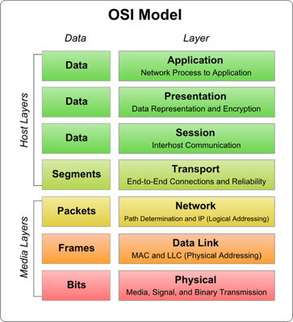
Application Layer
Recall that the application layer refers to the data that is exchanged
At times, we lump the top three layers together, other times we split them apart
Recall the concept of encapsulation between layers
Messages moves between levels in the stack – cannot skip!
Application data put into a transport layer, then network, …
Network core devices
Ignore application layer data
Until they don’t – traffic shapers and intrusion detection
This Photo by Unknown Author is licensed under CC BY
This Photo by Unknown Author is licensed under CC BY-SA
Notes:
The Kurose and Ross text is called the “top-down” approach because it starts with the application layers and works down to the physical layer. There are compelling arguments for starting at the top or the bottom. Since you’ve probably grown up using the internet then you are probably most familiar with the top layers, and that implies it’s as good place as any to start.
The application layers are the top three layers of the OSI model, or the just the top layer of the 5-layer model. At times, we pay careful attention to the differences between layers, at other times, we largely ignore them. For example, from a network’s perspective, we don’t care whether you are displaying your email in MS Outlook or on your phone. However, if we were tasked with supporting an email system for a large, multinational company, we’d probably pay careful attention to the network footprint different aspects of the application stack have on our systems.
In addition to lumping application layers together, one of the most important concepts is the idea of encapsulation. Sending emails, watching movies, and surfing the web are all very different applications – and have very different network requirements, but as far as we are concerned, the application, whatever it is, will communicate to the network using a transport layer. The transport layer is completely agnostic to whether the data its sending or receiving. The authors of the transport layer software can make absolutely no assumptions about the data that you’re exchanging. And this is a good thing!
Just for one moment, imagine that the opposite were true. If every different application that were deployed over the internet needed a special transport handler before it could work, then we would need to upgrade operating systems, switch, and routers to handle the next new app. However, if we were to imagine that world, then we could design a new transport for every new application that was totally optimized to handle every corner case for that application.
Since we don’t live in that world, it is important for software engineers to understand the impacts of their design choices when building a new application. In fact, it is in this interface between the application and transport layers that the software- and network-engineers need to work, hand-in-hand to deploy applications that can scale up to handle global demands. Some choices made here can be simple – what pick one of the well-known transport mechanisms; but then other choices may be less obvious, as we’ll see later in this series.
Finally, because the application layer is typically opaque to the transport layer (and lower), network core devices typically ignore the application data. So, typically routers don’t give different priority to web vs. email messages – they both get routed equally. However, there are some devices that do pay attention to the application. For example, a relatively new class of device called “traffic shapers” can prioritize some types of traffic at the expense of others. Network Intrusion Detection Systems (IDS) can use application data to detect when someone is trying to compromise a network and shut them down at the edge of the network.

Slide 5
Principles
Language independent
Application Architectures
Communications (Internet)
Transport Type (Internet)
Application Protocols
Notes:
The chapter introduces five key principles that govern how an application interacts with the network stack. Lets explore each in more detail.

Slide 6
Principles - Language Independent
Network code is handled by OS, language provides libraries for API
OS may expose different levels of OSI model
UNIX Transport Layer Interface (TLI)
Windows Network Driver Interface Specification (NDIS)
Sockets API
Establish a connection, create a file ID that can be used with read()/write()
struct hostent *server;
int sockfd;
struct sockaddr_in serv_addr = {
.sin_family = AF_INET,
.sin_port = htons(PORT),
};
char input[32];
sockfd = socket(AF_INET, SOCK_STREAM, 0);
server = gethostbyname(SERVERNAME);
memcpy(&serv_addr.sin_addr, &server->h_addr_list[0], server->h_length);
connect(sockfd, (struct sockaddr *) &serv_addr, sizeof(serv_addr));
write(sockfd, "EHLO localhost\r\n", 16);
read(sockfd, input, 32);
Notes:
Networking applications is a mixture of both hardware and software actions. Applications request data is to be exchanged, but it must eventually be put onto the network hardware. This is really a job for the operating system. The OS will manage the network hardware and provide structures to move raw data to and fro. But the OS’s role doesn’t stop there.
One of the key jobs of the OS is to protect information from possibly competing processes. Since there is only one network, but many network applications, when data arrives from the network, the OS look at the data and determine which process it should be delivered to (or possibly ignored entirely). If we left this up to individual applications then all hopes of security would be thrown out the window.
If the OS will manage the network stack, then it will provide an Application Programmer’s Interface to enable applications to make requests to the OS to send or receive network data. Like other OS APIs, they tend to favor the C language. They are wrapped up in C & assembler language compatible libraries that can be invoked easily by these and other languages. This leads to the idea that other languages like Java or Python can also include these libraries and make the same calls. Those languages frequently provide some helper routines to make it easier for the application developers, but ultimately, theres nothing that one language can do that cannot be done in another.
Different operating systems can also choose to expose different levels of the OSI stack to the application. For example, an OS could simply expose only the internet protocols transport mechanisms. Others provide lower-level entry points. One (terrible) example was the UNIX System V’s Transport Layer Interface that enabled programmers to design their own custom network stack. The Windows NDIS interface is similar in scope and slightly easier to use. In both cases, its possible to actually create alternatives to every layer in the OSI model – if you don’t like Ethernet, make your own!
In most cases, we don’t want to do that, instead, as an applications programmer, we just want to get a connection established that we can then read or write data to, and that is exactly what the operating system will do. Using the sockets API, we can establish a connection – often with some one-time setup such as what is shown here, but then we can use the read/write system calls to move data between computers.

Slide 7
Principles – Application Architectures
Client-server –
always on host (server), handles requests from ad hoc clients
Server typically handles all/many of the clients
Becomes a challenge to scale an application
Peer to Peer (P2P) –
applications communicate amongst themselves directly
Robustness and scalability can be better, but depends on number of peers
Notes:
The application’s architecture is another core principle. There are generally two versions of this: client server and peer to peer. The client server remains the most common.
In the standard client server model, there is an always-on host that is listening for incoming requests. When an ad hoc client connects the server will evaluate the message, perform some task on behalf of the server, and then listen for more requests. While this seems simple, as the complexity of the client-server protocol increases or the number of concurrent clients increases, the server can become overloaded and performance can suffer. We describe this as a scablility challenge, client server can be difficult to scale up.
On the flip side, peer to peer networks communicate amongst themselves. There is often some mechanism for peers to find each other and then, once found, they can communicate between them. This architecture naturally scales better than client-server, but it always depends on the number and reliability of the peers.
We will look at this in more detail in some upcoming slides.

Slide 8
Principles – Communications
Can be a many-to-many relationship between clients and servers
5 Tuple Keeps it All Straight
Client address, client port number
Server address, server port number
Transport type
Port numbers – Integers
Well known #’s assigned by IANA
22, 23, 25, 80, …
Can be anything, 1 .. 65535
By convention, <1024 is “restricted”
Notes:
One of the challenges created by applications is that there can be a many-to-many relationship between clients and servers. For example, the same client machine can have multiple connections open to the same server. Someone, we need a way to keep them all straight.
The Internet protocols use a combination of 5 things, or a 5-tuple from discrete math. This tuple includes the client address, the server address, the client port number, and the server port number, as well as the transport type.
Typically, a client opens a connection to a well known port number, using some anonymous local port number. For example, maybe a machine on campus has an address of 157.160.38.35, and it uses its local port 53234 to open a connection to 157.160.28.36 server port 80, using the TCP transport. These five values will be unique for the entirety of connection. In fact, these are the minimum number of values to uniquely identify any connection. The same computer could open another connection to the webserver using a local port of 55234, but it would still be connected to 157.160.28.36 port 80.

Slide 9
Principles – Transport Types
Types of transport:
Reliable data transfer –
sent message is guaranteed to be delivered or sender will be notified of failure
Throughput Guaranteed
guaranteed transport will deliver a steady of data within some constraint
Timing Guaranteed
Low-latency networks delivery messages with some negotiated constraint
Secure Channels
Transport provides protection of the data being exchanged
For example, end-to-end encryption to prevent “man in the middle” (MITM) attacks
Mobility
Data makes the best use of available networks with little to no application intervention
Notes:
There are four general transport types that applications can use, based on reliability, throughput, latency, and security. One additional dimension that is emerging is mobility.
Reliability means that a sent message will arrive at the destination or sender will be notified of the failure. The protocol may need to resend data to correct for errors or corrupted data, but the transport protocol will do that without any intervention from the application.
Throughput guarantees are desirable for applications that must move large amounts of data. Typically, the application has a mechanism to request some minimum amount of data (bits per second) that it can reserve for its transmission. For example, streaming services may need to sustain some minimum number of bits per second to keep the stream alive.
Timing or latency guarantees enable an application to send data with an upper bound on delay. For example, digital telephone networks may require a maximum of 100ms of latency to avoid detectable pauses in conversations.
Security has emerged as one of the most important transport types. The idea is that the application can off-load the encryption to the network, enabling more secure and strong implementations in the network drivers, and possibly off-loading the computation onto dedicated encryption hardware built into the network devices.
Finally, mobility is becoming an increasing challenge. As mobile uses move around, the “best” connection between the mobile device and a server can change. Plugged into a desktop, the mobile device may favor its tethered connection. Walking around a building, WiFi may be faster and more reliable than cellular. At the edge of a building, the two may become equally poor. Between buildings, cellular connections may become the most reliable. However, they are often “metered,” in that users pay per bit, and a connection established on one network may not be able to migrate to another – remember that 5 tuple? Change any one of those and the connections a different connection!

Slide 10
Principles – Transport Types (Internet provided)
Types of transport:
Reliable data transfer –
sent message is guaranteed to be delivered or sender will be notified of failure
Throughput Guaranteed oriented
guaranteed transport will try to deliver a steady of data within some constraint
although some messages may be dropped
Timing Guaranteed
Low-latency networks delivery messages with some negotiated constraint
Secure Channels
Transport provides protection of the data being exchanged
For example, end-to-end encryption to prevent “man in the middle” (MITM) attacks
Mobility
Data makes the best use of available networks with little to no application intervention
Notes:
The transport mechanisms provided by the Internet are limited by the nature of the packet switching and routing systems used by the internet protocol. Unfortunately, we are really limited to just reliability and a potentially higher throughput mode. Because we cannot control the path that a packet will take through the different internet exchanges, we cannot control the latency or throughput. There are no guarantees a packet will arrive, that it will arrive in order, or that there will be an upper bound to length of time it takes.
Consequently, applications developers need to keep this in mind. While the app-devs can shirk some of their responsibility onto the network, they cannot get all of these interesting guarantees.

Slide 11
Principles – Internet Transport Types
Transmission Control Protocol (TCP)
Connection-oriented
Client and server negotiate connection before data is exchanged
Establishes a socket connection that lingers on both sides until its closed
TCP stack (OS) needs to manage the state of the connection
Connection is a full-duplex socket
Reliable
Sender puts data into TCP stack, comes out the other side, whole and in order
Data may actually arrive in fragments, out of order, or may need to be resent
Requires out of band (OOB) messages to achieve this – e.g. SYN and ACK messages
Congestion Control
Every datagram needs to be acknowledged, creates a natural check on network flooding
Notes:
The Internet protocol provides two transport types, the Transmission Control Protocol (TCP), and the User Datagram Protocol (UDP), covered on the next slide.
TCP is a connection oriented protocol. Each connection has a state on the client and the server, and the TCP transport layer sends messages between the two end-points to establish and maintain that state. After a connection has been established, then the end-points can exchange data until one or the other closes the connection. The connection that is established is full-duplex, both end-points can send and receive data on the socket.
The TCP is a reliable transport. When the sender sends data, the data will come out of the transport on the other endpoint whole, in order, and free from errors; or the sender will be notified that the transmission has failed. Beneath this façade, the data may actually arrive in fragments, with errors, and out of order. The TCP will manage requesting retransmissions and reordering to create the reliable data stream that the application expects. Of course, that also means that the developer has ceded controlled to the TCP stack, and we are now at the mercy of the TCP stack, which knows nothing of the application, to send messages and establish connections.
This exchange of messages creates a natural congestion control mechanism. The TCP stack will only send some many chunks of data to the remote endpoint for it stops and waits for an acknowledgement. This prevents one endpoint from saturating either the remote endpoint or the links in between.
Lets take a look at packets flowing between two TCP end points using Cisco’s packet tracer.

Slide 12
Packet Tracer Example
Notes:
Lets take a look at packets flowing between two TCP end points using Cisco’s packet tracer.

Slide 13
Principles – Internet Transport Types
User Datagram Protocol (UDP)
Stateless – from the stack’s perspective
Application may need to manage the state
No guarantees on reliability
Application may need to re-request data
No congestion control
Application needs to apply its own brakes
Why!?
Sometimes an application knows more than the TCP stack does
Notes:
The User Datagram Protocol (UDP) is the other transport mechanism provided by the internet protocol. This protocol is stateless – the UDP stack doesn’t keep track of the state of the connection, that is the job of the application. The UDP doesn’t guarantee reliability. The application needs to do this – possibly requesting retransmissions, resending data until acknowledged by the remote application etc. No congestion control, but remote devices are free to drop UDP packets like hot potatoes. The application needs to set its own limits and apply the brakes on slow end points.
Why do this? Because sometimes the application has more information than the network stack does. Perhaps the best example was the Andrew File Server (AFS). Popular in the late 1980’s and 1990’s, AFS was able to scale up to 10,000’s of users, and could easily handle file shares distributed throughout the internet. In fact, before the WWW, AFS was how many scientists shared data sets with each other. The AFS relied on UDP messages. AFS servers did not need to keep state for connections that may never be used again, enabling less memory over head. On the flip side, the UDP messages included encryption and security tokens that enabled the AFS server to validate every client request and ensure data could never leak out. There are many more details and interesting design ephemera that AFS provided, this just serves as an example of information that the application has that the transport stack does not.

Slide 14
Application Protocols
Part 2
This Photo by Unknown Author is licensed under CC BY-SA-NC
Notes:
In the first part of this lecture series we discussed how there is an independence relationship between the application and transport layers in the OSI / internet model, and why that was important. In this part of the series we look at several different application protocols.

Slide 15
Application Protocols
Applications have their own protocols
Types of messages exchanged
Syntax of those messages
Semantics of the message fields
Rules for determining when / how messages are sent
Application standards vary
Open (but rigid) RFCs – Web, email, …
Close & proprietary – Skype, Facebook messenger
Remember OSI vs. TCP model?
We aren’t concerned with how a web page or email message is displayed, just how to get it from one system to another
GIVE ME 32
Vague
SEND MSG ID=32
Better
25 | 01 | 01 | 32
Best
Notes:
Applications have their own protocols that govern the types of messages, and syntax and semantics, and the rules for how the messages get sent. This is absolutely crucial. Computers, lets be frank, stupid – they lack the ability to determine the context of a message, they cannot handle any ambiguity in a message.
Application developers need to design the messages exchanged carefully and thoughtfully. Each application will have a set of messages that will be exchanged. For example, if we were to build a web-based email service, we would need messages that allow users to request an email message, and the server to return the requested message, but we’d also need to have messages that represent errors – such as the requested message doesn’t exist. Every type of action between a client and server will need to be defined with a message that can be exchanged to handle that action.
Each of those messages needs a clear and concise syntax. It is important that the syntax is clear and unambiguous. The receiver of the message needs to be able to determine if the message is well-formed or there has been an error. For example, <click> the message, as a string, GIVE ME 32, lacks clear semantics, while <click>the message SEND MSG ID=32 has syntax that can be more easily checked. <click> Arguably, the third message has even better syntax – its clear, integers long, we can look in a table to make sure that each of the different integers is one of a set of valid values, and reject the message if its not.
Its equally important to have clear semantics about each of the different parts of the message. The first version of the 3 messages is terrible, while its closer to human speech, it depends on the context of the communication to determine what you want. The second version is better, at least we can tell what the user is requesting, but its harder to parse. Finally, the third version is great – each of the fields’ meanings is determined solely by its number – we can look at a table of well known commands, look up command 25, and know exactly what the rest of the fields means.
Unfortunately, application standards vary widely. Some applications have official, open, and rigid RFCs that govern their message formats. Good examples are the various web and email RFCs. Other applications can have a more closed and proprietary format. These applications may be commercial, such as Skype or Facebook messenger, and not intended to be shared beyond their corporate developers. It doesn’t mean that they lack any standards, it just means that they aren’t widely published, or may even be held as trade secrets. Imagine if one could create their own Skype compatible client without having to pay for the licensing from Microsoft. Clearly, this would financially harm Microsoft, and would be likely to bring down the nazguls, err, the corporate lawyers onto you.

Slide 16
Hypertext Transfer Protocol (HTTP)
Developed in 1990s by Sir Tim Berners-Lee
RFC 1945, 2616
Client & Server based protocol
Typically uses ports 80 or 443
Client makes a request on a URL
GET – retrieve
PUT – upload
POST – send form data to a program
DELETE – remove a URL
PATCH – update contents in place
Notes:
Our first example of an open protocol is the hypertext transfer protocol developed in the 1990’s by Sir Tim Berners-Lee (though he wasn’t Sir at the time!). HTTP is governed by RFC1945, 2616, and some others. HTTP is the underlying protocol for moving objects on the web. The term object here means web pages, images, audio, video, or really anything between server and client.
The IANA assigned port number for HTTP is 80, and the encrypted version HTTPS is 443, but web servers can run on any port number. Its common to see port 8000, 8080, 8888, etc. used for testing on a local machine. Recall that ports > 1024 do not typically require elevated system privileges to open up, so a user on clipper can run their own web server on port 8000. This can create some interesting security issues!
The HTTP protocol defines several request types to create, replace, update, and delete web pages, a collection of actions we call CRUD. The most common two request types are GET and POST.
Due to the clear, unambiguous documentation, its possible for anyone to create a client or a server that meets the requirements of the standard. This animation shows a simple web request being made by a human using the “net cat” command. The request opens port 80 to web.ship.edu, and makes a GET request. The data that’s returned is the HTML contents of Ship’s web page. This type of operation can be embedded into any program, or used to retrieve more interesting results. For example, several years ago, I wrote a PERL script that connected to my kids’s school learning system and retrieved the upcoming homework and new grades. Each day it would tell me when they had upcoming assignments, and when my kids needed to some help in a subject. It worked because of the well developed HTTP standard.

Slide 17
TAKE A LOOK AT RFC 1945

Slide 18
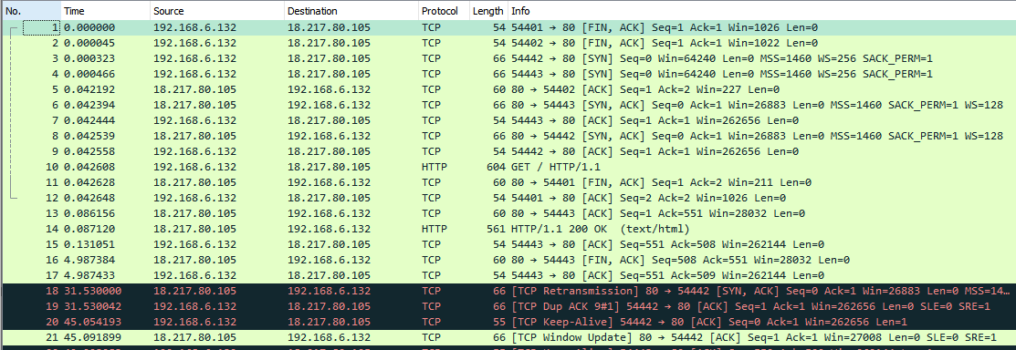
A simple HTTP request
A simple HTTP request –
note that we can see the request from the captured data
Note the OOB TCP messages (FIN, ACK, SYN)
Note the TCP keep-alive protocol
Notes:
In the last video, we looked at a packet tracer example for retrieving a web page. This trace is using the tool WireShark to capture live data from two real machines. We can actually do some interesting comparisons – note that this used 15 packets instead of the 12 from packet tracer. Lines #1 and #2 were closing a previous connection to the server (FIN), so ignore them. Lines #3 and #4 used port #54442 and 54443 to on one machine to open connections to port 80 on the remote server. Line #5 is an acknowledgement to #2. #6 is an ACK for #4. #8 is an ACK for #3, #9 is an ACK for #5 (note the out of order response!). #10 is the actual request – look at the text – it’s the same GET that we did on the previous slide! #11 is an old response to #1, #12 is the response to #11. #13 is the ACK for #10, #14 is the first chunk of the result, #15 is the acknowledgement. #16 is the server saying its done, #17 is the acknowledgement.
So, if we carefully map this out, we get the same 12 messages from packet tracer, but because its real-world, theres more “cruft” in the way. The time column is also pretty interesting – its in seconds. So, this web page took 86ms to request and retrieve the data, and then an additional 30ms to process the data in the application and close the connection.

Slide 20
Electronic Mail (email)
Mail Transfer Agent (MTA)
Simple Mail Transport Protocol (SMTP) RFC 5321
delivers received messages to user mail box
User mail boxes
Accessed locally as a text file
Accessed remotely using POP3 or IMAP
Notes:
Email became the killer application of the 1980’s, and it remains one of the most important user-facing services on the internet. There are several, somewhat independent, components in a mail system. One part, the mail transfer agent has the job of the postman – listening for incoming mail requests from other servers and delivering those messages to users inbox, or sending outbound mail to those remote systems. This part of the protocol is governed by the Simple Mail Transport Protocol (SMTP) and covered most recently by RFC 5321. We’ll see an example of the SMTP protocol on the next slide.
The other parts of the mail system work with users to retrieve their mail from their inbox. In days gone by, users used terminal oriented “mail” commands or their more visual versions such as elm or pine. Later, two other network facing protocols were developed, POP3 and IMAP. We’ll take a look at those shortly.

Slide 21
SMTP
Simple text-based messaging
Designed for a simpler, more trust-worthy internet
A human user or program could send email through SMTP:
S: 220 smtp.example.com ESMTP Postfix C: HELO relay.example.com S: 250 smtp.example.com, I am glad to meet you C: MAIL FROM:<bob@example.com>
S: 250 Ok
C: RCPT TO:<alice@example.com>
S: 250 Ok
C: RCPT TO:<theboss@example.com>
S: 250 Ok
C: DATA
S: 354 End data with <CR><LF>.<CR><LF>
C: From: "Bob Example" <bob@example.com>
C: To: Alice Example <alice@example.com>
C: Cc: theboss@example.com
C: Date: Tue, 15 Jan 2008 16:02:43 -0500
C: Subject: Test message
C:
C: Hello Alice.
C: This is a test message with 5 header fields and 4 lines in the message body.
C: Your friend,
C: Bob
C: .
S: 250 Ok: queued as 12345
C: QUIT
S: 221 Bye
{The server closes the connection}
Notes:
SMTP is a simple mail transfer protocol. It has some well defined rules – such as the “hello message” send by the server and the response from the client. SMTP was designed such that a human could deliver their own mail messages as is shown in this transcript.
We are inundated with mail, much of it Unsolicited Commercial Email or SPAM. To counteract this, the SMTP protocol has undergone several, such as only receiving messages from trusted hosts, required security keys and encryption, but ultimately, it works the same way it has for the last 40 years.

Slide 22
Mail Access Protocols
POP3
Simple protocol to allow a program to retrieve mail from a user’s mailbox
Designed for a quick connect, retrieve, and disconnect operations
Means mail client has to poll remote server to get new mail
IMAP
Allows more advanced features, such as folders, search, etc.
Retrieve portions of messages, even just portions that have changed
Stateful protocol, remains connected
Server can “push” notifications to the connected client
Notes:
POP3 and IMAP are two common methods for accessing a remote inbox.
POP3 is simpler, and used to move messages from the server to the local machine. A web client connects, retrieves the messages from the server, and deletes them as it goes. When its done, the POP3 client disconnects. To get new messages, the POP3 client has to reconnect and check if there are any that have been received. This is a form of “polling,” which can create delays in receiving messages. So, users can increasing the polling frequency, but then theres more network traffic due to the increased and wasted polling. This can also be troublesome on mobile devices, where the phone spends more time awake and polling mailboxes.
IMAP is a more comprehensive protocol, allowing more advanced features, such as folder organizations and partial retrievals. IMAP also stays connected – allowing the server to “push” messages to the remote device as they arrive. Of course, IMAP maintains that connection at a cost – the server has to manage more simultaneous connections, with the corresponding additional load on the system.
Given the hundreds of millions of GMAIL users, its hard to imagine how Google can support all of those imap users for people using their phones as their primary mail connection!

Slide 23
Packet tracer setup a web server

Slide 24
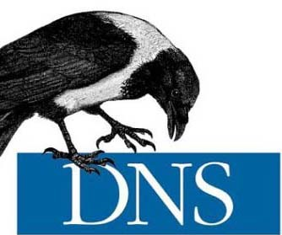
DNS and Streaming
Part 3

Slide 25
DNS – Domain Name Systems
Translate names to internet protocol (IP) addresses
Features:
Host lookup – convert name to address
Host alias – multiple names for same machine
Service alias – “ship.edu” for email can be different than web
Load balancing – DNS returns “rotated list” of servers
Architecture
Distributed, Hierarchical Database
Root servers maintain the pointers to top-level domain names
Top-level domain server points to each authoritative server for each domain name
Authoritative server points to each of its own machines
Notes:
The Domain Name System or DNS is probably one of the most important services on the internet. Its primary job is to provide a lookup service for human readable names and convert them to their IP address. As noted in the last lecture, IP addresses are typically expressed 4 integer numbers (also known as dotted-quad addressing). These addresses are highly network specific, for example 157.160.36.12 is a machine on our campus – but what does it do? On the other hand, most of know what sloop is, right? It turns out that sloop’s IP address is 157.160.36.12! Sloops a lot easier to remember. It is the DNS that allows us to get the IP address for a particular name.
There are several key features to this protocol. First, it can convert the name to an IP address, and if the system’s administrator desires, it can reverse the number to a name.
It also allows multiple names to be given to the same machine. These aliases are useful for naming services. For instance, maybe we start off with a single machine like sloop that handles our web and mail traffic, so we can create aliases such as “web.ship.edu” or “mail.ship.edu.” Later, we decide that we would be better splitting the machine up, so we can simply move the aliases to other machines, or dedicate them as their own machines. Aliases can also make systems administration tasks easier. For example, if sloop were one of several virtual machines on a server, we could create aliases like “vm0-guest0,” and “vm0-guest1”, … for each of the virtual machines. Then, its much easier to automate processes like backups, startup, and shutdowns.
The DNS also creates service descriptors for domains. For example, your email address might be “ab1234@ship.edu,” but there isn’t a single machine on campus that has that host name. Instead, the mail servers look ask the DNS system for the mail-exchange for that domain and deliver mail to the result.
DNS also supports load-balancing. A given name can have many addresses associated with it, and the order which they come out may be randomized or given in a round-robin nature. Using this strategy, we can now have several machines that each respond to “web.engr.ship.edu,” and the DNS will distribute requests to each one of them, spreading the load across all of the machines.
To pull this off, the DNS architected as a distributed, hierarchical database. At the very top of the hiear

Slide 26
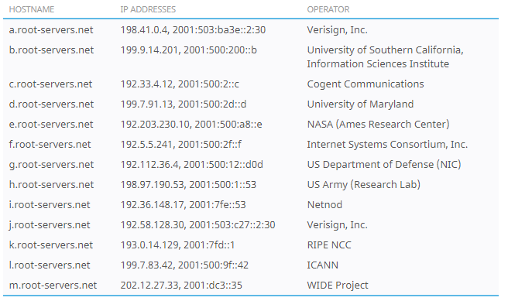
Root Servers
Root servers are at the top of the DNS hierarchy.
There are 13 different root server “clusters”, with 1086 instances world wide.
The root servers will direct traffic to the official top-level domain name servers
The root servers are the official directory of the internet’s top level domain names
5,635 TLD (in 2020)
There are 13 servers for .com TLD, and
There are 13 servers for .edu TLD.
13 seems like a common number here?!
Let checkout http://root-servers.org
Notes:
There are 13 root server clusters that service the entire internet. Each of the 13 clusters is managed by a designated operator, and the operator determines peerage rules. While many of these operators are US based companies or agencies, the actual cluster computers are not. The job of the root servers is to answer queries about how to get to one of the 5635 top-level domain name designated servers.
For example, if my DNS wants to find “google.com,” if it doesn’t already know, then it will need to ask the root server who handles the “.com” TLD, but the root servers do not serve anything more specific. For example, the root servers don’t know how to resolve “google.com”.
These cluster computers all share the same IP address. When a root node cluster is added to an internet exchange, all of the traffic at that exchange can use that more local connection rather than one that is “further” away. So, when your DNS server tries to resolve an address and it asks “192.41.0.4”, the a-root-servers.net address, it probably won’t make its way all the way back to Verisign, but rather be handled in one of the internet exchange points before it gets there.
This is really a great idea – by spreading these root servers out across the world, the internet naming system should be able to survive just about any type of natural disaster or man-made assault.

Slide 27
Top-Level Domain Servers
The top-level domain servers are at the next level of the hierarchy
These services direct DNS lookups to the “authoritative” server for a specific domain.
For example, EDUCASE is the sole registrar for “.edu” domain names
Ship, and all other .edu’s have a record with their registrar to point to our designated or authoritative name servers.
Lets checkout “nslookup” on ship.edu…
Neustar UltraTools DNS Traversal tool https://www.ultratools.com/tools/dnsTraversal
Notes:
The top-level domain servers are at the next level of the hierarchy. Architecturally, they are similar to the global root servers. There are 13 clusters, and each cluster may be replicated around the world. Each registrar maintains its own database. For example, EDUCASE, an advocacy group for technology in education manages all of the “.edu” domain name assignments.
For example, we have “.ship.edu” as our domain name. To get this, we simply asked EDUCAUSE for the registration. If we were really sneaky, we could have asked for “.millersville.edu” too. If we were really mean spirited, we could even point that at a fake website. Ideally, EDUCAUSE will police the domain registrants and deal with conflicts like that. Every TLD registrar has its own process for dealing with that.
When one of EDUCAUSE’s clustered computers receives a request for a “.ship.edu” address, it doesn’t know how to answer it specifically, but it can reply with which servers are authoritative for the domain and redirect the request there.
Why have this middleman? This is a classic Divide and Conquer approach to solving a problem. Consider the split between the root servers and these middlemen. While there are 5800 TLDs on the internet now, there are millions of different domain names. By splitting the name lookup by TLD, the load can be spread out over more clusters. Now, consider the split between the middle men and the institutional or corporate name servers, and the billions of host names that those databases contain. Not only would this database be huge, but it would be slow to respond. Further, there would be a near constant stream of changes to the database as institutions CRUD up the DNS entries for their site.

Slide 28
Authoritative Server
Each domain maintains its own publicly facing DNS server
Can create as many or as few records as desired
Can have subdomains: engr.ship.edu
Subdomains have their own name services.
Notes:
Finally, at the local level, there is an authoritative domain server for each domain. For performance and security its often a good idea to have a cluster here as well, although its typically much smaller, often three or four machines for a large organization. In the case of Shippensburg, we can see that we do have such an arrangement, and we have a backup copy of our database served by IUP, so that if the campus network were unavailable, our names could still resolve, which is useful for services such as Office365 or Google that are not physically located on our network.

Slide 29
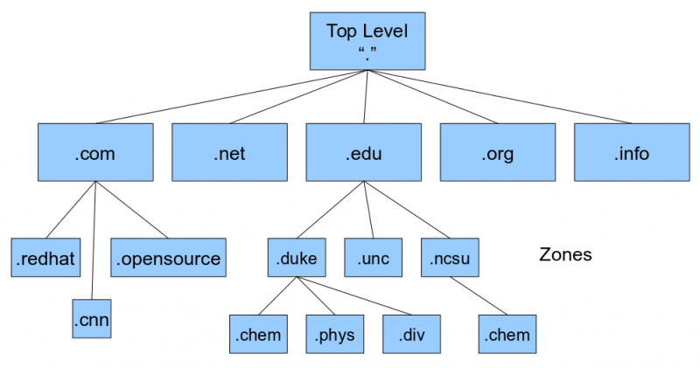
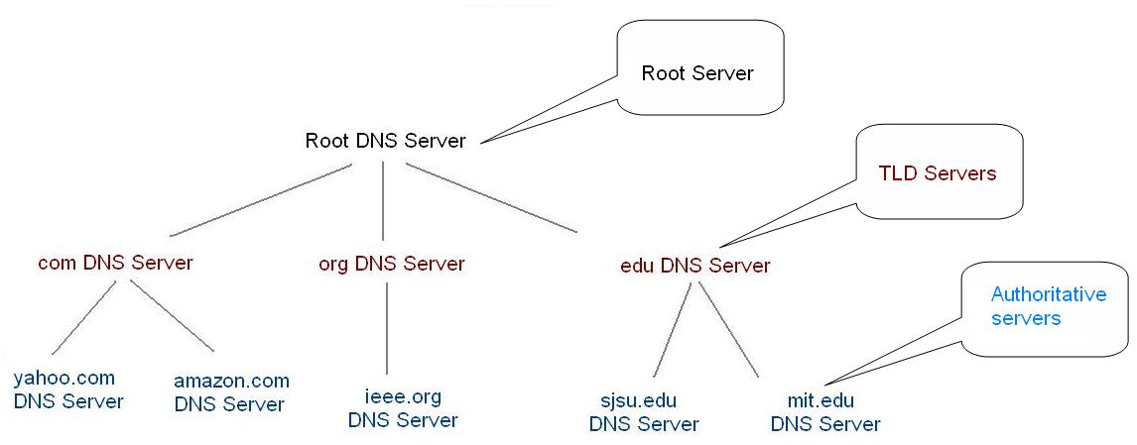
DNS Hierarchy
This Photo by Unknown Author is licensed under CC BY-SA
This Photo by Unknown Author is licensed under CC BY-SA

Slide 30
Types of DNS Results
Each DNS entry is a 4-tuple: (Name, Value, Type, TTL)
Type A – name is hostname, value is IP address
Type NS – Name is a domain, value is hostname of authoritative server
Type CNAME – Name is a hostname, value is a canonical hostname
Type MX – Name is a domain alias, value is a mail server
TTL indicates how long the value can be cached by intermediate servers

Slide 31
DNS Lookups
Database lookups are reverse-hierarchical
Local machines ask their DNS server to resolve a hostname
That DNS server can retrieve information from the root and TLD DNS to get to the authoritative server
Finally, your local DNS asks the authoritative server to resolve the name
Enables each domain to maintain their own list of machines
Root servers become critical, protected resources
The middle servers becomes important for security and privacy

Slide 32
Packet Tracer DNS Example

Slide 33
Peer to Peer Distribution
P2P architecture has minimal reliance on always on, central servers
Classic example is BitTorrent
Peers distribute portions of files
Distributes the server bandwidth across all peers
Peers are not anonymous!
Peers are not reliable!
Notes:
After that deep dive into DNS, lets shift gears and take a look at Peer to Peer distribution and how these applications impact network transport. Recall that there are two main ways to organize a protocol, one based on client server, like the DNS that we just studies, and the other is the peer to peer.
Peer to Peer or P2P architectures try to make minimal reliance the always-on, centrally managed servers of the client-server architecture. The classic example of a P2P architecture is BitTorrent. The BitTorrent architecture uses peers to distribute contents of files. Because each peer is pushing data out to each other, it becomes very hard to fully saturate a single link.
Of course, it should be noted that while BitTorrent does improve performance, it doesn’t mean that peers are anonymous nor does it mean that the torrent distribution network is any more reliable than the client server version. We’ll take a look at this in a bit.

Slide 34
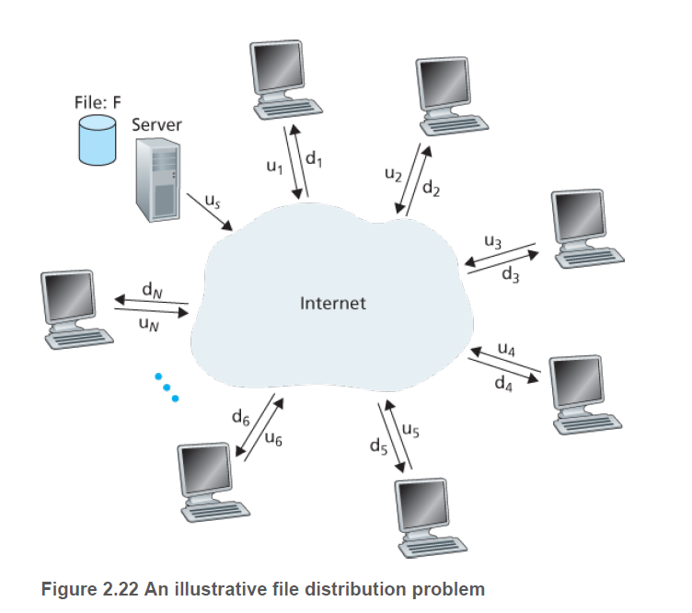
Client Server – Single Server, Multiple Clients
Let
$u_{s}$ represent the total upload rate of the server
$u_{i}$ represent the upload rate of a client
$d_{i}$ represent the download rate of a client
$F$ represent the size of the file (in bits)
$N$ represent the number of clients / peers that wish to retrieve the file
F$ind D,$the distribution time
Server must send one copy of file to each client: $NF$ bits
At best, server’s upload rate is max, so $D≥NF/u_{s}$
At worst, time is set by slowest client: $Dworst≥F/min\left(d_{1},d_{2},…d_{n}\right)$
So, $D_{CS}≥\max\left(\frac{NF}{u_{s}}, Dworst\right)$
Lower bound on transmission rate
What happens if: $\sum{d_{i}}≫u_{s}$?
Notes:
If the goal of a Peer2Peer network is to remove the bottlenecks created by a central server and the congestion of a central network, then we should be able to quantify the improvement in performance. To do that, we need to consider some basic mathematics.
We represent the relationships between computers, servers, and the internet as in this figure. We can represent u_i, and d_i as the upload and download speed of computer on the internet. We represent the “thing” that is being download a generic file with F number of bits. Finally, we track the number of peers or clients that are trying to retrieve the file.
Lets first study the client-server model. At best, the server’s upload speed is better than anyone else’s combined, and it becomes the minimum time for an upload (i.e. we cannot exceed the upload speed). So, the distribution time must be at least D >= NF/us. However, in the worst case, we have to wait for the slowest client. The total time to distribute to ALL clients is no worst than Grandma and her 2400 bps modem. So, what we end up with is the relationship that the distribution time must be at least as bad as the max of the two of those. Can we find a lower bound? What happens if the total download speed is way bigger than the upload speed?

Slide 35
Peer to Peer
Initial seed - upload file to first peer: $Dfirst≥F/u_{s}$
Slowest peer sets minimum time:
$$Dslow≥F/min⁡(d_{1},d_{2},…d_{n})$$
Peer-to-peer bandwidth is the aggregate of the upload rate: $Dagg≥NF/\sum{u_{i}}$
Minimum time:
$$Dpp≥Dfirst+max⁡(Dslow,Dagg)$$
Notes:
For the peer-to-peer arrangement, there is a cost to upload the file to the first peer. After that, the slowest peer sets the minimum time, so the time must be >= that peer’s time. However, the fastest peers can download based on the aggregate bandwidth the other peers, so the aggregate time must be at least that bound. Finally, the time for peer to peer must be at least as bad as the worst of those three times.

Slide 36
Scenario 1 – Client Server Wins (Barely)
Notes:
In this first scenario, there are only a handful of clients, their download speed is assymetric to their upload speed – pretty common in household last-mile type connections. Here, there aren’t many clients, and the servers big upload speed wins.

Slide 37
Scenario 2 – Peer to Peer Wins
Notes:
In this scenario, there are 25 clients / peers, we still have a assymmetric upload speed, but because there are so many peers, they can beat the client server.

Slide 38
Iterating the two scenarios…

Slide 39
Discussion
Both analysis set lower bounds
Both lower bounds are achievable
Client server centralizes loads
Demands higher-bandwidth networks and server (cost is super-linear!)
Adding more bandwidth can saturate server
Adding more server can saturate bandwidth…
Peer to peer distributes loads
At the cost of inability to control number of active peers
Popular downloads might have hundreds or even thousands of peers, others not
Content providers cannot control content
Asynchronous sharing – aka leeches

Slide 40
BitTorrent
Popular P2P file sharing protocol
Peers in a torrent share equal-size chunks of files, typically 256KB
Each torrent has a tracker node
Tracks peers
New peers join the tracker node, advertise their status and file data
Peers exchange data with neighbors
Priority determined by highest bandwidth neighbors (unchoked)
Randomly client will pick one to send data (optimistically unchoked)
Can establish a new unchoked peerage to maximize throughput
Penalize freeloaders
Data is tracked by a distributed hash table
DHT tells who has which chunks
Chunks are finger printed (MD5 sum) to prevent modification

Slide 41
Video Streaming
Video streams
Compressed stream of images, 24-30 frames per second
Compression algorithms today are high variable, can be tuned on demand
High def – 100kbps – 3Mbps, 4K >10Mbps
Often use HTTP streams
Use the partial-content request to grab chunks of data
Dynamic Adaptive Streaming over HTTP (DASH)
Video stored on server in several differential compression qualities
Client requests a few seconds at a time, adapts its quality based on bandwidth
Depend on Content Distribution Networks (CDN)
Recall Netflix’s Open Connect servers

Slide 42
Content Distribution
Server Placement
Enter Deep – Akamai, Netflix and Google strategy
Place content servers deep into the ISPs networks
Akamai keeps 1700 servers throughout the world
Harder to maintain and keep refreshed
Bring Home – Google
Manage central content servers at top tiers
Use private networks to get users into content centers quickly
Google Example
14 mega-data centers, having on order 100,000 servers each
50 clusters in IXPs scattered around world, 100-500 servers each
Hundreds of enter-deep clusters in ISPs 10’s of servers each

Slide 43
Netflix Case Study
Netflix –
Based on Amazon’s Cloud Computing
Content ingestion – studios upload movies to Netflix’s amazon compute nodes
Content processing – compute nodes create different versions (DASH)
Upload to CDN – upload to Amazon’s compute nodes, as well as open-connect servers
Uses Akamai to distribute its web pages to customers
Direct IXP installs at 50 locations
Open Connect
Large sites : Several 10Gbps uplinks, 100 TB of storage per rack
Small sites: Netflix predicts demand and uploads select content to smaller servers

Slide 44
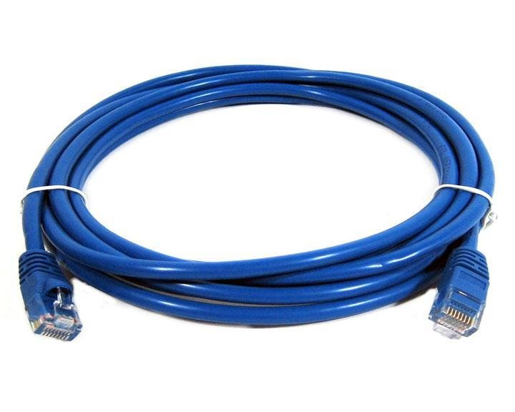
Socket Programming
Part 4

Slide 45
Socket Programming
Examples:
UDP client
UDP server
TCP client
TCP server
Web server
Web client
File server
File client

