Slide 1
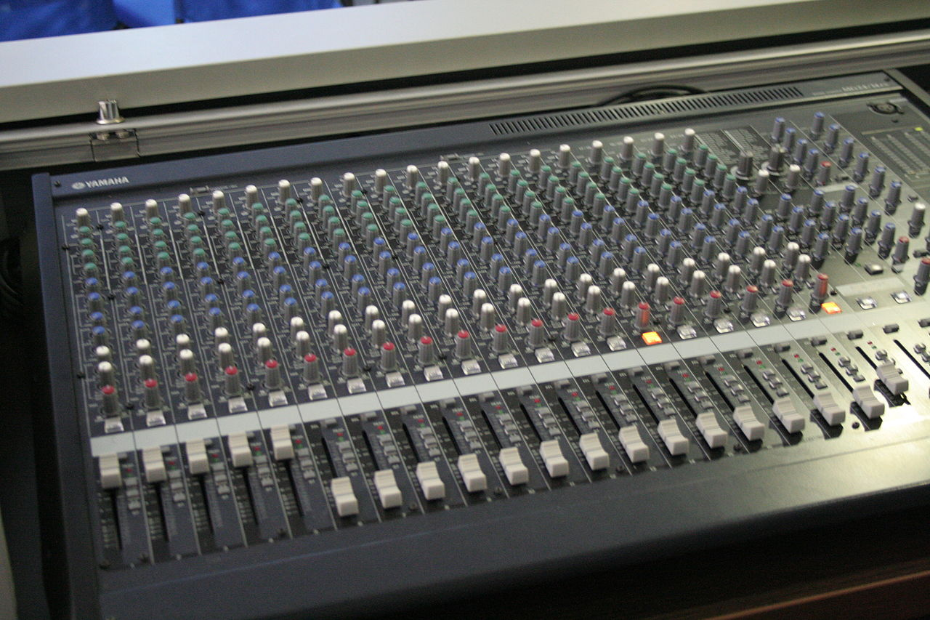
Network Layer Control Plane
Chapter 5
This Photo by Unknown Author is licensed under CC BY-SA

Slide 2
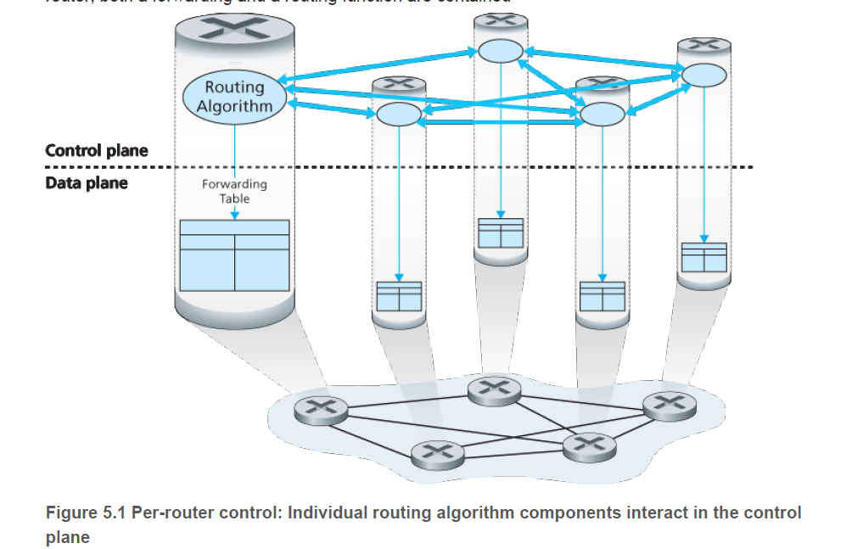
Network Control Plane
Types of Control
Per-Router
Each router maintains own configuration
Static, OSPF, BGP
Centralized Control
Control agent manages configuration for fleet of routers
Typically a logically central (but distributed) CA
Standard for large datacenters for load balancing and distributing services
Especially for geographic distribution – www.google.com may be the same IP but not the same machine

Slide 3
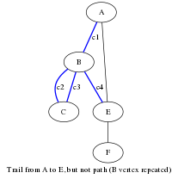
Eine kleine Graphmusik
Graph – logical construct
Set G=(E,V), where
Each vertex $v∈V$, and each edge $xy∈E$
Can be directed or undirected
Edges can carry annotations such as “cost” – note quotes
Properties of Graphs
Well studied in topology, strong algorithms for answering questions
Graphs can be used to simplify the actual real-world

Slide 4
Paths in a Graph
Path from u to v:
A sequence of edges which starts at vertex u and arrives at v.
Path length – number of edges
Path “cost” – total “cost”
If “cost” is a constant 1, then path cost = path length.
Shortest Path
path with fewest edges
Least cost path
Path with least “cost”

Slide 5
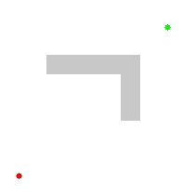
Dijkstra’s Algorithm
Proposed by E.W.D. in 1956 – finds shortest path in a graph
Runs in time $Θ\left({\left|V\right|}^{2}\right)$
1 function Dijkstra(Graph, source):
2
3 create vertex set Q
4
5 for each vertex v in Graph:
6 dist[v] ← INFINITY
7 prev[v] ← UNDEFINED
8 add v to Q
10 dist[source] ← 0
11
12 while Q is not empty:
13 u ← vertex in Q with min dist[u]
14
15 remove u from Q
16 // only v that are still in Q
17 for each neighbor v of u: 18 alt ← dist[u] + length(u, v)
19 if alt < dist[v]:
20 dist[v] ← alt
21 prev[v] ← u
22
23 return dist[], prev[]
Run-time complexity:
$$O\left({\left|V\right|}^{2}\right)$$
Space complexity: $$O(\left|V\right|+\left|E\right|)$$
https://en.wikipedia.org/wiki/Dijkstra%27s_algorithm

Slide 6
Path Costs
Dijkstra’s Algorithm works for many different problems
The “cost” parameter is subjective – value > 0 can work
For roads, it could be distance, est. fuel cost to travel, time to travel
For networks, it could be:
Round trip time
Cost through an interchange
Bandwidth
Costs can also be composite and as complex as you like: $f\left(x\right)=\sqrt{1+RTT^{2}+QDelay^{2}+\log_{10}{Bandwidth}}$

Slide 7
Link State Algorithm
Link-State algorithms have
Require complete knowledge of network topology
All links and all edge weights
Uses this to setup the “graph” for Dijkstra’s algorithm
Requires
Some additional algorithm to communicate link-state to all other routers
Unfortunately…
Link state can change as soon as its been transmitted!
Even worse…
Selection as “best node” can overwhelm a previously OK router
Causes “oscillations” in the network state leading to instability and slowdown
Notes:
Show an example of routers using “congestion state” as their cost – a previously good path becomes a bad path, unloading the previously overwhelmed router.

Slide 8
Distance Vector Algorithms
DV algorithms
Replace global state with “distance vector” that is exchanged between adjacent routers
Depends on adjacencies and cooperation between routers
May not lead to the globally best path but a locally best path
Still requires another algorithm to exchange distance vectors.
Typically, whenever a neighbor sends a new DV, the router recomputes its best DV, and if there are changes, resends them.

Slide 9
Distance Vectors & Bellman Ford
Distance vector: $\vec{D_{x}}=\left(d_{x1},d_{x2},…d_{xn}\right)$
Where:
$d_{x}(y)$ represents router x’s estimate of least from itself to router y
Bellman-Ford
Provides an “update” function to revise local distance vector.
Given a set V of distance vectors from router x’s neighbors: $d_{x}\left(y\right)=\underset{v}{argmin}{( \left(x,y\right)+d_{v}(y))}$
Notes:
Suppose there are three routers. Router x has a distance vector set: x,y,z : | 0, 5, 1 |, |1, 0, 3|, and |2, 2, 0|, we can update x’s distance vector dx(y) = min from: 5+0 or 1+2, since 3 is < 5, we replace dx(y) with 3. next, we compute dx(z) and min of (5+3 or 1+0), stays 1.

Slide 10
Infinite Iteration
Distance Vector algorithms can fail to converge
Updates can cancel each other and “oscillate” back and forth
Iteration can also create routing loops
To route from X to Z, if X believes its best path to Z is through Y, and Y believes its best path to Z is through X then we get an infinite cycle
Poisoned Reverse
If Z routes through y to get to x, then z will advertise to y that its distance to x is infinity

Slide 11
Comparison
Factor | Link-State | Distance Vector
Locality | Global | Local
Message Complexity | $$Θ({|V|}^{2})$$ | $$O\left({\left|V\right|}^{2}\right)$$
Speed of Convergence | $$O\left({\left|V\right|}^{2}\right)$$ | $$O\left(\left|V\right|\left|E\right|\right)$$
Robustness | Router can broadcast incorrect costs, but its neighbors can route around using global state. | A node can advertise a bad route, and cause catastrophe through the whole network.

Slide 12
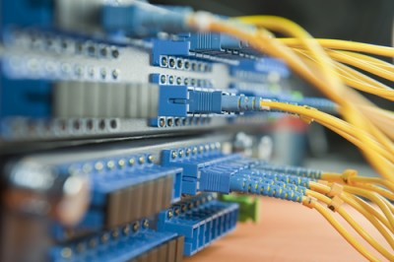
Autonomous Systems
Autonomous Systems
A collection of systems that are organized and locally managed by the same operator
Typically represents a collection of one or more routers organized at the local level and share administration domains
Larger ISPs can be split into multiple AS
Manage complexity
Incremental technology improvements
Regionalization
Mergers & Acquisitions
Routing is different
IntraAS – routing internal to the AS
InterAS – routing between different AS
This Photo by Unknown Author is licensed under CC BY-NC-ND

Slide 13
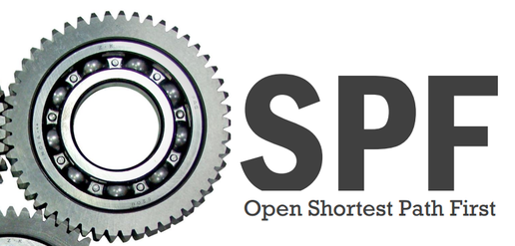
Open Shortest Path First
Link state algorithm
Interior Gateway Protocol (IGP)
Used almost exclusively as intraAS
Broadcasts link state to all neighbors
Uses Dijkstra’s algorithm to find shortest paths
Each router has a complete topological map of the network
Computes a shortest path to all subnets in the AS with itself as a root node
Can then accept traffic from other nodes and route them along “its” best path
This Photo by Unknown Author is licensed under CC BY-SA

Slide 14
Theory versus Reality
OSPF requires some set of link weights
Link weight / cost typically the bandwidth of the network link
Challenging for “point-to-point” links or congestion prone links
Link weights may not be constant – can be a composite
Determined by network operator to control traffic flows
E.g. Fastest link may be most expensive
Network operators want a desired network configuration
Need to figure out the weights to arrive at that after OSPF converges
Notes:
Do example where the OSPF “converged” routes might not be what we want.

Slide 15
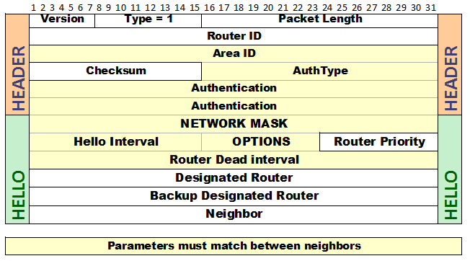
Implementation
OSPF uses a broadcast mechanism to send its routing info
Periodically – must be < 30 minutes
Asynchronously – when a link state changes
Communicates over IP in its own transport layer
Important to select interfaces that receive OSPF broadcast
Can expose confidential information outside of AS

Slide 16
OSPF “Hello”
“Hello” message
Initial multicast message where each router advertises itself and its route costs
Routers keep sending hello messages periodically
Eventually, all routers in an AS learn about each other and their costs
Routers then send costs on a periodic basis and keep checking each other’s status. If a router does not respond (e.g. <10sec) then it forces a recalculation of routes

Slide 17
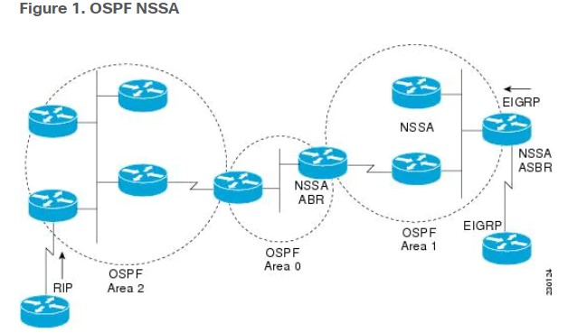
OSPF Areas
A single AS can be subdivided
Simplify administration zones
Reduce OSPF overhead
Recognize geographic differences…
OSPF allows “areas” to be defined
Uses the same dotted quad as IPv4 (but it isn’t necessarily the IP address)
Area 0 (0.0.0.0) is the “backbone” and connects areas to each other
Areas are linked to the backbone by with “area border routers”
Stub Areas
OSPF area that does not receive OSPF routes
Usually external to the AS
Reduces the size of the link-state database

Slide 18
OSPF vs. Previous Protocols
OSPF wasn’t the first internal routing algorithm:
E.g. RIP, RIPv2, EIGRP
Security
OSPF was designed to include a key/password exchanged using a simple plain text or MD5 hash. This is to provide authentication and verification
Same cost paths
OSPF allows multiple same-cost paths and can select them using a network admin determined function (e.g. Round Robin) – supports load balancing
Supports hierarchical routing within an AS
OSPF has “areas” that enable routing decisions to be made separately from each domain.
This Photo by Unknown Author is licensed under CC BY

Slide 19
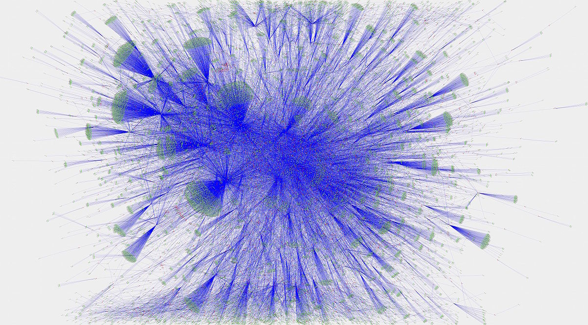
Border Gateway Protocol (BGP)
Inter-AS Routing Protocol
Design for exchange between AS
Distance vector algorithm
BGP exchanges CIDR ranges – automatically combines subnets
Each AS sends external routes that they service
BGP builds the “best” paths to reach those routes
BGP used heavily in the internet exchanges to facilitate inter-AS routing
This Photo by Unknown Author is licensed under CC BY-SA

Slide 20
BGP Best Routes
Hot Potato Routing
Default mechanism for BGP – get the packet out of the routing cloud as fast as possible w/out regard for next AS
Route Selection Algorithm
Pick the interface that advertises itself to handle the network prefix of the packet
Assign local preference on BGP attributes
If ties, select routes with shortest AS-PATH
If still tied, use hot potato using closest next-hop
If still not unique, pick randomly
This Photo by Unknown Author is licensed under CC BY-NC-ND

Slide 21
BGP Autonomous Systems
BGP is organized around autonomous systems
Collection of IP routing prefixes that are under the control of a network operator on behalf of an entity.
There are public and private autonomous systems – e.g. Ship is AS398663, Google is 15169, Microsoft is 8075. All of an organization’s routes are tied to these AS numbers.
BGP advertises the routes as belonging to a specific AS rather than a specific router
Goal is to find best path to an AS rather than a specific network
ASN are assigned by IANA – like IP addresses
ASN are 32-bit – like IP addresses

Slide 22
BGP Information
BGP is an incremental protocol
It only sends on changes
New route advertisements
Route withdraws
Changes to attributes
Rate changes
BGP is also a path-vector protocol
In addition to the distance vector, adds the path to take advantage of that distance
Routers can then select shortest paths as a criteria

Slide 23
Routing Policy
Why are there different policies for inter- and intra- routing?
Costs
IntraAS – everything is related, and operators likely to pay for capacity to get best performance.
InterAS – network operators less willing to cover costs for everyone elses routes
Scale
IntraAS – OSPF can handle many routers, but in practice, only a handful
InterAS – BGP has to scale to handle the entire internet
Performance
IntraAS – OSPF is targeted to find best route and maximize performance in a constrained network
InterAS – BGP has to handle complex policies and service agreements that change constantly.

Slide 24
Obtaining Internet Presence
SOHO
Asymmetric speeds, limited bandwidth
Loop availability
Co-location
Growth
Medium operation
Dedicated loops
Higher costs
More CPE
DNS, Routing, Firewall, DHCP, …

Slide 25
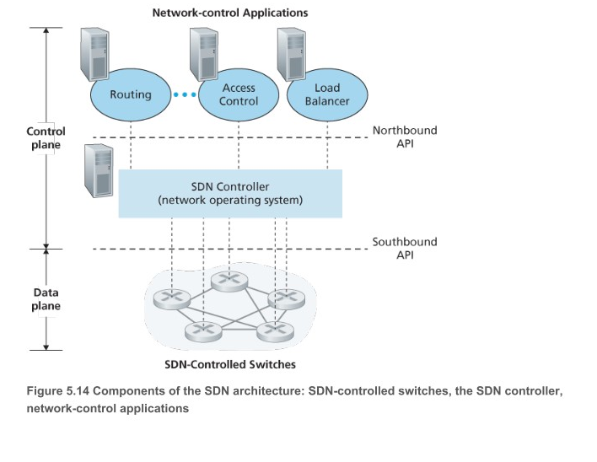
Software Defined Networks
Software Defined Networks
Using “flow based forwarding”
Separation of data and control planes
Network control functions external to the routing network
Programmable Network

Slide 26
Internet Control & Status
Part 2

Slide 27
Internet Control Message Protocol (ICMP)
Internet Control Message Protocol
Used to exchange status messages between devices – typically routers, not data.
RFC 792
Generate response to errors in IP operations, directed to the source IP
ICMP messages are encapsulated in an IP packet
IP protocol 1

Slide 28
ICMP Control Messages
There are a variety of ICMP protocols / message types:
Type | Code | Description
0 | 0 | Echo Reply
3 | 0 | Network unreachable
3 | 1 | Host unreachable
3 | 2 | Protocol unreachable
3 | 3 | Port unreachable
3 | 4 | Fragmentation Required
3 | 5 | Source route failed
3 | 6 | Dest. Network unreachable
3 | 7 | Dest. Host unknown
3 | 8 | Source host isolated
3 | 9 | Network admin. prohibited
3 | 10 | Host admin. Prohibited
3 | 11 | Network unreachable for ToS
3 | 12 | Host unreachable for ToS
3 | 13 | Comm admin prohibited
3 | 14 | Host procedure violation
3 | 15 | Precedence cut-off in effect
Type | Code | Description
5 | 0 | Redirect datagram for network
5 | 1 | Redirect datagram for host
5 | 2 | Redirect datagram for ToS & Net
5 | 3 | Redirect datagram for ToS & Host
8 | 0 | Echo Request (ping start)
9 | 0 | Router advertisement
10 | 0 | Router Solicitation
11 | 0 | TTL expired in transit
11 | 1 | Fragment reassembly exceeded
12 | 0 | Pointer indicates error
12 | 1 | Missing required option
12 | 2 | Bad Length
13 | 0 | Time stamp
14 | 0 | Time stamp reply
42 | 0 | Extended ping request
43 | 0 | Extended ping reply – no error
43 | 1-4 | Extended ping reply - error

Slide 29
ICMP – Time Exceeded Message
Generated by gateway to inform source of discarded datagram due to TTL reaching 0.
Used by traceroute command to identify gateways

Slide 30
ICMP – Destination Unreachable
Generated by a host or gateway if the destination is unreachable.
TCP has this built in – responds with RST
UDP & other protocols don’t – need an ICMP response

Slide 31
ICMP in Software
Kernel Task
ICMP messages are sent & received by the device controller or OS
Linux exposes some features to you – but retains ownership of the ICMP stack

Slide 32
Traceroute
Traceroute makes clever use of the ICMP protocol
Sets IP packet “TTL” to a 1, sends ping to remote machine
First router in path gets a packet that just “expired”, sends ICMP message in reply
Traceroute computes time of send and reply to measure RTT
Then, traceroute sets TTL to 2, sends again to get next router…

Slide 33
ICMP in WireShark

Slide 34
ICMPv6
IPv6 has its own ICMP version
Has support for “ping6”, but used for Router & Neighbor Solicitation

Slide 35
Flood Ping
Normally, ping messages are innocuous
Ping utilities are built to be “rate limited” – typically one per second
Flood pings –
No rate limit – send another as soon as a response is received
Malicious – send as fast as you can, don’t wait for a response
ICMP messages take priority on IP networks & routers
A form of denial of service attack

Slide 36
Ping of Death
A malicious ping can be delivered to a machine and cause kernel to crash
Well-formed ping is 56 bytes total, but can be as large as 65,355 bytes
One problem can be that the receiving host received malformed ping and crashes
Another is buffer space exhaustion

Slide 37
SMURF Attack
A massively distributed denial of service attack
Large numbers of ICMP echo requests were sent with a spoofed source IP
Send via broadcast – all hosts reply

Slide 38
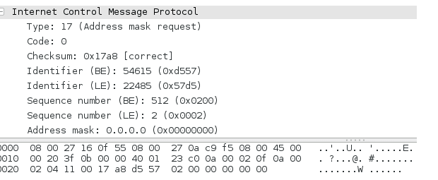
Using ICMP to surveil a remote host
Using tools like Kali, wireshark, and hping3
hping3 –icmp-addr –c 3 [victim ip]
*SHOULD* return the subnet mask of the victim host. Why is this useful? Find other victims.

Slide 39
Using ICMP to surveil a remote host
Other nifty hping3 techniques:
hping3 – icmp-ts : issue “time stamp requests” to see what time the remote system reports – can give a glimpse into time zone (location), time accuracy, etc.
Ping record route:
ping –c -1 –R destintion Ask ICMP messages to stamp ICMP replies, up to 9 hops can be stamped May be more accurate than traceroute – reflects actual results
Fuzzing
ICMP messages are a potential attack surface for a fuzzing attack

Slide 40
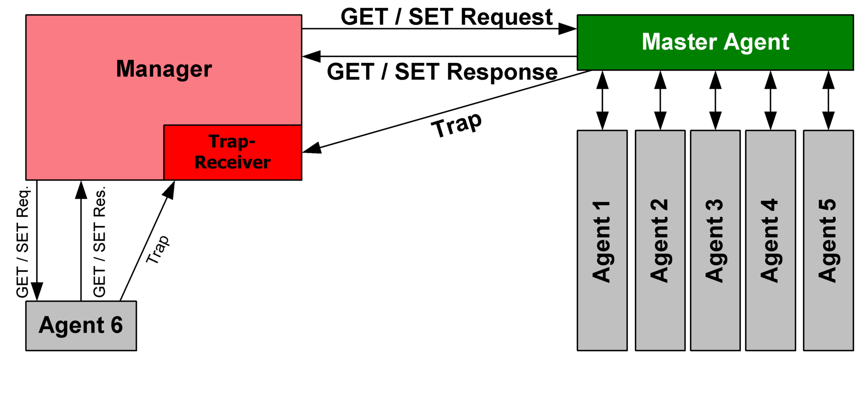
Simple Network Management Protocol (SNMP)
A standard software protocol that enables management of network devices
Key Components
Managing Server
Managed Device
Management Information Base (MIB)
Network Management Agent
SNMPv2
Polling mode
Traps
Message Types:
Get Request, Get Next Request, Get Bulk Request, Inform Request, Set Request, Response, Trap

Slide 41
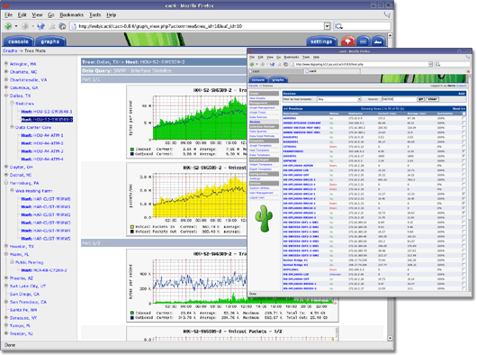
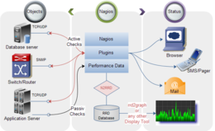
SNMP Management Tools
Cacti
Nagios

Slide 42
Scanning hosts with SNMP
Scanning for snmp hosts on a network:
nmap –p 161 157.160.36.0/22
Walking the tree:
snmpwalk

Slide 43
Cisco IOS Commands
Part 3

Slide 44
OSPF in Cisco
Cisco’s Implementation of OSPF Features
Sub Areas
Route redistribution from other sources
Authentication
Configurable costs, rexmit intervals, transmit delays, priority, dead/hello intervals
Virtual links through point-to-point & disconnected networks
Not-So-Stubby Areas

Slide 45
Cisco OSPF Router ID
Router-ID uses the largest IP on its interface as RouterID
Loop back addresses ALWAYS selected first
Router(config)# interface loopback 0
Router(config-if)# ip address 1.1.1.1 netmask 255.255.255.255

Slide 46
Cisco OSPF Enabling
OSPF “process ID”
A number used to identify the OSPF process
Can be more than one OSPF process!
Make sure its something you can remember – e.g. we’ll use “100”
But it could be any integer.
After enabling
Select the networks that should be advertised
Also select whether to redistribute routes
See help for more commands
Wildcards, Not Network Masks
Uses wild-cards – if a bit is clear, cannot change, if its 1 it can be anything.
Netmask 255.255.255.0 becomes wildcard 0.0.0.255
Router(config)# ip ospf 100
Router(config-route)# network 192.168.10.5 0.0.0.7 area 10

Slide 47
Cisco OSPF Interface Specific Parameters
Cisco also allows specific parameters on each interface:
Router(config-if)# ip ospf cost #
Router(config-if)# ip ospf retransmit-interval seconds
Router(config-if)# ip ospf transmit-delay seconds
Router(config-if)# ip ospf priority value
Router(config-if)# ip ospf hello-interval seconds
Router(config-if)# ip ospf dead-interval seconds
Router(config-if)# ip ospf authentication-key keystring
Router(config-if)# ip ospf message-digest-key key-id md5 key
Router(config-if)# ip ospf authentication [message-digest | null

Slide 48
Cisco SNMP Interface Configuration
General configuration:
Router(config)# snmp-server contact NameOfIndividual Router(config)# snmp-server location LocationOfDevice Router(config)# snmp-server chassis-id serialNumber
Version 1 & 2:
Router(config)# snmp-server view mib2 mib-2 included
Router(config)# snmp-server community name view viewname ro mib-access
Version 3:
Router(config)# snmp-server group name v3 [auth|noauth|priv] read readview write writeview notify notifyview access access-list
Router(config)# snmp-server group group1 v3 auth access lmnop
Show SNMP group:
Router# show snmp group

Slide 49
Cisco SNMP User Security
Security is important!
Router(config)# snmp-server engineID local id remote ip udp-port port
Router(config)# snmp-server user username group groupname remote ip udp-port port { v1|v2c|v3 } encrypted auth {md5 | sha} auth-password access list

Slide 50
Cisco Traps and Informs
Send traps & Informs to remote agent
snmp-server host host-id [traps | informs] [version {1| 2c | 3 [auth | noauth | priv]}] community-string [udp-port port-number] [notification-type]

